Slide 1
Practice Education Programmes at Royal Holloway
Alix Walton, Programme Director
alix.walton@rhul.ac.uk

Slide 2
The Practicalities
Based at Senate House – just off Tottenham Court Road
Sessions are 10am – 4pm or 10 - 1pm
Classroom-based teaching
Royal Holloway offers a qualifying social work course only at MSc level
You can work with a student from RH or another university or an NQSW

Slide 3
Practice Educator Programmes
Both PEPS1 & PEPS2 at Masters level: 30 credits each
Can be used to exit studies with a PG Cert (60 credits); PG Dip (120 credits) or a full MSc (180 credits) in Advanced Practice
PEPS 1: focus on core skills and knowledge for working with students on placement
PEPS 2: building on & extending skills, knowledge & experience: role, range (of strategies & tasks), and context (broader overview of s.w. education)
Can enter PEPS2 direct if have completed PEPS1/Enabling Others at another university (usually transferring any academic credits) or with significant prior enabling learning experience & knowledge.

Slide 4
Practice Educator Programmes: PEPS Stage 1
5 day programme (4 full days, 2 mornings), running Nov to June each year, mirroring the student placement (RH 1st yr MSc: Jan-June)
Also fine to take student from another university
Module Leader: Zoe Howes (also our placement lead).

Slide 5
PEPS Stage 1
Teaching focusses on the process of working with a student on placement covering:
Pre-placement preparation & induction
Identification of learning opportunities and meeting students’ learning needs
Teaching & learning methods, including learning styles and supervision
Assessment methods; holistic assessment; PCF
Dealing with difficulties, including borderline & failing students

Slide 6
PEPS Stage 1
Assignment:
3500 words covering PEPS Domains (primarily A-C) Focus on evaluating your practice & analysing underpinning knowledge
Direct observation of your practice (by a PEPS2 qualified person)

Slide 7
PEPS Stage 2
4.5 day programme, running Oct to May each year (4 full days, 1 half-day assignment workshop)
Students: usually working with a final year student (RH or other)
Some people work with another ‘learner’ e.g. NQSW (must have support of employer for this)
Module Leader: Alix Walton
Focus on extending PE skills & knowledge: application/critique of adult learning, reflective supervision, giving feedback, wider context & roles e.g. PAP & FTP panels

Slide 8
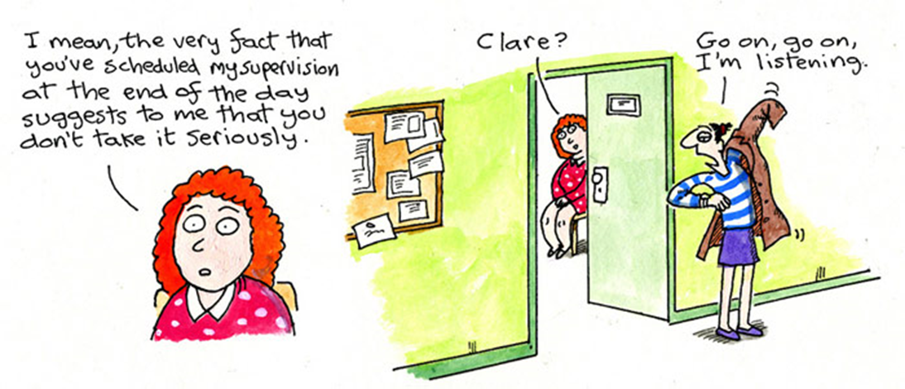
PEPS Stage 2
Assignment: A 3500 word critical reflection of your development as a practice educator (over PEPS). Focus on areas of your choice.
With supporting evidence - 2 direct observations of practice (1 from PEPS1) & 1 witness testimony.

Slide 9
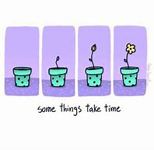
To fast-track or not to fast-track?
Time to learn and practice
Support over longer period
Gain experience & confidence – 2 students or 1 student & 1 NQSW (In line with BASW PEPS guidance)

Slide 10
Practice Educator Programmes
Over to you for questions…..

