Slide 1
ASYE: What is it?
Employer-based programme of support and development for newly qualified social workers (NQSWs) in their first year of employment.
Provides access to regular support to develop NQSWs’ skills, knowledge and capability and strengthen their professional confidence
Smooths transition from qualifying education to the demands of practice
Practice is assessed holistically against the Professional Capability Framework (PCF) and the Knowledge and Skills Statement (Children/Adults)
Every NQSW is allocated an assessor to support and assess their practice.

Slide 2
Accessing the ASYE
Who is eligible?
All NQSWs employed by an organisation based in England are eligible to complete the ASYE programme
How long after finishing university can you start the programme?
You must be registered on the programme within two years of completing a recognised social work degree programme.
Is it compulsory?
Not in England (but it is a requirement of registration in Wales and compulsory in N Ireland)
Are there different programmes depending on where you work?
Single programme irrespective of the setting and service user group

Slide 3
Accessing the ASYE
How long does it take?
There is an expectation that the ASYE will be completed in 12 months (though exceptions are made for part-time workers/sickness etc)
Do you have to be in a social worker position?
You can access the programme in an unqualified role if that role would enable you to undertake sufficient work to meet the expectations (though this may vary in different organisations).
Do employers get anything for taking NQSWs on the ASYE?
For now, they get a grant funding from Skills for Care or DfE.
Our approach in Camden is that all our newly qualified social workers must complete the ASYE programme

Slide 4
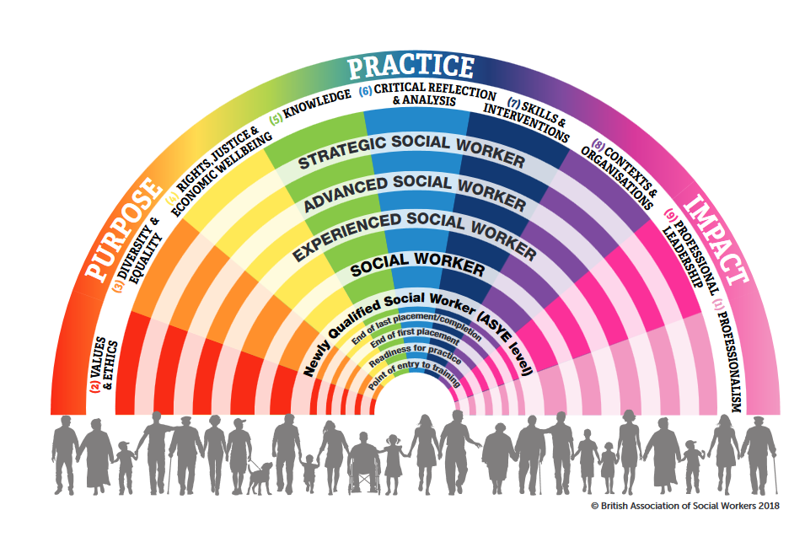
By the end of the ASYE:
social workers should have consistently demonstrated practice in a wider range of tasks and roles, and have become more effective in their interventions, thus building their own confidence, and earning the confidence of others. They will have more experience and skills in relation to a particular setting and user group, and have demonstrated ability to work effectively on more complex situations. They will seek support in supervision appropriately, whilst starting to exercise initiative and evaluate their own practice.

Slide 5
KSS - Adults
The role of social workers working with adults
Person-centred practice
Safeguarding
Mental capacity
Effective assessments and outcome based support planning
Direct work with individuals and families
Supervision, critical reflection and analysis
Organisational context
Professional ethics and leadership

Slide 6
KSS – Children
Relationships and effective direct work
Communication
Child development
Adult mental ill health, substance misuse, domestic abuse, physical ill health and disability
Abuse and neglect of children
Child and family assessment
Analysis, decision-making, planning and review
The law and the family and youth justice systems
The role of supervision
Organisational context

Slide 7
Learning agreement
Workload management and learning opportunities
Supervision
Support for NQSWs: Local partnerships, workshops, training, peer support, ASYE co-ordinator, QA

Slide 8
NQSWs must show evidence of meeting the PCF capability statements at ASYE level and the KSS through a critical reflection log (NQSW) and a record of support and progressive assessment (assessor).
3 month review
6 month review
12 month review
NQSW self- assessment
3 direct observations of practice
Service-user feedback
Professional feedback
Professional documentation
Assessment is progressive and based on the principles of holistic assessment.

Slide 9
Built in reviews and support should enable early identification of concerns
Learn from ‘mistakes’
Linked with probation

