Slide 1
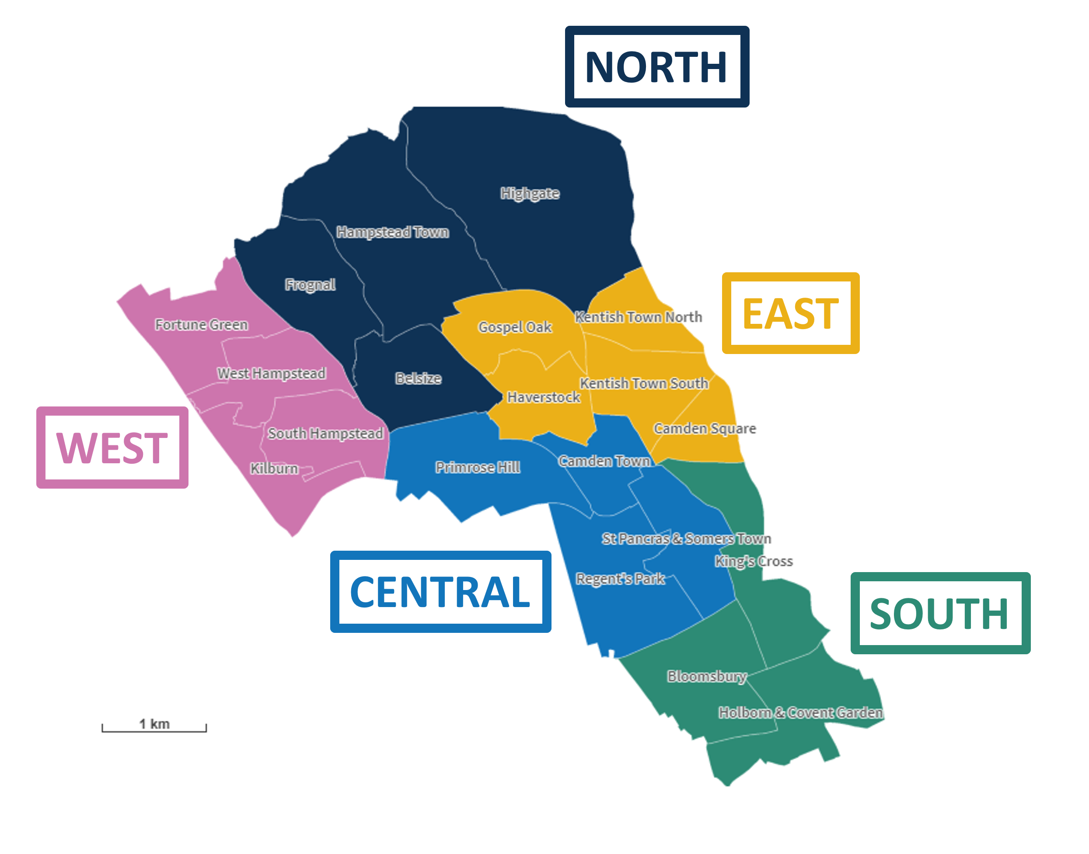
Electoral Ward | Neighbourhood
Highgate | North
Hampstead Town | North
Belsize | North
Frognal | North
Fortune Green | West
West Hampstead | West
Kilburn | West
South Hampstead | West
Gospel Oak | East
Haverstock | East
Kentish Town North | East
Kentish Town South | East
Camden Square | East
Regent’s Park | Central
St Pancras and Somers Town | Central
Camden Town | Central
Primrose Hill | Central
King’s Cross | South
Bloomsbury | South
Holborn and Covent Garden | South

