Slide 1
WELCOME Practice Education Course Briefing
11 June 2024
Jay Fente and Sally Nieman
Notes:
Jay

Slide 2
Introductions
Overview of the role of the practice educator and the requirements
Information from the Universities
Opportunities for questions
Application / placement processes (in separate break out rooms for children’s and adults)
Notes:
Jay

Slide 3
What is the role of the practice educator?
Supporter
Assessor
Teacher
Mediator
Learner
Role model
Coach
Manager
Supervisor
Mentor
Guide
Facilitator
Notes:
Sally

Slide 4
What’s in it for me?
Contributing to the next generation of social workers
Placement most influential part of social worker training
Opportunity to study again: space to learn and reflect
Experience of teaching, assessing and supervising
Contributes to fostering of a learning culture
Money!
Notes:
Sally

Slide 5
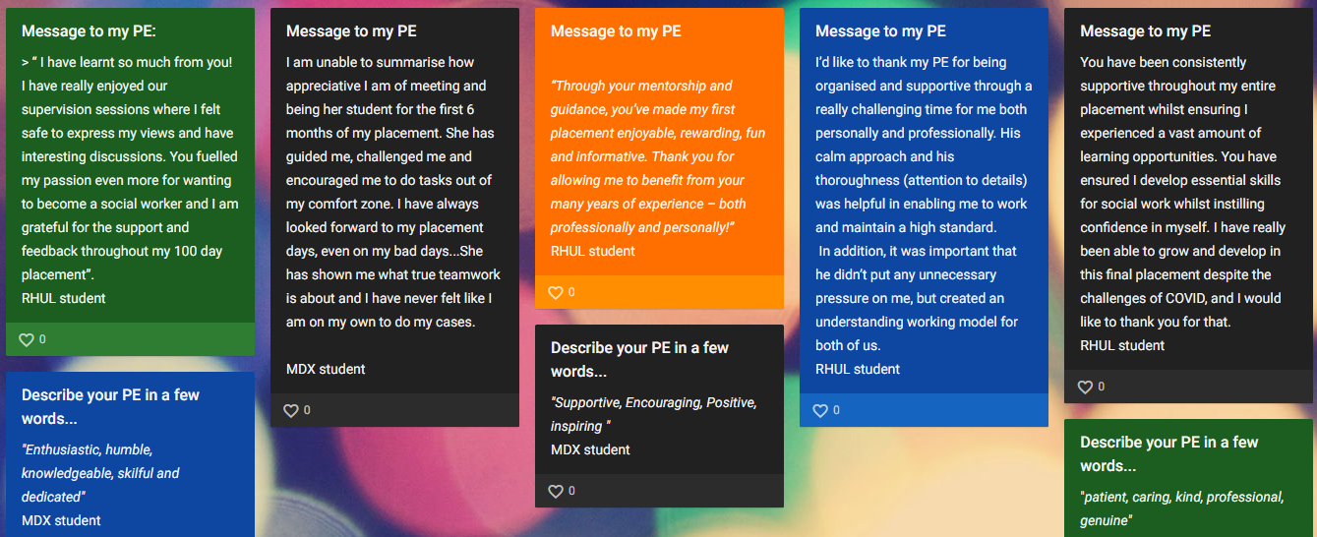
Notes:
Sally

Slide 6
What is expected of me when I have a student?
Induction
Weekly supervision of 1.5 hours
Providing a learning space and reflective environment
Allocate work to the student to support achievement of learning objectives
Provide regular feedback to the student
Completing the Pan London placement documentation using the PCF,
including:
practice learning agreement
midway report
final report
observations of practice
Academic requirements if undertaking PE qualification

Slide 7
Practice Education Professional Standards (PEPS)
Minimum requirements for practice education
Two stages of progression to practice education:
Stage 1 PEs can supervise, teach and assess students on their first placements; they may contribute to the last placement, but they should not take full responsibility for the assessment of a student as fit to practice at the point of qualification.
Stage 2 PEs can supervise, teach and assess students up to and including the last placement and have the authority to recommend that social work students are fit to practice at the point of qualification.
Usually completed over 2 years with 2 learners (but fast-track / combination courses are available)
Notes:
Jay

Slide 8
Universities courses
Royal Holloway
London Met
Middlesex
Other in special circumstances
Notes:
Sally RHUL, Jay other two

Slide 9
What questions do you have?

