Slide 1
Adult Safeguarding:
Self Neglect and Hoarding
Camden SAPB Learning events

Slide 2
AGENDA
What is self neglect and hoarding?
Signs, risks and potential causes
Adult safeguarding and reporting concerns
Safeguarding processes and enquiries
Barriers and enablers
Multi-agency working and risk assessment
Mental Capacity
Tools to support practice

Slide 3
What is Self Neglect
A wide range of behaviours which relate to neglect to care for one’s own personal hygiene, health or surroundings
The person themselves may not recognise the impact of their behaviour
Behaviours with the potential for serious consequences to the health and well-being of the person themselves and those around them.
Notes:
Gibbons (2006) defined it as “the inability (intentionally or non-intentionally) to maintain a socially and culturally acceptable standard of self-care with the potential for serious consequences to the health and well-being of those who self-neglect and perhaps too to their community”.

Slide 4
Signs of self neglect
Poor personal hygiene, unkempt
Poor diet and nutrition, malnourished
Inadequate / inappropriate clothing
Aids and adaptations are being refused or not being used
Non-compliance with medication
Refusal of or failure to seek important medical treatment
Care support is being repeatedly declined
Health is deteriorating, wellbeing is affected
Isolated from family and friends
Not engaging with support offered
Hoarding
Squalor, increasingly unsanitary
Lack of basic amenities
Infestations, vermin
Neglect of household maintenance
Structural deterioration, fire
Fire hazards
Refuses to allow other organisations on their property, eg water, gas and electricity providers
Inability/unwillingness to manage personal affairs, mismanagement of finances

Slide 5
Hoarding
Hoarding is the excessive collection and retention of any material to the point that it impedes day to day functioning.
Compulsive hoarding (inanimate objects, animals, and data)
Having so many things that you cannot manage the clutter where you live, and find it difficult or impossible to throw things away (Mind)
A hoarding disorder is where someone acquires an excessive number of items and stores them in a chaotic manner, usually resulting in unmanageable amounts of clutter. (NHS)
Severe cluttering that makes it difficult to live in their home - it is no longer able to function as a viable living space
A large number of items that would appear to hold little or no value and would be considered rubbish by other people
Persistent difficulty discarding or parting with possessions, regardless of their actual value.
Due to a perceived need to save the items and to distress associated with discarding them
Linked to significant distress or impairment of work or social life
Recognised as a mental health disorder (can also be linked to other) physical and mental health problems)
Notes:
The main difference between collecting and hoarding is:
How you organise the items
How much it affects your life

Slide 6
Signs of hoarding and significant concerns
Limited access to the property due to extreme clutter
Smoke alarms not fitted or not functioning
Evidence of structural damage or outstanding repairs including damp
Interior doors missing or blocked open
Clutter is obstructing the living spaces and is preventing the use of the rooms
Room(s) scores 7 - 9 on the clutter image scale
Beds inaccessible or unusable due to clutter or infestation
Entrances, hallways and stairs blocked or difficult to pass
Toilets, not functioning or not in use. Human urine and or excrement may be present
Household appliances are not functioning or inaccessible and there is no safe cooking environment
Concern with the integrity of the electrics and may also be using candles
Concern for declining mental health
Property is not maintained within terms of lease or tenancy agreement and the adult at risk is at risk of notice being served by Environmental Health
Heavy pest / rodent infestation
Excessive odour in the property and rotting food may be present
Notes:
Other examples: - Evidence may be seen of extreme clutter at windows or outside the property
- Pungent odour can be smelt inside the property and possibly from outside.

Slide 8
Consequences / Risks
Health – deterioration of physical and mental well-being, increased mortality, nutritional risks
Risk of fires, especially related to hoarding, falls and trips, items falling from a height
Residence – threat to their tenancy and risk of homelessness
Environmental – unsanitary conditions, hoards of rubbish, rotten food and faeces – risk of disease, infection and foul smells in the community
Lack of repairs, risks to the structural integrity of the home
Vermin and infestations – pests, rats, mice, bed bugs
Other people – risks to children, family, neighbours, visiting professionals and emergency services
Increased use of health-care services, hospice care, hospitalisation, and emergency department visits
Notes:
Very important in how referrers articulate their concerns to ASC to help us understand level of urgency and prioritise accordingly

Slide 9
True or False?
Self neglect is usually a lifestyle choice.
Self neglect doesn’t always have to be the subject of a safeguarding enquiry.
Notes:
https://www.local.gov.uk/our-support/partners-care-and-health/care-and-health-improvement/safeguarding-resources/self-neglect-worbook#a-short-truefalse-quiz-on-msp-in-self-neglect-work

Slide 10
Potential causes
Social Isolation and poor social support
Physical or mental illness eg brain injury, dementia, obsessive compulsive disorder or hoarding disorder
Age related changes in physical or mental health
Bereavement or traumatic event
Being proud of independence and a fear of losing control
Drug and alcohol dependency
Mental health difficulties
Fear and anxiety, a mistrust of professionals

Slide 11
Factors that lead to self-neglect and hoarding being over looked
The perception that this is a “life-style choice”
Poor multi-agency working/ lack of information sharing
Lack of engagement with the individual or family
Challenges presented by the individual or family
Family carers lead us to assume support is being provided
A desensitisation to/ from well known cases
Individuals have chaotic lifestyles and multiple needs
Inconsistency in thresholds across agencies and teams
Notes:
Given self neglect’s association with Cognitive impairment, loneliness and Mental health, it is an area expected to increase significantly given the rise in the ageing population

Slide 12
Case example – James and Lucy
Multiple transplants and complex co-morbidities
Unable to be discharged home from hospital as his wife reportedly ‘blocking the discharge’
Discovered that his wife Lucy was critically ill with cancer
Living with son, Chris, in a severely hoarded property, along with a number of cats. Chris had mental health issues.
Nobody had been into the property for ten years.
Discovered Lucy had been buying thousands of items online – all still unwrapped, filling the property and the communal stairways.
No water and heat in the property, both the toilet and the kitchen were inaccessible.
A neighbour convinced that a leak in their property was causing damp throughout the adjoining walls.

Slide 13
Adult
The Care Act 2014 includes self-neglect as a category of abuse
It places a duty of co-operation on all agencies to work together to safeguard adults
The Care Act emphasises the importance of early intervention and preventative actions to minimise risk and harm.
Safeguarding
Who does safeguarding apply to? An adult who…
      Appears to have a need for care or support
      Appears to be experiencing or at risk of abuse or neglect
      As a result of those needs, is unable to protect himself or herself from the abuse or neglect, or the risk of it.
Notes:
Care and support needs – whether or not the local authority is meeting them

Slide 14
Raising Safeguarding Concerns
A safeguarding concern needs to be raised where an adult is living in a way that is putting their health/safety or wellbeing at risk of harm.
When self neglect concerns are reported to the LA, a s42.1 (information gathering) is started to establish the person’s safety and decide whether a statutory safeguarding response is needed
If the adult at risk has declined support services and the are high risk of serious harm, a s42.2 Enquiry is undertaken to decide what action should be taken
When considering whether to progress to s42.2 Enquiry; the LA explores the adult at risk’s mental state, cognition, ability to respond to an emergency, medical needs, condition of the home, how long the issue has been going on and whether there have been previous concerns raised with Adult Social Care.
Timely information sharing leads to more effective risk management and allows management plans to be developed.

Slide 15
Making a referral
Safeguarding concerns
Email MASH – asc.mash.safeguarding@camden.gov.uk
MASH requires professionals to complete the SAPB Safeguarding Referral Form, found here: https://www.camden.gov.uk/safeguarding-adults#qubd
Telephone 0207 974 4000, option 1 (also covers out of hours Emergency Duty Team)
Remember, if you think an adult is in immediate danger you should call the police on 999 (urgent) or dial 101 (non-urgent).
Care Act Assessment
Email adultsocialcare@camden.gov.uk
Telephone 0207 974 4000, option 1 (also covers out of hours Emergency Duty Team)
If an adult at risk is already known to a specific team or allocated worker in Adult Social Care or Mental Health, you can contact them directly with concerns.
You should receive feedback on your referral.

Slide 16
What type of referral
Care Needs Assessment
The adult may be struggling to look after themselves or their environment due disability, mental health issues, substance abuse, or due to advancing age or changes in their adult
They have not been assessed or offered support, or not for a long time
An assessment of their care and support needs and the right support might address the issue
S42 Enquiry
Self neglect may not prompt a section 42 enquiry. This will depend on the person’s ability to protect themselves by controlling their own behaviour.
There may come a point when they are unable to do this without external support, for example if:
The adult is not accepting support or plans that would improve the situation
The adult does not have insight into the situation
The situation is high risk, critical or urgent

Slide 17
What information to include
What you know of the person’s care and support needs
Details of the suspected abuse or neglect – what you saw, key risks
Any immediate actions taken or required, also any other options you have explored already
Whether the adult is aware of the concern being raised, and what outcomes they want
Any information on mental capacity, communication needs
Information on how best to make contact or how this can be facilitated
Is there anyone else at risk

Slide 18
For self neglect and hoarding
Risks to other people, physical health, fire safety, threat to their tenancy, environmental (description), structural integrity, vermin
Consider using the Clutter Image Rating (see the multi-agency self-neglect tool-kit)
Describe what kinds of items are being hoarded

Slide 19
Consent and information sharing
You should seek consent to make a referral where possible, or let the adult know you are making one
If you answer yes to any of these questions, then consent is not required. Please share information with relevant people.
They lack capacity to decide
It’s in their vital interests (high risk)
Is there a risk to others?
Is it in the public interest to share information?
Is there reasonable suspicion of a crime?
Could the adult have been coerced or controlled?
Could the adult have Mental Health Problems needing a MHA assessment?
If the adult does not consent, that means we do not have their co-operation but that does not prevent us taking any steps we can.
Notes:
The LA would considers if there is an overriding public interest that would justify information sharing e.g. risks to others, fire risks, vermin, infestations etc
Defensible decision making:
I did this because……..
I ruled this out because…….
I chose this course of action because………
Any observations or factors that lead to this decision, any guidance or advice from other professionals

Slide 20
Myth:
Once a concern has been raised with the Local Authority, it is their responsibility to resolve the situation
Reality:
Safeguarding is a collective responsibility working across multiple partners who can help address safeguarding concerns
Notes:
This information is from the Department of Health and Social Care - In January 2022 it published the briefing for social workers and other safeguarding practitioners working in adult social care who are involved in safeguarding. It sets out the roles and responsibilities in relation to adult safeguarding in local authorities, including the statutory duties social workers and others with delegated responsibilities are expected to fulfil.

Slide 21
Examples of action
Visits or checks of physical health concerns by GPs, District nurses, other primary care staff
Referrals to mental health services or substance misuse services
Visits and assessments by Environmental Health and London Fire Brigade
Input and involvement from Housing Providers
Input from Housing Repairs to restore essential safety and hygiene to unsafe or unhygienic properties
Assessment of care and support needs and establishing the person’s views and wishes
Undertaking mental capacity assessments if needed – who depends on what
Speaking to anyone providing care and support, speaking to the adult’s family and informal network e.g. friends
Gathering information from anyone providing care and support, the adult’s family and social networks, the person's professional support network e.g. GP, District Nurse etc
Decide if a multi-agency planning meeting is required to share information and formulating a plan
Identify, evaluate and formulate a risk management plan
Support from Environmental Health around enforcement options (as a last resort)

Slide 22
Partnership working
Self-neglect and hoarding - requires effective multi agency working
An individual’s self-neglect may present differently to different agencies. By working together and sharing their experience of working with individuals, agencies can together better safeguard an adult at risk.
Multi-agency meetings are needed to:
  Share information
  Agree an approach to minimise the impact of specific risks
  Improve joint working between agencies and professionals that have different roles and expertise
Most Safeguarding Adult Reviews highlight a breakdown in partnership working as a key factor in failing to keep people safe.
Also helps identify who knows the person best, and who may be able to support another agency when they are introduced to the person for the first time.

Slide 23
Effective Risk Assessments
Should consider:
Presentations of self-neglect and the home situation
The individual’s perception of their situation
Engagement in activities of daily living
Functional and cognitive abilities of the person
Family and social support networks, and the lack of these
Underlying medical conditions
Underlying mental health conditions
Substance or alcohol misuse issues
Should include:
Clear analysis of risks to the adult and others.
Clear monitoring arrangements
Clear reviewing arrangements
Clear timescales for actions and reviews.
Agencies need to be clear of their roles and responsibilities.
Management oversight, support and supervision.
Timely information sharing
Should be shared

Slide 24
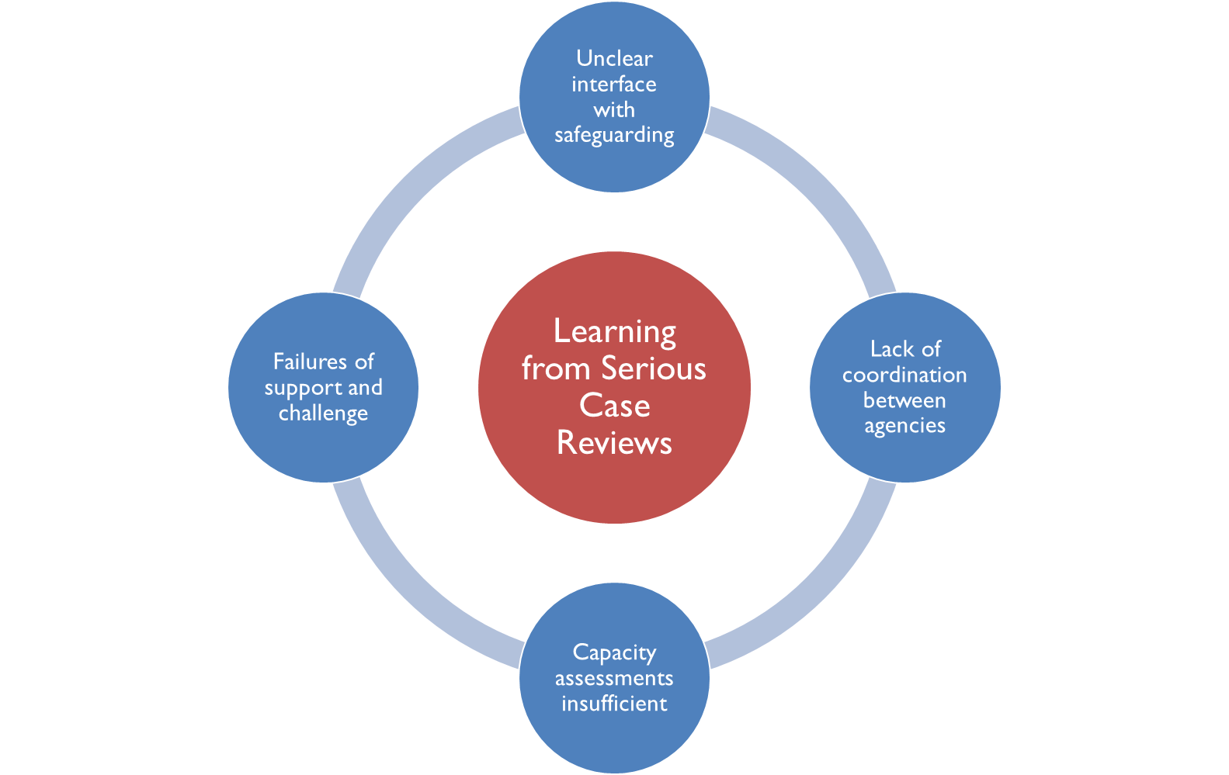
Learning from SARS – Prof Michael Preston-Shoot
Too accepting of “lifestyle "choice & insufficient professional curiosity
Failure to escalate concerns to senior managers
Delays in raising safeguarding concerns or commencing Section 42 enquiries
No agreed strategies to continue to engage
Poor record keeping of decision-making
Not involving family / network
Mental capacity and risk assessments insufficiently robust
Not sufficient account of person’s feelings and wishes

Slide 25
Mental Capacity
Challenges:
Impairment? Fluctuating? Unwillingness to engage at all?
What about people who have capacity and continue to put themselves at high risk of harm?
But:
The person’s behaviour or circumstances may cause doubt as to whether they have capacity to make a decision. Eg making repeated unwise and potentially harmful decisions.
Need not only the ability to understand the consequences of a decision (decisional capacity), but also the ability to execute, or carry out the decision(executive capacity).
Consider the adult’s understanding of the risks and safety implications of their decision, and ability to act on this.
Needs real world observations and information from others, not just what the person says
The importance of advocacy - individuals should be able to express their wishes regarding their care and support needs.
The role of the courts - if you are concerned about mental capacity but cannot get one done, then you can apply to the Court of Protection, or if the person is deemed to have capacity but is at risk of serious harm or death and refusing all services, or unduly influenced – Inherent Jurisdiction to the high court
We should assume a person has capacity unless proved otherwise. And a person is not treated as unable to make a decision merely because their decision is unwise.
Notes:
Advocacy - This could be a formal advocate where, for example, mental capacity is lacking, or it could be a family/friend who the individual appoints to support them. Where an agency has the individual’s wishes clearly recorded, they must ensure these are shared when relevant decisions are being made.

Slide 26
Working with adults who self neglect and hoard
Barriers
Mental Capacity
Refusal of help
Work patterns and resources don’t support long-term, relationship-based work.
Ethical dilemmas between respecting the adult's autonomy and us fulfilling our duty of care
Risks can be high and the options for intervention are limited.
There can be pressure on professionals to take action, but often very little they can do.
Often a lack of clarity about who should take responsibility for supporting people who self-neglect.
Service-related factors eg eligibility, time, multi agency working etc

Slide 27
Working with adults who are difficult to engage or adults with capacity who refuse support
What steps have been taken to involve the adult? What are the adult’s views and wishes? Advocacy?
Consideration of how the adult communicates and engages with other agencies and professionals e.g., GP. Involve others. Multi-agency approaches.
Consideration of vital and public interests
Consideration of what actions can and should be taken, and consider possible legal interventions
Thorough, ideally multi-agency, risk assessment, risk management, monitoring, review
Professionals meetings, information-sharing, joint working
Risk management forums eg MARAC, community MARAC, High Risk Advisory Group
Family Group Conference

Slide 28
Working with adults who are difficult to engage or adults with capacity who refuse support
Professional curiosity. Why are they not engaging ( diagnosis, history, trauma )
Continuous resistance can lead to a lack of professional curiosity - stop trying to engage with someone and instead make assumptions about how the person is likely to respond.
Professionals may accept what an individual tells them despite evidence (or lack of) to the contrary.
A lack of engagement or refusal of services should not mean safeguarding work is not attempted or recorded
Section 11 Care Act (2014) sets out circumstances where, even in the face of a refusal of assessment by the adult, there is a continuing duty under S9 Care Act (2014). Eg if the adult is experiencing, or is at risk of, abuse or neglect
If a person declines safeguarding support and/or a S42 enquiry that is not necessarily the end of the matter - consideration to ways in which the risk to the adult could be managed or mitigated, impact, public/vital interests.

Slide 29
Tools to support practice -
What else helps
Things to think about:
Professionals meetings – anyone can arrange one, share information
Joint risk assessment and risk management – share the responsibility. Good information sharing alongside robust and co-ordinated multi agency working
Risk assessment – be clear about different roles, responsibilities, timescales, monitoring, review, record decisions and limitations
Mental capacity – what areas need to be assessed, who is best to do this, consider executive capacity
Advocacy – refer to ReThink
Consider risk management High Risk Advisory Group
Family Group Conference
Referrals (including safeguarding, housing, environmental health, Police, Fire Service, Health, Mental Health)
Flexible care management arrangements
Recruitment and training for staff
The opportunity to build relationships over time to understand the whole person, create flexible interventions using multi-agency resources to assess risk and capacity

Slide 30
Working with adults who self neglect and hoard - Enablers
The enablers identified by people who draw on services are:
Respectful, timely engagement
Spotting motivation and being there at the right time
Encouraging, person-centred approach, not intrusive, directive, pushy
Someone who goes the extra mile, is reliable, compassionate and understanding
Intervention delivered through relationship: connection, emotional literacy, trust
‘Being with’ the person when clearing/cleaning is taking place, promoting choice where possible
Support that is relevant to the service user’s own perception of needs
Practical input, household equipment, benefits, advocacy, re-housing
Access to mental health services to tackle deep-rooted issues
(Braye, Orr and Preston Shoot 2014)

Slide 31
Developing a shared understanding of where the person wants to be, based on their own lived experience and strengths in overcoming adversity
Focusing on their strengths, ‘what works’, protective factors that might offset risks
identifying what a good outcome might look like from the person’s point of view (how they define wellbeing and what would promote this)
Ensuring people have as much control and choice as possible, accessible information, know their options
Ensuring the pace, meetings and protection plans are guided by their needs and circumstances.
Appropriate advocacy to ensure this and that their rights are protected, and they are supported to participate in the safeguarding process
Person-centred approached to working with risk and positive risk enablement
Making Safeguarding Personal
Making Safeguarding
Personal

Slide 32
Hoarding and identity
Rethinking our approach – putting people’s identity at the heart of practice
Camden’s What Matters Approach – strengths based, person centred
The concept of Hoardiculture / the hoardicultural approach
Research in Practice Article – ‘Let me get this straight: Hoardiculture’ by Martin Hampton (Published 14/06/2023) and Poem
https://www.researchinpractice.org.uk/adults/news-views/2023/june/let-me-get-this-straight-hoardiculture/
Thinking about the meaning of these collections, of the hoard, the identity of the person, how we work in co-production with them
Camden’s Artist in Residence – Trevor Appleson - reflection into the nature of hoarding, recognition of the importance of those belongings, the link to memories and identity, ‘never just trash to be cleared away’
To provoke conversations around practice, reflect on the identity of social work and the visibility of service users, the communication between the social worker and individual

Slide 33
Case example - Peter
Peter lived with his wife in a two bedroomed Camden Council flat.
Peter has multiple sclerosis, diabetes, oedema of legs and ankles.
The District nurses tried to visit him weekly to dress his venous leg ulcers but couldn’t get into the room.
Peter hadn’t had a shower for years.
His wife was distraught saying that she would leave him. She was the main carer and Peter made it very clear that he didn’t want any care.
His room was stacked high with piles of books, his bed was covered. He was also a chain smoker.
The social worker’s approach involved talking to Peter about his books
The social worker found a copy of a book with a great scene about hoarding
Suggested to help him to make a library.
Obtained grants to redecorate and buy shelves, to organise the hoard
Peter now lives in an immaculately clean library which he is very proud of. He has a two-hour care package to assist him with a shower once a week. Peter has stopped smoking.
Notes:
Appendix 1 – case studies. Also see the case study on page 32 of the Camden SAPB Multi-agency self-neglect tool-kit

Slide 34
Practice tools
Quizzes – how overwhelmed by clutter are you?
Talking points – books, films, art that open up the discussion
Photographs – which can chart progression
Clutterer’s Anonymous quiz

Slide 35
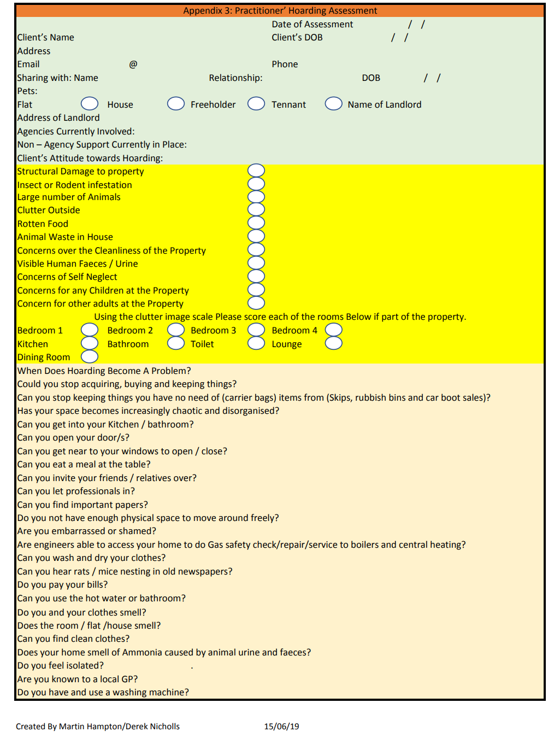

Slide 36
In summary - best practice approaches to self neglect
Multi-agency - work with partners to ensure the right approach for each individual
Person centred - respect the views and the perspective of the individual, listen to them and work towards the outcomes they want
Acceptance - good risk management may be the best achievable outcome, it may not be possible to change the person’s lifestyle or behaviour
Analytical - it may be possible to identify underlying causes that help to address the issue
Non-judgemental - it isn’t helpful for practitioners to make judgements about cleanliness or lifestyle; everyone is different
Empathy - it is difficult to empathise with behaviours we cannot understand, but it is helpful to try
Patience and time - short interventions are unlikely to be successful, practitioners should be enabled to take a long-term approach
Trust - try to build trust and agree small steps
Reassurance - the person may fear losing control, it is important to allay such fears
Bargaining - making agreements to achieve progress can be helpful but it is important that this approach remains respectful
Exploring alternatives - fear of change may be an issue so explaining that there are alternative ways forward may encourage the person to engage
Always go back - regular, encouraging engagement and gentle persistence may help with progress and risk management
Notes:
SCIE - Self-neglect: At a glance | SCIE
https://www.scie.org.uk/self-neglect/at-a-glance

Slide 37
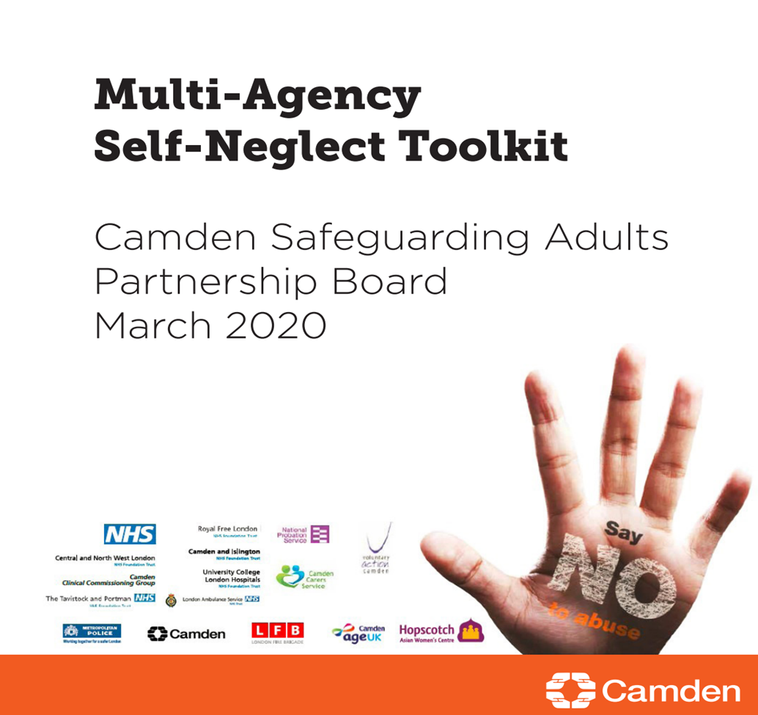
Resources
Camden SAPB Multi-Agency Self-Neglect Toolkit
https://www.scie.org.uk/self-neglect/at-a-glance
https://www.scie.org.uk/self-neglect/policy-practice/evidence-base
https://www.researchinpractice.org.uk/media/4833/working_with_people_who_self-neglect_pt_web.pdf
https://www.researchinpractice.org.uk/adults/news-views/2023/june/let-me-get-this-straight-hoardiculture/
https://www.local.gov.uk/our-support/partners-care-and-health/care-and-health-improvement/safeguarding-resources/self-neglect-worbook#a-short-truefalse-quiz-on-msp-in-self-neglect-work

Slide 38
Relevant
The Care Act (2014) statutory guidance – self-neglect is included as a category under adult safeguarding.
Article 8 of the Human Rights Act 1998 gives us a right to respect for private and family life. However, this is not an absolute right and there may be justification to override it, for example, protection of health, prevention of crime, protection of the rights and freedoms of others.
Mental Health Act (2007) s.135 – if a person is believed to have a mental disorder and they are living alone and unable to care for themselves, a magistrate’s court can authorise entry to remove them to a place of safety.
Mental Capacity Act (2005) s.16(2)(a) – the Court of Protection has the power to make an order regarding a decision on behalf of an individual. The court’s decision about the welfare of an individual who is self-neglecting may include allowing access to assess capacity.
Public Health Act (1984) s.31-32 – local authority environmental health could use powers to clean and disinfect premises but only for the prevention of infectious diseases.
The Housing Act 1988 – a landlord may have grounds to evict a tenant due to breaches of the tenancy agreement.
Legislation

