Slide 1
Camden & Islington NHS Foundation Trust Structure: Council Staff Structures
PLEASE NOTE: The focus of the structure charts is to reflect the number and distribution of Camden employed Social Workers within Camden & Islington NHS Foundation Trust as part of the Section 75 agreement. Most Trust staff are not reflected on these charts unless there is a link with a Camden staff member. Separate charts exists for Trust structures.
Structure charts for the following Teams / Services are compiled into this document:
Summary of distribution of Section 75 Social Workers / Lead Practitioners / Team Managers / Service Managers across Mental Health
Intensive Teams: North and South Camden Crisis Teams
Approved Mental Health Professional (AMHP) Service
Core Teams
Discharge Facilitation Team (DFT)
Complex Anxiety and Depression Team (CDAT)
Personality Disorder Service (PD)
Core & Community Services - North Camden Recovery and Rehabilitation Service
Intensive Teams: Camden Assertive Outreach Team (CAOT)
Core & Community Services - South Camden Recovery and Rehabilitation Service
Camden Early Intervention Service (EIS)
Intensive Teams: FOCUS Community Mental Health Team and Camden Community Rehabilitation Team (CCRT)
Services for Ageing and Mental Health (SAMH) CMHT
Mental Health Review Team

Slide 2
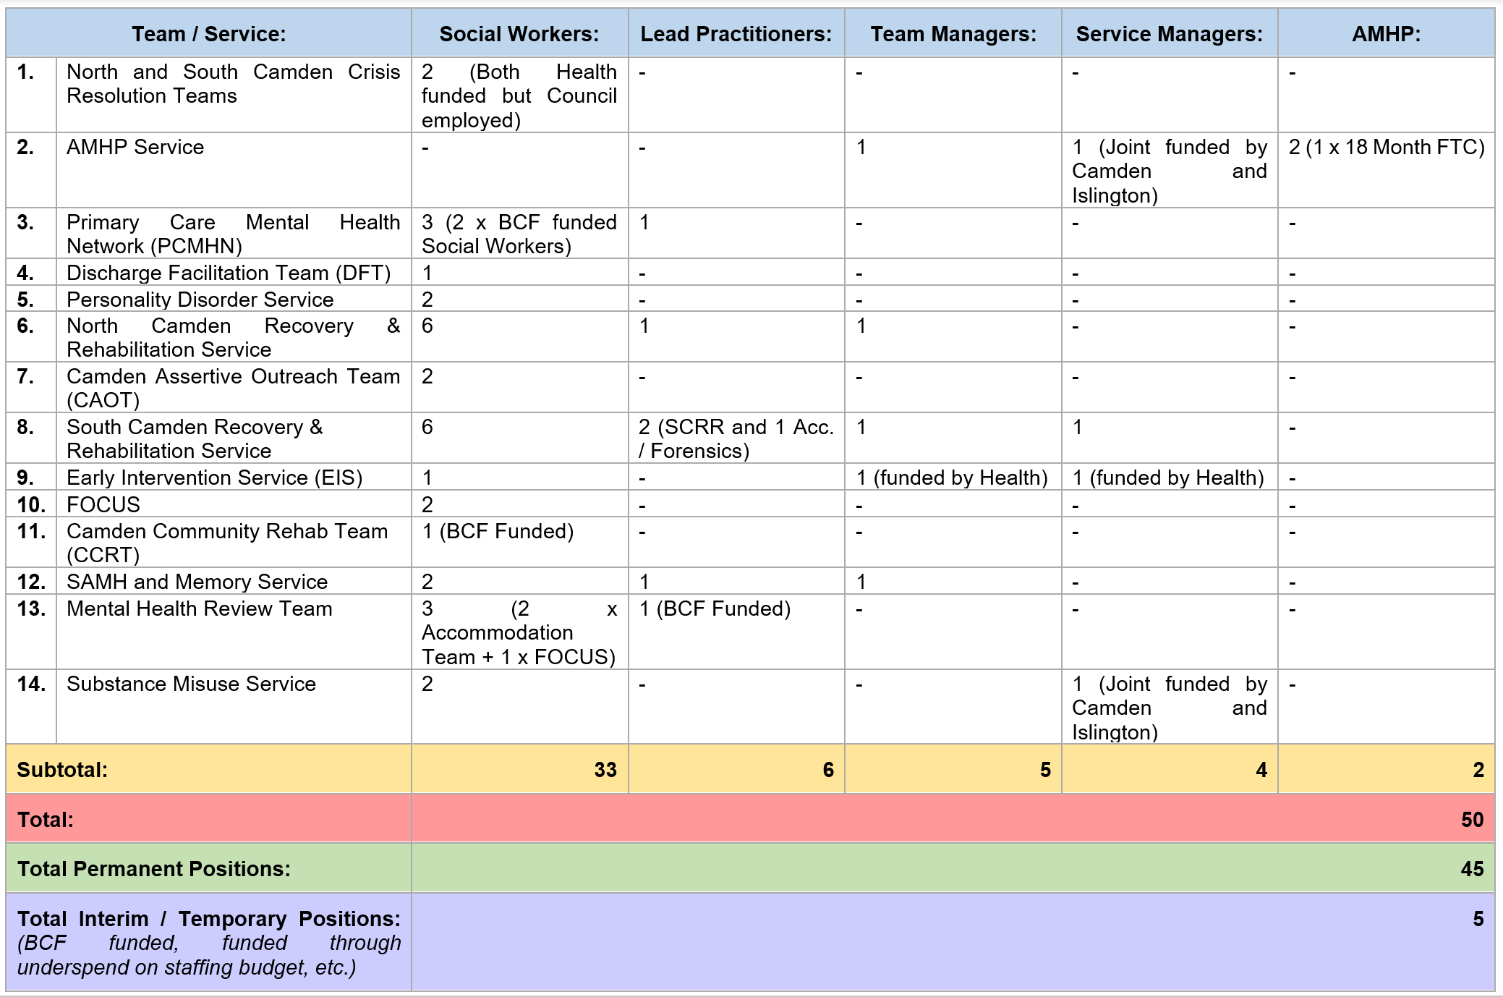
Summary of distribution of Section 75 Social Workers / Lead Practitioners / Team Managers / Service Managers across Mental Health

Slide 3
Camden & Islington NHS Foundation Trust Structure: Intensive Teams – North and South Camden Crisis Resolution Teams
Camden & Islington NHS Foundation Trust Structure: Approved Mental Health Professional (AMHP) Service
Camden Operational Director:
Peter Cartlidge Peter.Cartlidge@candi.nhs.uk
Tel: 0203 317 6541
MH Established Positions: 2
Head of ASC Operations:
Avril Mayhew
Avril. Mayhew@camden.gov.uk
Tel: 0207 974 1444
MH Established Positions: 3
2 x Social Workers Health Funded
Temporary Positions: 6 month AMHP cover only – May 2023
Location:
North - 3 Daleham Gardens, London, NW3 5BY
South - St Pancras Hospital, 4 St Pancras Way, London, NW1 0PE
AMHP Service Manager - 729233:
David Hamilton
David.Hamilton@candi.nhs.uk
Tel: 0207 317 7386
Location:
St Pancras Hospital, 4 St Pancras Way, London, NW1 0PE
Intensive Teams Head of Service:
Roger Evans
RogerJohn.Evans@candi.nhs.uk
Tel: 0207 561 4183 / 077 8633 4474
Service Manager:
Alice Murphy
Alice.Murphy@candi.nhs.uk
Tel: 079 7371 3946
AMHP Team Manager - 729235:
Nigel Yard
Nigel.Yard@candi.nhs.uk
Tel: 0203 317 6845
AMHP / Social Worker - 729239:
Gary Dixon
Gary.Dixon@candi.nhs.uk
Tel: 0203 3176 845 / 073 0550 7465
Temporary AMHP - 733333
Helen Olukoya-Busari
Helen.Olukoya-Busari@candi.nhs.uk
Tel: 07811 594 271
North Team Manager: Heenal Patel
Heenal.Patel@candi.nhs.uk
Tel: 0203 317 6323 / 075 3818 0696
South Team Manager:
Molly Pritchard - Smith
Molly.Pritchard-Smith@candi.nhs.uk
Tel: 0203 317 6851 / 074 4682 7008
Chart Key:
Trust Staff
Council – Head of Service
Council – Service Manager
Council – Team Manager
Council – Lead Practitioner
Council – Social Worker / AMHP
North Social Worker - 733106:
Mary Clark
Mary.Clark@candi.nhs.uk
Tel: TBC
South Social Worker - 710989:
Gloria Levy
Gloria.Levy@candi.nhs.uk
Tel: 0203 317 6333 / 6857

Slide 4
Camden & Islington NHS Foundation Trust Structure: Core Teams
MH Established Positions: 4 (2 x BCF Funded
Head of Core and Community Services:
Tom Costley
Thomas.Costley@candi.nhs.uk
Tel: 079 7198 8110
Location:
Core Team – Regis Road, London, NW5 3EG
Service Manager:
Clare Church
Clare.Church@candi.nhs.uk
Tel: 07766 115 350
North West Core Team
Team Manager:
Claire Beaman
Claire.Beaman@candi.nhs.uk
Tel: 0203 317 6816 / 078 1249 4876
Kentish Town Core Team
Team Manager:
Stephen Bradley
Stephen.Bradley@candi.nhs.uk
Tel: 07879 111270 / 020 3317 6816
South Core Team
Team Manager:
Lorraine Lloyd
Lorraine.Lloyd@candi.nhs.uk
Tel: 0203 317 6810
Chart Key:
Trust Staff
Council – Head of Service
Council – Service Manager
Council – Team Manager
Council – Lead Practitioner
Council – Social Worker
Lead Practitioner – 729236:
Sarah Green
Sarah4.Green@candi.nhs.uk
Tel: 0203 317 6607
Social Worker - 730892:
Salih Mehmet
Salih.Mehmet@candi.nhs.uk
Tel: 078 704 80277
Social Worker –
Vacant
Social Worker - 730893:
Joycelyn Oti Akenteng
Joycelyn.OtiAkenteng@candi.nhs.uk
Tel: 0203 317 6806
Social Worker –
Vacant
Social Worker - 730894:
Mavis Sarfo-Adu
Mavis.Gyabaah@candi.nhs.uk
Tel: 07411 254 011
Social Worker - Vacant

Slide 5
Camden and Islington NHS Foundation Trust Structure: Discharge Facilitation Team (DFT)
MH Established Positions: 1
Location:
Highgate Mental Health Centre, Level 2, Highgate, London, N19 5 NX
Director of Delivery Improvement:
Angus Gartshore
Angus.Gartshore@candi.nhs.uk
Tel: 0207 561 4144 / 4181
Service Manager:
Vacant
Senior Social Worker:
Mandy Woods
Mandy.Woods@candi.nhs.uk
Tel: 078 7656 5597
Lead Practitioner (0.6FTE)- 736288:
Vacant
Chart Key:
Trust Staff
Council – Head of Service
Council – Service Manager
Council – Team Manager
Council – Lead Practitioner
Council – Social Worker

Slide 6
Camden and Islington NHS Foundation Trust Structure: Complex Depression and Anxiety Team (CDAT)
Camden and Islington NHS Foundation Trust Structure: Personality Disorder Service
MH Established Positions: 0
MH Established Positions: 2
Sabbatical: BF substantive post – Back on 16 May - 729880
Location:
St Pancras Hospital, 4 St Pancras Way, London, NW1 0PE
Location:
St Pancras Hospital, 4 St Pancras Way, London, NW1 0PE
CDAT Operational Service Manager:
Helen Middup
Helen.Middup@candi.nhs.uk
Tel: 02033177661 / 0781029 1417
Service Lead:
Vacant
CDAT Team Manager:
Yussef Ferguson
Yussef.Ferguson@candi.nhs.uk
Tel: 020 3317 6748
Team Manager:
Cassie Painter-Tickell
Cassie.TickellPainter@Candi.nhs.uk
Tel: 0203 317 6998 / 07929 752 142
CDAT Social Worker:
MarieLouise Moore
Marielouise.Moore@candi.nhs.uk
Tel: 07811 944 765
Chart Key:
Trust Staff
Council – Head of Service
Council – Service Manager
Council – Team Manager
Council – Lead Practitioner
Council – Social Worker
Social Worker - 733009:
Michaela McGuigan
Michaela.Mcguigan@candi.nhs.uk
Tel: 0203 317 6994
Social Worker – 729880:
Adaku Onyema
Adaku.Onyema@candi.nhs.uk
Tel: 07971 989725/07949 199614

Slide 7
Camden & Islington NHS Foundation Trust Structure: North Camden Recovery & Rehabilitation Service
Chart Key:
Trust Staff
Council – Head of Service
Council – Service Manager
Council – Team Manager
Council – Lead Practitioner
Council – Social Worker
Head of Core and Community Service
Tom Costley
Thomas.Costley@candi.nhs.uk
Tel: 079 7198 8110
MH Established Positions: 8
Secondment:
SP substantive post – 720425 -
7 August 2023
Service Manager:
Sue Dinham
Sue.Dinham@candi.nhs.uk
Tel: 0203 317 6844
Secondment:
729242: DB – Covering RD Maternity Leave
Diana.Brown@candi.nhs.uk
Tel: 07929 836 692
Location:
3 Daleham Gardens, London, NW3 5BY
Team Manager - 729237:
Kathryn Maguire
Kathryn.Maguire@candi.nhs.uk
Tel: 020 3317 4656
Team Manager:
Cheryl Ward
Cheryl.Ward@candi.nhs.uk
Tel: 0207 685 4640
Lead Practitioner - 729242:
Vacant
Social Worker - 729928 :
Jennifer Brown (0.4 FTE)
Jennifer.Brown@candi.nhs.uk
Tel: 020 7685 4600
Social Worker - 720425:
Sarah Schofield
Sarah.Schofield@candi.nhs.uk
Tel: 020 3317 7661
Social Worker - 729765:
Husai Papenthein
Husai.Papenthein@candi.nhs.uk
Tel: 020 7685 4661
Social Worker - 733108:
Nicola Lancaster
Nicola.Lancaster@candi.nhs.uk
Tel: 079 2975 2166
Social Worker - 729881:
Dione Gallimore
Dione.Gallimore@candi.nhs.uk
Tel: 020 7685 4657
Social Worker - 733069:
John Barrett
John.Barrett@candi.nhs.uk
Tel: 02076854633 / 07909524307

Slide 8
Camden & Islington NHS Foundation Trust Structure: Camden Assertive Outreach Team (AOT)
MH Established Positions: 2
Chart Key:
Trust Staff
Council – Head of Service
Council – Service Manager
Council – Team Manager
Council – Lead Practitioner
Council – Social Worker
Location:
4 Greenland Road, Camden Town, London, NW1 0AS
Intensive Teams Head of Service:
Roger Evans
RogerJohn.Evans@candi.nhs.uk
Tel: 0207 561 4183 / 077 8633 4474
Service Manager:
Sara Tiplady
Sara.Tiplady@candi.nhs.uk
Tel: 078 0242 0350
Service Manager:
Sue Dinham
Sue.Dinham@candi.nhs.uk
Tel: 0203 317 6844
Team Manager:
Sophie Sturrock
Sophie.Sturrock@candi.nhs.uk
Tel: 0203 317 6924
Social Worker - 710982:
Cecilia Hennes
Cecilia.Hennes@candi.nhs.uk
Tel: 0203 317 6590 / 077 6805 7163
Social Worker - 733283:
Lucy Rogers
Lucy.Rogers@candi.nhs.uk
Tel: 079 2966 8683

Slide 9
Camden & Islington NHS Foundation Trust Structure: South Camden Recovery & Rehabilitation Service
MH Established Positions: 10 + 1 AA (Forensics)
Head of Core and Community Service
Tom Costley
Thomas.Costley@candi.nhs.uk
Tel: 079 7198 8110
Chart Key:
Trust Staff
Council – Head of Service
Council – Service Manager
Council – Team Manager
Council – Lead Practitioner
Council – Social Worker
Secondment:
MBH substantive post- 729238:
Bablur.Hossain@candi.nhs.uk
Tel: 0203 317 6440
Service Manager - 711002: Louise Cantrell
Louise.Cantrell@candi.nhs.uk
Tel: 0203 317 6431
Secondment:
LSF substantive post – 730457:
Lorna.Stewart-fraser@candi.nhs.uk
Tel: 077 4775 8862
Location:
Peckwater Centre, 6 Peckwater Street, London, NW5 2TX
Team Manager - 729238:
Michael Fahey
Michael.Fahey@candi.nhs.uk
Tel: 0203 317 6439
Team Manager:
Arinola Adelekan
Arinola.Adelekan@candi.nhs.uk
Tel: 0203 317 6434
Lead Practitioner - 730457:
Rebecca Neal
Rebecca.Neal@candi.nhs.uk
Tel: 020 3317 6442/ 07812 494 874
Forensic Lead Practitioner - 720273:
Ayodeji Afuwape
Ayodeji.Afuwape@candi.nhs.uk
Tel: 020 3317 6700
Social Worker - 720431:
Vacant
Social Worker - 711007:
Samsodeen Lawal
Email: TBC
Tel: TBC
Social Worker - 730661:
Tiziana Ragno
Tiziana.Ragno@candi.nhs.uk
Tel: 0203 317 6421
Social Worker – 720430:
Vacant
Social Worker - 717495:
Olalekan Babatunde
Olalekan.Babatunde@candi.nhs.uk
Tel: 07973774220
Social Worker - 729929:
Busola Thompson
Email:TBC
Tel: TBC

Slide 10
Camden & Islington NHS Foundation Trust Structure: Early Intervention Service (EIS)
MH Established Positions: 2
SM is Health Funded
Camden Operational Director:
Peter Cartlidge Peter.Cartlidge@candi.nhs.uk
Tel: 0203 317 6541
Maternity Leave:
KM – 729234
Kelsey.Mandle@candi.nhs.uk
Tel: 078 2572 6326
Location:
4 Greenland Road, London, NW1 0AS
Service Manager - 729240:
Rachel Busby
Rachel.Busby@candi.nhs.uk
Tel: 0203 317 6604 / 077 6860 7601
Team Manager - 729234:
Thomas Murphy
Thomas.Murphy@candi.nhs.uk
Tel: 07824838124
Social Worker - 732150:
Nikki Mathews
Nikki.Matthews@candi.gov.uk
Tel: 07970404668
Chart Key:
Trust Staff
Council – Head of Service
Council – Service Manager
Council – Team Manager
Council – Lead Practitioner
Council – Social Worker

Slide 11
Camden & Islington NHS Foundation Trust Structure: FOCUS Community Mental Health Team and Camden Community Rehabilitation Team (CCRT)
MH Established Positions: 3
Chart Key:
Trust Staff
Council – Head of Service
Council – Service Manager
Council – Team Manager
Council – Lead Practitioner
Council – Social Worker
Intensive Teams Head of Service:
Roger Evans
RogerJohn.Evans@candi.nhs.uk
Tel: 0207 561 4183 / 077 8633 4474
Maternity Leave:
KF -
Focus TM – Due back Oct 2023
katie.fathi@candi.nhs.uk
Tel: 07971988105/020 3317 6609
Service Manager:
Sara Tiplady
Sara.Tiplady@candi.nhs.uk
Tel: 0203 317 6469 / 078 0242 0350
Location:
CCRT: 154 Camden Road, London, NW1 9HU
FOCUS:4 Greenland Road, London, NW1 0AS
CCRT Team Manager:
Joanne Ajiboye
Joanne.Ajiboye@candi.nhs.uk Tel: 0203 3174 770/07816115117
FOCUS & Reablement Team Manager:
Mark Worsley
Mark.Worsley@candi.nhs.uk
Tel: 07870384980/02033176601
CCRT
FOCUS
Social Worker - 729914:
Adeola Douggan
Email: TBC
Tel: TBC
Social Worker - 733237:
Martha O’Sullivan
Martha.O'Sullivan@candi.nhs.uk
Tel: 020 3317 6608
Social Worker - 720414:
Jade Alisha Sayers
Email: TBC
Tel: TBC

Slide 12
Camden & Islington NHS Foundation Trust Structure: Services for Ageing and Mental Health (SAMH)
MH Established Positions: 4
Chart Key:
Trust Staff
Council – Head of Service
Council – Service Manager
Council – Team Manager
Council – Lead Practitioner
Council – Social Worker
Head of Service:
Ian Sherriffs
Ian.Sherriffs@candi.nhs.uk
Tel: 0203 317 6584
Maternity Leave:
JD due back Oct 2023 -
Service Manager -
jessica.danson@candi.nhs.uk
Tel: 07818012743
Maternity Leave:
729241 – RD -
rachel.duffield@candi.nhs.uk
Tel: 02033176432
Service Manager:
Sarah Laurie
Sarah.Laurie@candi.nhs.uk
Tel: 07747 765864
Location:
Peckwater Centre, 6 Peckwater Street, London, NW5 2TX
Team Manager – 729241:
Diana Brown
Diana.Brown@candi.nhs.uk
Tel: 07929 836 692
Lead Practitioner - 732397:
Adeteju Ojelade
Adeteju.Ojelade@candi.nhs.uk
Tel: 0203 317 6704
Social Worker - 720440:
Deloris Lewinson
Deloris.lewinson@candi.nhs.uk
Tel: 0203 317 6526 / 07813 393 092
Social Worker - 720441:
Adedokun Omole
Ade.Omole@candi.nhs.uk
Tel: 020 3317 6533

Slide 13
Camden & Islington NHS Foundation Trust Structure: Mental Health Review Team
MH Established Positions: 2 x Trust Positions + 4 x Council Positions = TOTAL: 6
Head of Core and Community Service:
Ian Sherriffs
Ian.Sherriffs@candi.nhs.uk
Tel: 0203 317 6584
Head of ASC Operations:
Avril Mayhew
Avril. Mayhew@camden.gov.uk
Tel: 0207 974 1444
Chart Key:
Trust Staff
Council – Head of Service
Council – Service Manager
Council – Team Manager
Council – Lead Practitioner
Council – Social Worker
Temporary Position: 734453
Service Manager:
Louise Cantrell
Louise.Cantrell@candi.nhs.uk
Tel: 0203 317 6431
Service Manager:
Mohammed Bablur Hossain
mohammedbablur.hossain@camden.gov.uk
Tel: 02033176440/07970404704
Location:
Regis Road, London, NW5 3EG
Lead Practitioner - 734451:
Sam Pepper
Sam.Pepper@candi.nhs.uk
Tel: 07970 404707
Social Worker - 734453:
Blessing Alimi
Blessing.Alimi@candi.nhs.uk
Tel: 0203 317 6434
Social Worker - 734454:
Helen Gillibrand
Helen.Gillibrand@candi.nhs.uk
Tel: 020 3317 4778 / 07970 404645
Assistant Practitioner:
Olufemi Tejan-Sie
Olufemi.Tejan-Sie@candi.nhs.uk
Tel: 077 755 41060
Social Worker - 734452:
Anne Shields
Anne.Shields@candi.nhs.uk
Tel: 07557 257037
Former Accommodation Team
Occupational Therapist (0.2 FTE):
Jill Chadwick
Jill.Chadwick@candi.nhs.uk
Tel: 0203 317 4557 / 075 809 38727

