Slide 1
Social Work England, Continuing Professional Development and Updates
Vicky Hart
Regional Engagement Lead (London)
Victoria.hart@socialworkengland.org.uk

Slide 2
Purpose of the session
Social Work England updates
Learn more about Social Work England and what we do.
Understand the professional standards, and how Social Work England’s requirements drive positive change in the profession.
Get to know the renewals process and how to maintain registration as a social worker.
An overview of continuing professional development (CPD), the changes to CPD requirements, and how to meet the requirements.
Opportunity to ask questions.

Slide 3
Social Work England
The specialist regulator for social workers in England
Notes:
Context Social Work in England report

Slide 4
What does Social Work England do?
Maintains and oversees the social work register.
Sets professional standards for social workers and maintains the register of who can practice.
Responsible for handling concerns raised about social workers’ fitness to practise.
Sets education and training standards for social work, inspects education providers and approves qualifying courses.
Approves post qualifying courses for Approved Mental Health Professionals (AMHP) and Best Interest Assessors (BIA – soon to be Approved Mental Capacity Professionals –AMCP)

Slide 5
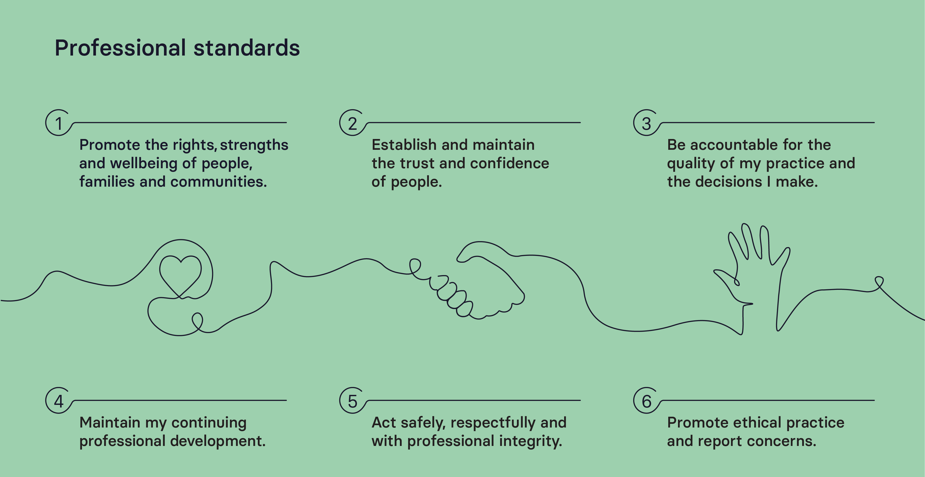
Notes:
We’ll explore professional standard 4 later in the presentation.
1.1 Value each person as an individual, recognising their strengths and abilities.​
1.5 Recognise differences across diverse communities and challenge the impact of disadvantage and discrimination on people and their families and communities.​
1.6 Promote social justice, helping to confront and resolve issues of inequality and inclusion.​
5.1 Do not abuse, neglect, discriminate, exploit or harm anyone, or condone this by others.​
6.1 Report allegations of harm and challenge and report exploitation and any dangerous, abusive or discriminatory behaviour or practice.

Slide 6
Registration and renewal
How to register with Social Work England, and what it means to be a registered social worker

Slide 7
Record your CPD Record at least 2 pieces, including one with peer reflection.
Pay your £90 fee You can set up a direct debit to pay this in 2 x instalments of £45.
Apply to renew your registration Apply between 1 September and 30 November. Don’t forget to hit ‘submit’ and make a note of your RN number.
steps to do each year
Notes:
One of our key responsibilities as the regulator is to maintain the social work register.
Our registration rules ensure that all social workers on our register are able to practise safely and effectively.
If you are removed from the register for any reason, you will not be able to practise under the protected title of social worker until you have restored your registration.
If you wish to re-join the register after leaving or being removed, you will need to pay a restoration fee of £135 (non-refundable) as well as a registration fee of £90.

Slide 8
Renewing your registration
Maintaining registration is the responsibility of individual social workers. If, for any reason, you do not renew your registration you will be removed from the register.
You must be registered with us in order to practise under the protected title of ‘social worker.’
Notes:
One of our key responsibilities as the regulator is to maintain the social work register.
Our registration rules ensure that all social workers on our register are able to practise safely and effectively.
If you are removed from the register for any reason, you will not be able to practise under the protected title of social worker until you have restored your registration.
If you wish to re-join the register after leaving or being removed, you will need to pay a restoration fee of £135 (non-refundable) as well as a registration fee of £90.

Slide 9
Continuing professional development (CPD)

Slide 10
The CPD requirements have changed
For the registration year 2021 to 2022, we require social workers to record:
A minimum of two pieces of CPD, including
At least one piece of CPD with a peer reflection.
These new requirements were decided after consultation with the sector.
The CPD deadline is 30 November 2022. As part of renewing their registration each year, social workers must meet the CPD requirements by this deadline. There are no extensions or extra time.

Slide 11
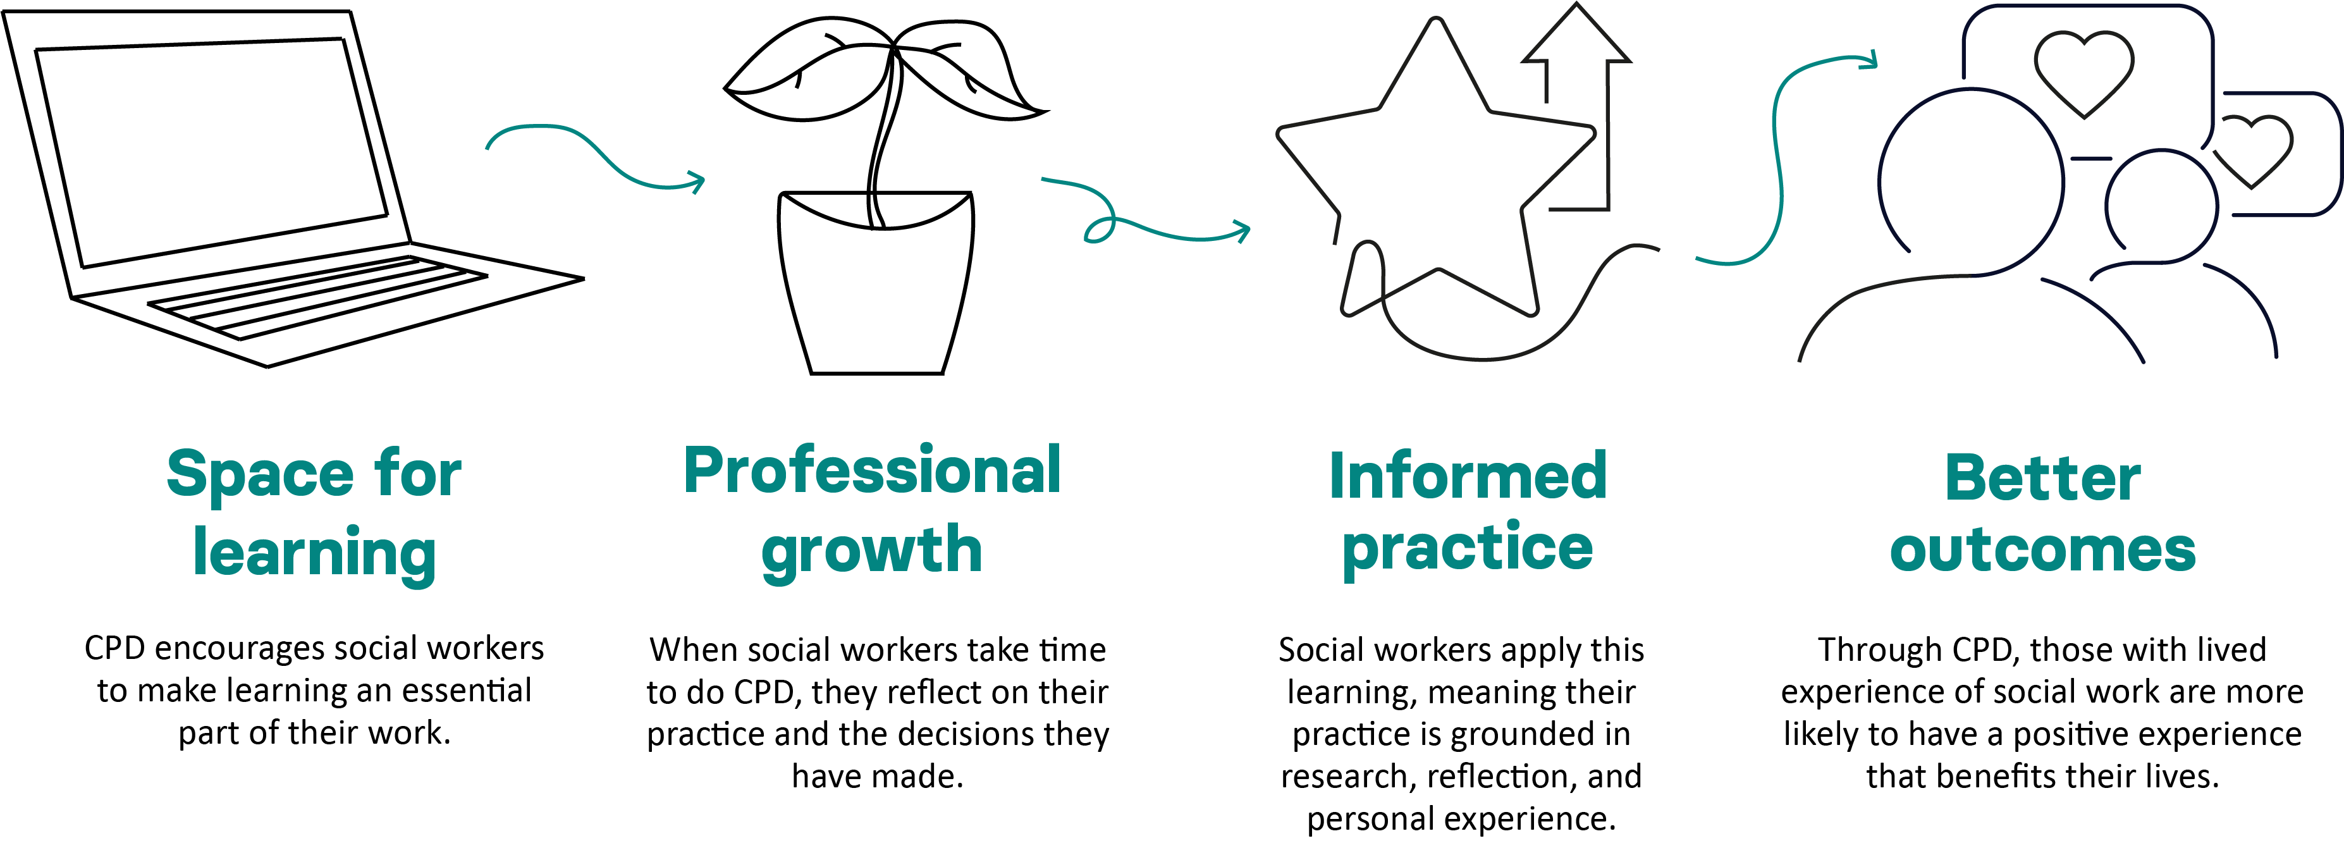
Why CPD?

Slide 12
Reading relevant books or articles
What is CPD?
On the job learning/experience
CPD is the reflection and learning activity that social workers undertake throughout their career to maintain and improve their practice.
CPD is an important part of our professional standards, which aim to improve public safety and confidence in social work.
The most important thing about CPD is that you reflect on what you have learned, and show has it has, or will, improve your practice.
Reflecting on your leadership or management
Attending an online seminar or webinar
Reflecting on feedback (from a colleague or a person with lived experience)
Types of CPD (some of them!)

Slide 13
4.1 4.2 4.3 4.4 4.5 4.6 4.7 4.8
Incorporate feedback from a range of sources, including people with lived experience of my practice (where applicable.)
The CPD standard
Use supervision and feedback to critically reflect on, and identify my learning needs, including how I use research and evidence to inform my practice.
The CPD standard is part 4 of our professional standards. You should aim to meet all 8 parts of the standard in a year. However, we understand this is not always possible, so this is not a mandatory requirement.
Keep my practice up to date and record how I use research, theories and frameworks to inform my practice and professional judgement.
Demonstrate good subject knowledge on key aspects of social work practice and develop knowledge of current issues in society and social policies impacting on social work.
Contribute to an open and creative learning culture in the workplace to discuss, reflect on and share best practice.
Reflect on my learning activities and evidence what impact CPD has on the quality of my practice. You must include reflection in all your CPD records.
Record my learning and reflection on a regular basis, and in accordance with Social Work England’s guidance on CPD. You meet this automatically by recording CPD on your account.
Reflect on my own values and challenge the impact they have on my practice.

Slide 14
The new form
Notes:
Share your screen
EDI survey

Slide 15
Peer reflection
Peer reflection means that you have discussed the content of your CPD activity with a peer, your manager or another professional.
The role of the peer is not to approve your learning, but to support you to think about how you can improve your practice. The discussion also allows you to share what you have learnt with others, contributing to an open learning culture (standard 4.5).
Who counts as a peer?
Another social worker registered in the United Kingdom
Your line manager or supervisor.
Other professional who has knowledge of your social work practice.
There is a bigger list of peers on our website. This list is not exhaustive.
Peer reflection guidance
Notes:
Q and As

Slide 16
When discussing your CPD with a peer, you should talk about:
what you have learnt from doing the CPD
the positive impact the CPD activity has had (or will have) on your role, practice and the people you work with.
Peer reflection discussions can be formal or informal. They can take place in one to one or group settings. For example, you could discuss what you have learnt from doing your CPD:
during supervision with your manager
during team reflection sessions
by having a conversation with a colleague
through a community of practice or an action learning set.
When you record a peer reflection, you should not record the name or other details of who you reflected with. You must anonymise all CPD.

Slide 17
Provide support to enable social workers to progress through post-qualifying specialist training.
Encourage social workers to work towards and maintain professional accreditation.
Encourage social workers to think creatively about their CPD activity.
Encourage social workers to plan, reflect on and record learning activity.
Encourage social workers to reflect on the impact of their learning.
Support social workers to meet the peer reflection requirement.
Role of managers and employers
LGA Standard 6
Notes:
LGA employers' standards – reference

Slide 18
How to record CPD
You must record CPD on your Social Work England online account.
Based on our consultation with the sector, we have made recording CPD simpler by replacing the unstructured and structured CPD forms with a new, single form.
The new CPD form asks a number of questions designed to help you reflect on your CPD activity, without being too prescriptive. Be sure to answer the mandatory questions.
At least one CPD record must contain peer reflection.
You can save your work as a draft if you want to come back to it later. The system times out after 60 minutes, so make sure you save regularly to avoid losing work.

Slide 19
CPD review
Each year, after registration renewal, we randomly select 2.5% of social workers to have their CPD checked. We call this CPD review.
CPD review is carried out by a team of 10 independent assessors, recruited for their experience working in quality assurance in social work, or similar roles.
The assessors will decide one of two outcomes for your CPD – accepted, or advice given. Where the outcome is advice given, you will be given feedback on your CPD, and automatically selected for CPD review next year.
All social workers selected are notified by email in January. If you are selected, you don’t need to do anything. Because you’ve already recorded your CPD during the registration year, we have everything we need to complete the review.
Notes:
Last year we did some analysis of the outcomes from the 89 that were given advice. This mainly was a quantitative exercise to compare the numbers across the team of assessors to ensure that they were being consistent in their outcomes
Advice given outcomes
The following are examples of feedback that:
Include a direct reference to the learning activity.
Include specific detail about what is missing from the CPD record.
Include specific questions to consider to improve the CPD record/ guide future reflection.
Include information about how to improve the CPD record/specific examples of how the CPD could have been improved.
References/directs social worker to the professional standards.
Has personalised advice – “you could…”
Example 1:
From the title of this training, it seems likely that this may have been useful training that could have given you lots of impetus for learning. However, you have not provided any detail regarding your work role or made any linkage between this piece of CPD and your professional responsibilities.
The guidance from Social Work England (4.6) states: It is important that you record in your online account the effect the learning has had on your practice, describing the positive changes you have made and evidencing the impact those changes have had with people. Unfortunately, as you have provided so little information, it is not possible for me to assess what impact this training has had on your practice.
In future I would suggest that your CPD record should contain some specific detail regarding what you learnt from the course. Do you come across many adults at risk harm as part of your role? Has this course provided you with any impetus for managing these situations any differently? What feedback have you received from users, colleagues, or supervisors regarding this aspect of your practice? By giving examples, this would strengthen your CPD record.
Example 2:
Your in-service training appears to have offered several important learning opportunities. However, to provide clearer context for this assessment it would have been helpful to see more detail on the training content.
Additionally, from the information you have presented, it is unclear what impact your learning has had (or will have) on your practice. For example, you indicate that training has helped you reflect on your own values, but there is no further detail on how this has helped guide your future approach (please see Section 4.8 of the CPD Standard).
In future, my suggestion is that you might want to provide clearer reflection on which of the CPD Standards have been most relevant to your learning. Additionally, when structuring your answer on the impact of your learning you might find it helpful to consider section 4.6 of the CPD Standard (and the corresponding part of the CPD Guidance for Social Workers).
Example 3
You have provided a good example of how you communicated with management in relation to a policy review.
However, what I would like to have seen is what specifically you have learnt from this experience and what positive changes you have made to your practice as a result. For example, are there alternative ways in which you could express your concerns that may be more effective? It may be, with this example, that there is nothing you believe you could have done differently. If that is the case, it would have been advisable to use a different example and one where, upon reflection of your actions and performance, you have identified an area for improvement in your own practice. I would then want to know how you have implemented that improvement in your practice moving forward.
Example 4:
It is positive that you were able to upload 4 pieces of CPD during the year.
It would have been helpful if you could have given more information about the impact on your practice. The training has increased and updated your knowledgebase, but it is not clear what you would do differently as a result of this increased knowledge and skills, and how this would be implemented in practice.
For example, if the safeguarding training had included information about gangs or county lines, you could perhaps have commented that you are now more aware of what to look for in relation to young people being at risk of county lines and you ensure that you look for any evidence of these signs.
I would have liked to have seen a bit more information about what you learned from the lifelong links learning and how this would be implemented in practice, rather than a comment that you are now able to do this work. What specific additional knowledge and skills do you now have to make you a more effective practitioner?
Example 5
The training session is clearly relevant to social work. However, there is a lack of detail regarding what training you actually delivered. We would have expected you to describe the feedback you received from foster carers and residential care workers, and how you changed the course content or delivery based on that feedback.
We would also have expected you to include a reflection on this learning, and how this has informed your social work practice. What works well in the training session? What do you learn from the individuals who attend the training?
It may assist if you refer to the relevant elements of the CPD Standard.

Slide 20
On the horizon…
Social Work Week 2022
Social Work in England Report II
‘This Is Social Work’ – podcasts
Social Work Now – newsletter
Future consultations

Slide 21
Questions

Slide 22
Stay in touch
socialworkengland.org.uk
We regularly update our website and social media with new content to support you with registration renewal and CPD. This includes blogs, video tutorials, and more. We also share opportunities to get involved, such as consultations and job listings.
Follow us to keep up to date!
@socialworkeng
Social Work England

