Slide 1


Slide 2
Introduction
MOSAIC is an integrated case management system used by social workers (Adults and Children) in Camden since 2005 and early help practitioners since 2016
The system is organised around specific social work procedures and tasks using the required statutory procedures and forms that enable social workers to assess, plan and review clients referred to the service
It is a system that is designed to be progressively built on and developed to ensure that it accurately reflects both existing governmental legislation, policy and guidance and local social work procedure and practice
The system contains the case records of all clients known to adults and children’s services and early help
It is a tool that assists practitioners and managers to improve the quality of case management and recording

Slide 3
MOSAIC has 3 components:
Data Model (Management Info) – Contains the data local authorities must collect to report to government and to measure local performance
Process Model (Workflow) –information is recorded following the specific social practice processes of assessment, planning and review and enables the recording of case notes, management decisions and authorisations
Exemplars (Forms) – contains a series of forms based on statutory requirements that ensure the recording of information for each of the key processes (CIN, CP and CLA)

Slide 4
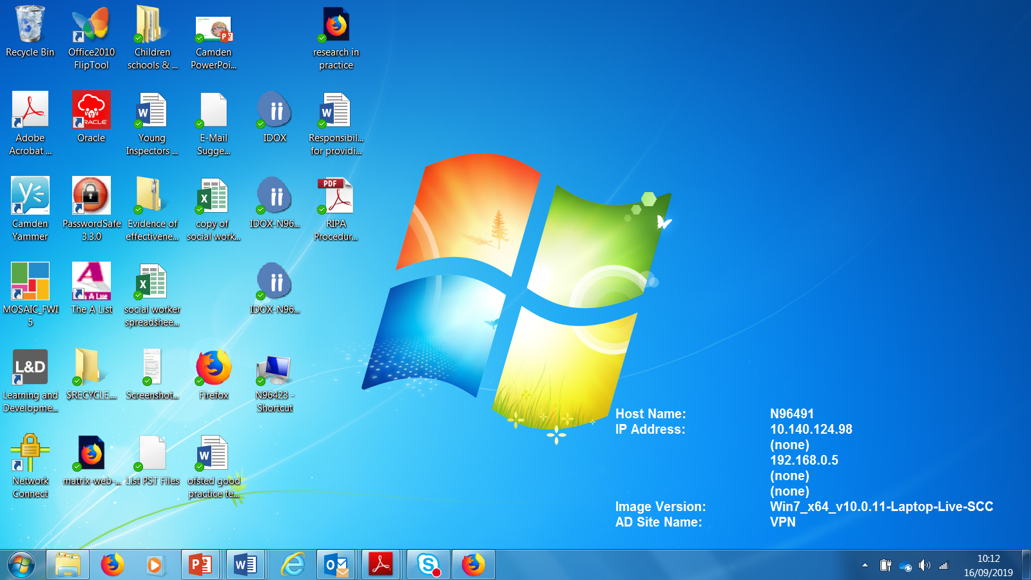
System is accessed via desktop
ICON

Slide 5
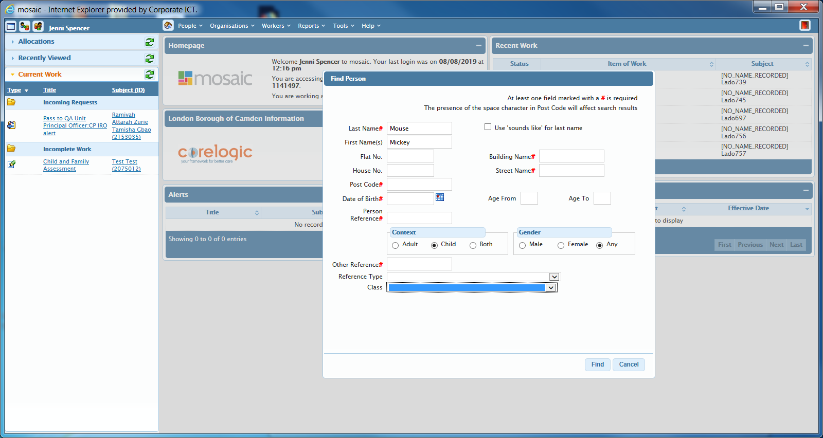
Search for client

Slide 6
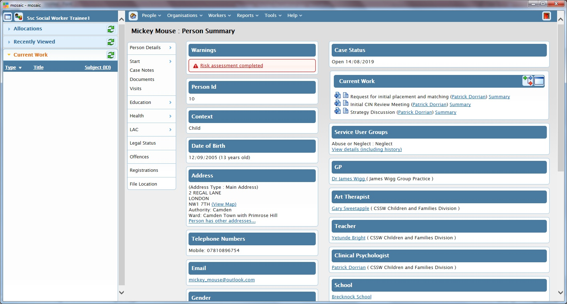
Person Summary Screen
Contains key data and enables navigation around each case record
Work requiring completion
Involved professionals

Slide 7
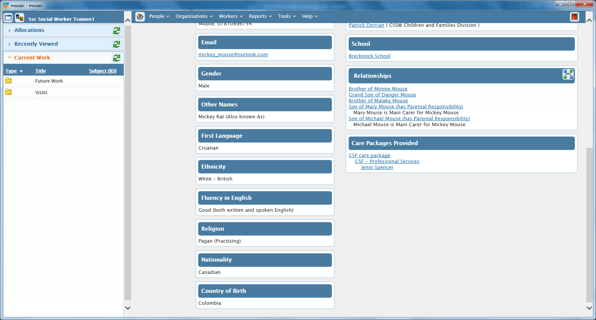
Person Summary Screen- contd

Slide 8
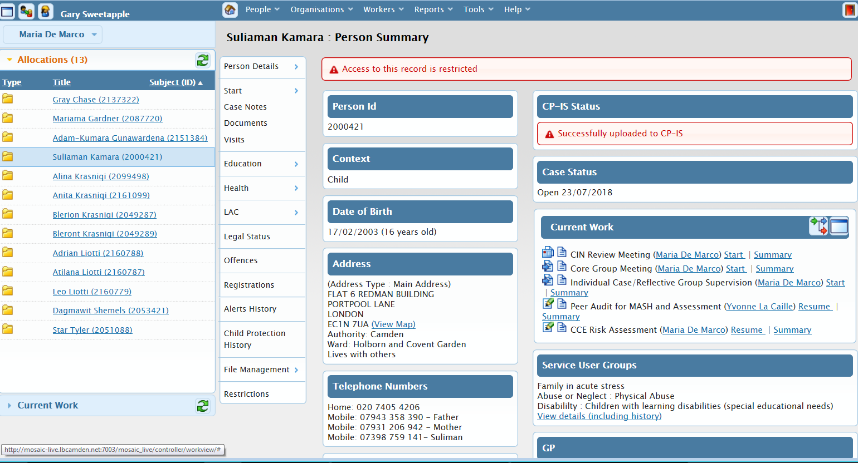
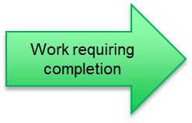
Managers work view
Enables management oversight of all cases allocated within team
Allocated cases

Slide 9
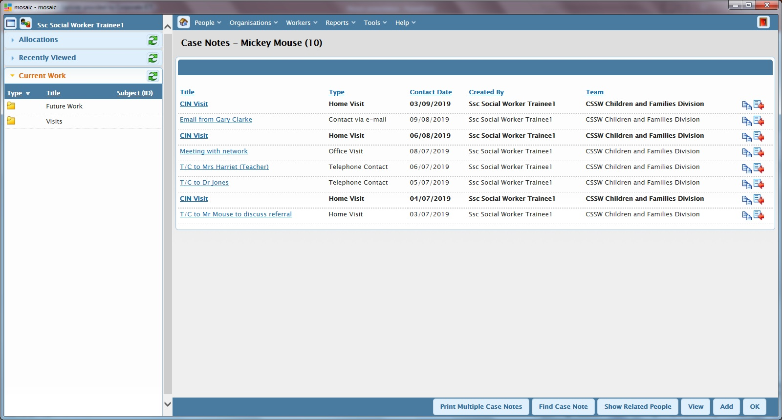
Case Notes
Contains running record of work undertaken by worker

Slide 10
Forms
All forms are embedded within the workflows in the system
The forms are based on the 4 common processes:
  Information- CSF Contact record, Contact and referral record, referral and Info, Chronology, Closing summary
  Assessment- C&F assessment, Strategy discussion, sec. 47 enquiry, Planning - CIN plan, CP plan, Care plan, Adoption plan, Pathway plan
  Review- CIN review, CP review, LAC review, Pathway plan review

Slide 11
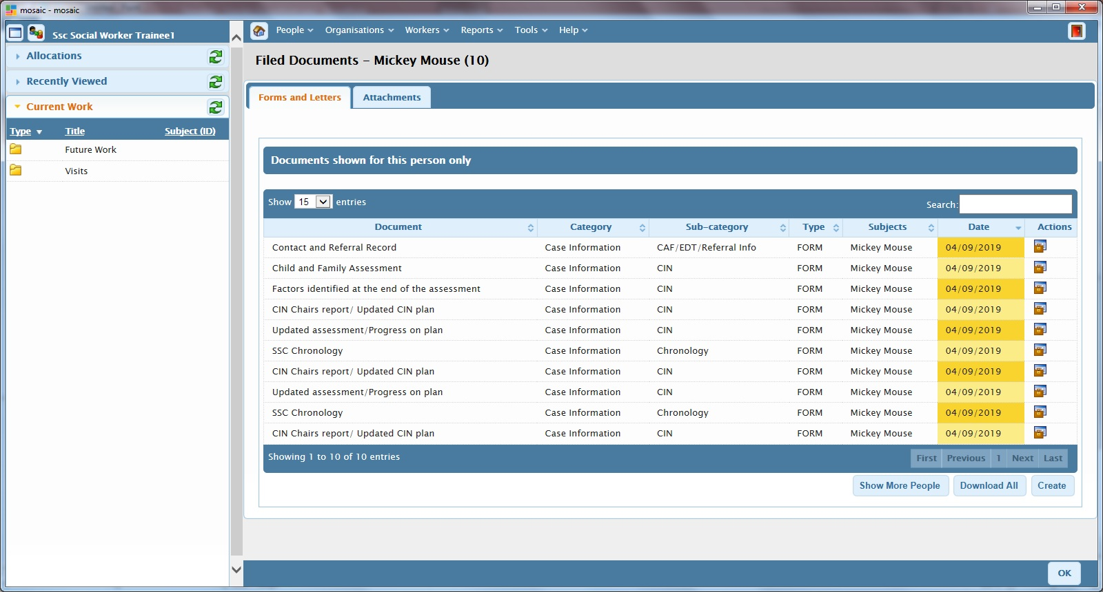
Documents
All forms held in system are listed under Forms and letters, uploaded documents and letters are listed under Attachments

Slide 12
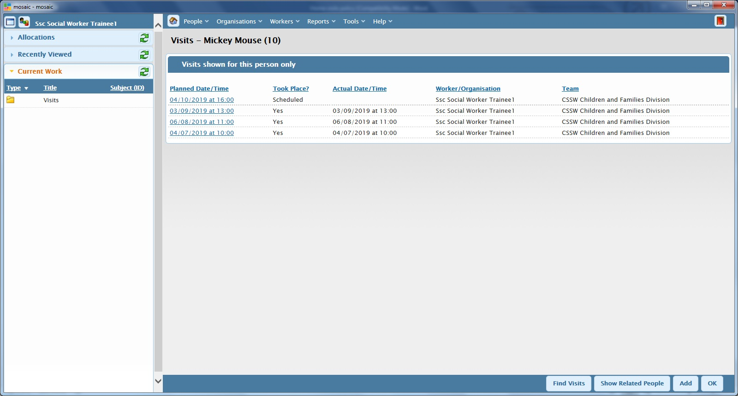
Visits
Dates of visits to child and family can be viewed here, with details recorded in case notes

Slide 13
Workflows CSSW main workflows are CIN, CP and CLA
CSF Contact
CSF Contact
Contact and Referral Record
Child and Family Assessment
Child Protection
Child In Need
Looked After Child
Strategy Meeting
Child In Need Reviews
Request for Placement
Outcome of Section 47 Investigation
Placement Arrangement Meeting
Child Protection Conferences and Core Group Meetings
Looked After Child Reviews

Slide 14
Workflow Steps
The system contains a number of workflow steps – these are stages in one of the main processes of CIN, CP and CLA
Workflow steps include:
the completion of forms
the sending of requests to managers for authorisations or to business support for admin tasks to be undertaken
The Next action to be taken in the case e.g. review meeting, section 47 investigation etc.

Slide 15
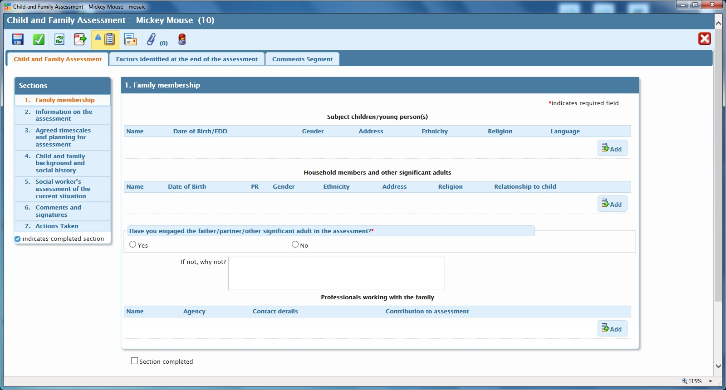
Forms

Slide 16
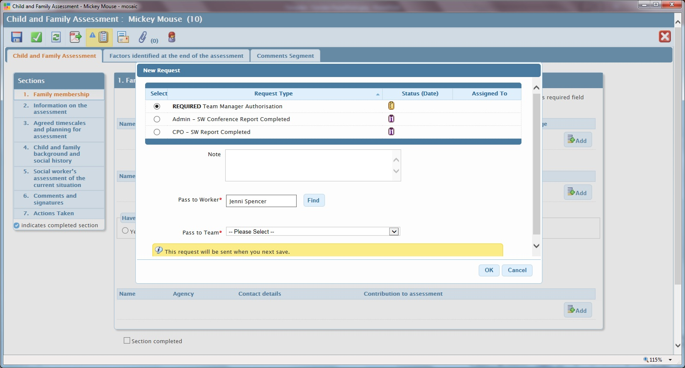
Requests e.g. TM Authorisations, Admin tasks

Slide 17
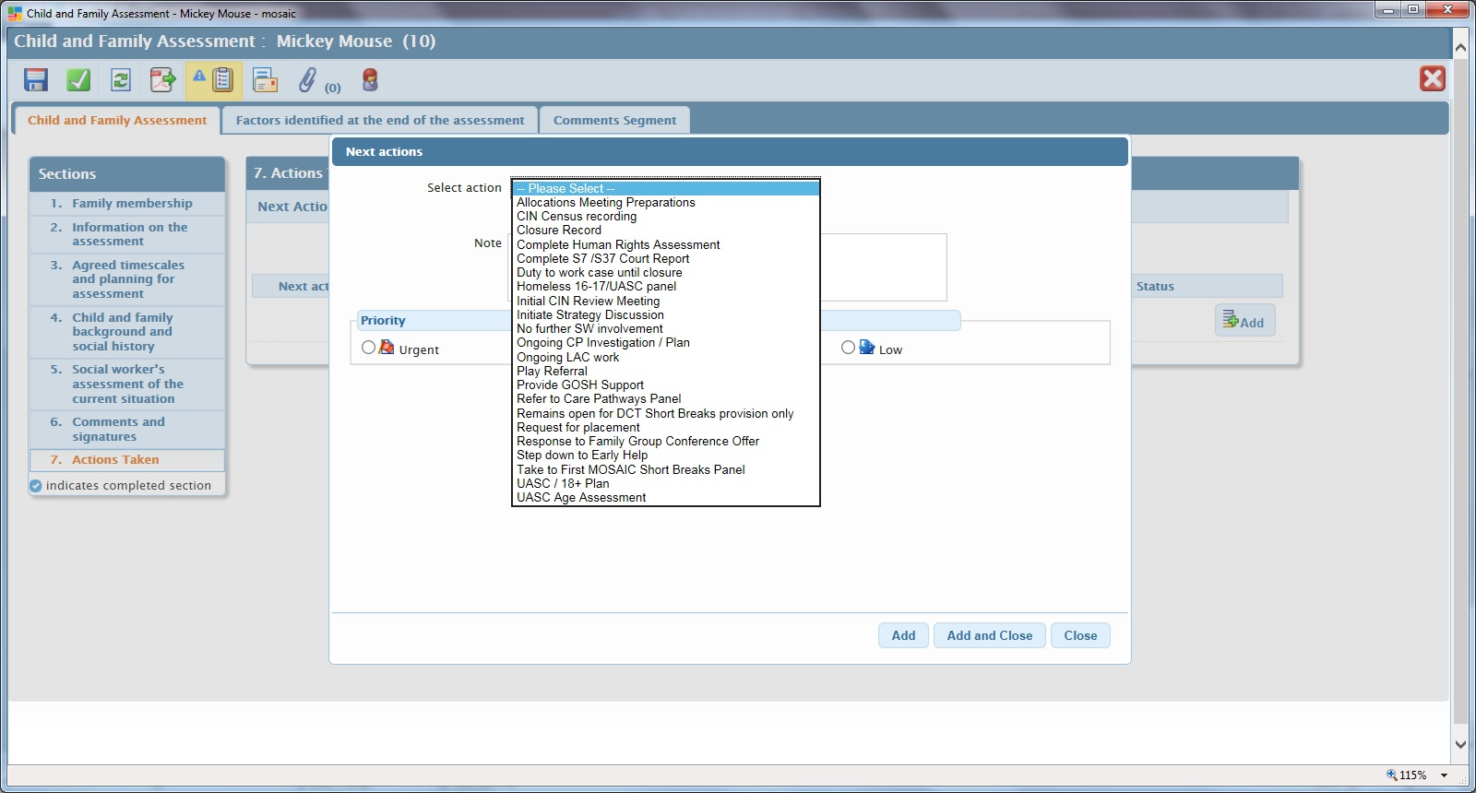
Next Actions

Slide 18
Benefits of the system
Consistency and quality in service delivery and recording:
System sets standards for practice by ensuring staff follow best practice processes based on statutory requirements
Improves and enhances practice by enabling all staff to be clear about procedural expectations by guiding them through the workflows and giving clarity and structure to processes
Enables collection of comprehensive and up to date performance data
Ensures close monitoring and management oversight of cases

