Slide 1
VOIDS PROCESSES
May 2021

Slide 2
Contents
Finding your voids by patch
Searching by status
Searching by bed size
Keys in. NOV received
Ending a tenancy
Confirming the void
Adding in void events like date keys in (KYIN)
Referring to repairs (using the context form)
Adding in a floating void event e.g. NOTEs, SENS etc
Updating property elements
How a CBL is arranged
Arranging a CBL on Northgate
Allocations process
Sign up process
Resulting an offer on Northgate
Setting a tenancy date

Slide 3
Essential Void Processes
Routine void
monitoring
Keys
&
Viewings
Allocations
&
Sign ups

Slide 4
Routine Void Monitoring Finding your voids
Search for your voids using individual NHO patch number or NM team number
Search by void status: NOD, PEM, CBL, CBLA
How to find a void across all team by bed size when you need to move on of your tenants

Slide 5
Finding your voids
Estates > Voids > Advanced search

Slide 6
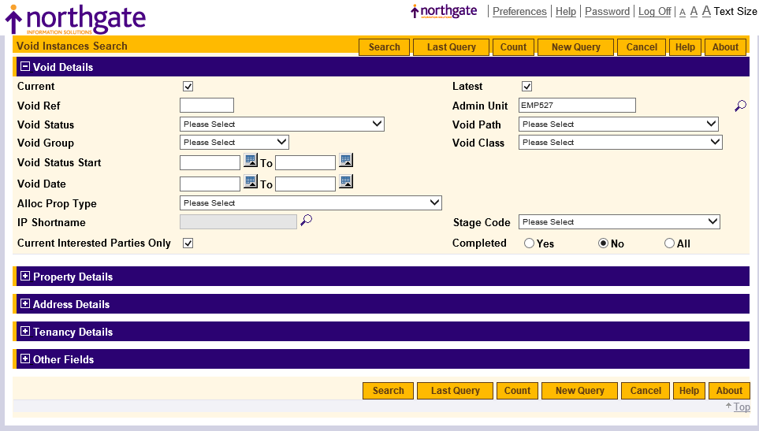
Add in your patch or team code in Admin Unit. Click search

Slide 7
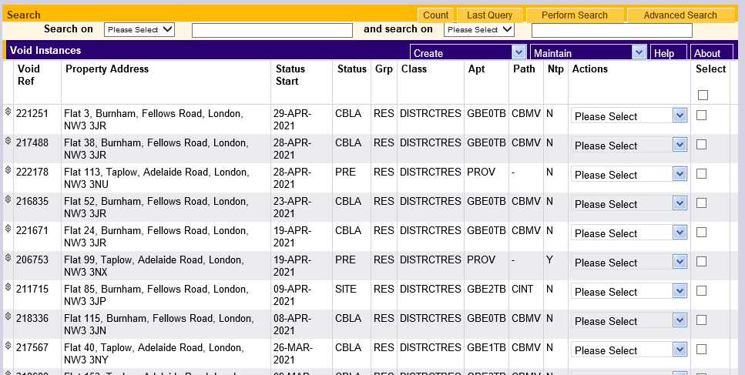
Gives you a list of your voids

Slide 8
Search by void status
Estates > Voids > Search on status. Add in status and click return

Slide 10
Searching by bed size
Estates > Properties > Advanced search

Slide 11
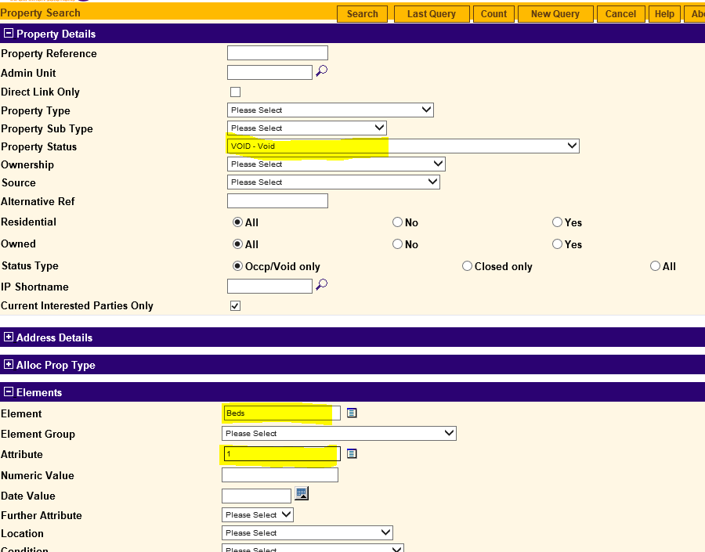
Property status = Void. Element = Beds. Attribute = No beds. Click search

Slide 12
Keys In NOV Received
End Tenancy
Confirm Void * Don't use void reason "New Void" * If there is a death but someone is trying to succeed use Succession or non stat succession for termination and void reason
Add in Key In date
Refer to Voids using the context VOID_REFER form
Store documents on TRIM
Set reminder for 2 weeks' time to check you have received property elements and that the void path has been amended from INTR.
Check with the voids team that they have received the referral if you see the void path is still INTR.
Property Elements – update all property elements
Add any more updates by creating a new void event – NOTE, complete event date (today's date) and add a comment and your name

Slide 13
Ending a tenancy
Estates > Tenancies. Then either enter tenancy ref or property ref or click on advanced search

Slide 14
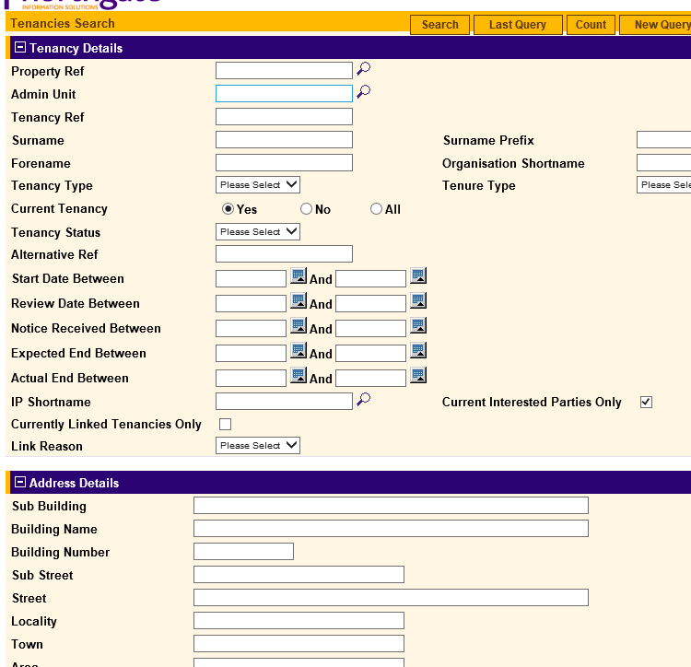
Search by name or address

Slide 16
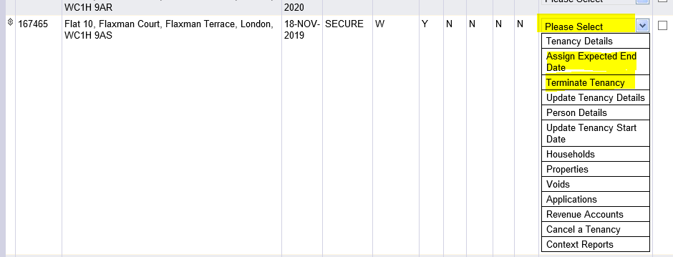
“Please select” then Either assign expected end date if we know someone is going to move or terminate tenancy if we want to end the tenancy An expected end date will create a PRE void. Remember we can enforce 4 weeks notice if no notice was given (not transfers/deaths/moving to RSL)

Slide 17
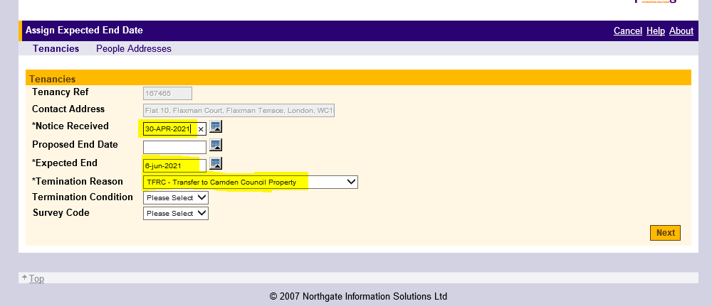
If you chose Assign expected end date, add in Notice received, Expected end date and Termination reason. Remember if it is a death and you are dealing with a succession claim or NSS to choose those codes rather than DECD. Be careful not to chose Transfer of tenancy if you are dealing with an actual transfer. Click next

Slide 18
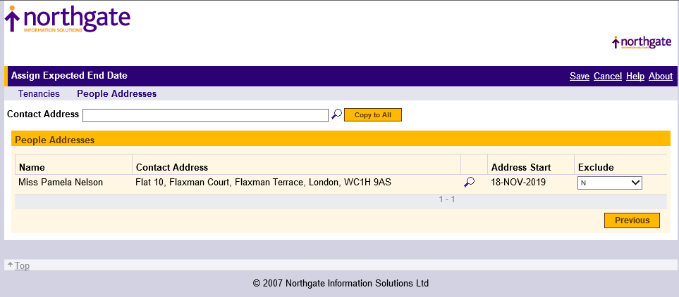
Fill out contact address using Search if it hasn’t copied over and copy to all for other household members. Then click Save

Slide 19
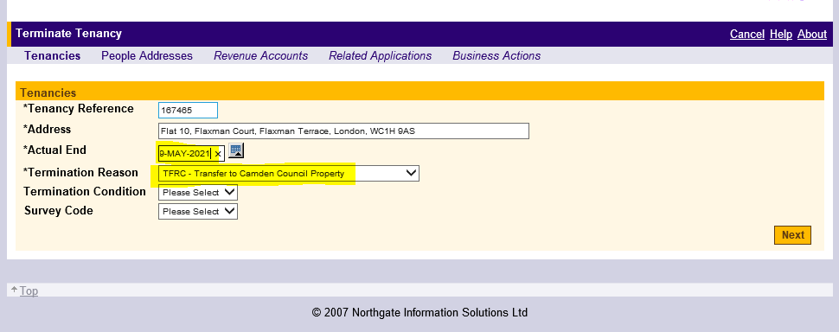
To terminate. Add in actual end date and Termination reason. Remember if you are dealing with a succession or non stat succession to use those reasons. Click Next. Remember to let Estates access know if this also ends a parking space, garage or shed

Slide 20
Confirming the void
Go to your void. It will look like this – a PRE void. This now needs confirming, updating and referring

Slide 21
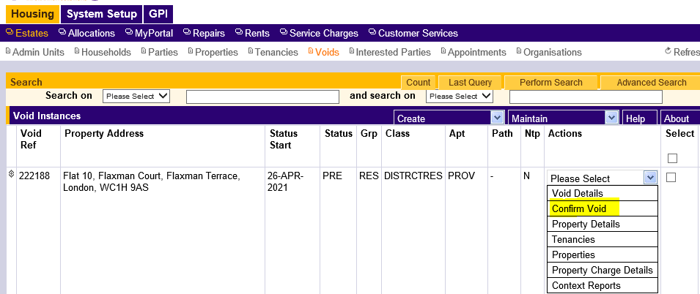
Click on Please Select then Confirm Void

Slide 22
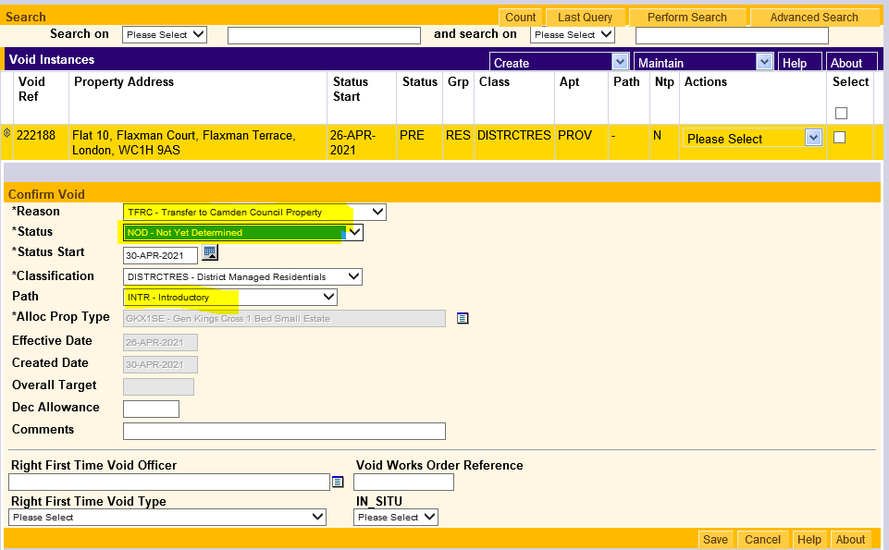
Amend Reason if it needs to be. Do not use New Void (CIP only). Amend status to NOD for a normal void. You will see void path automatically default to INTR Click save

Slide 23
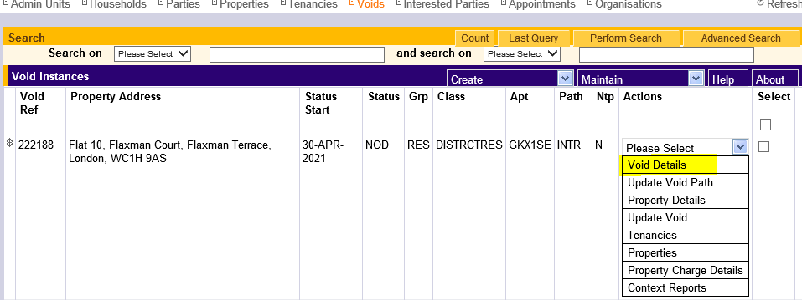
Void now looks like this. Click on Void Details.

Slide 24
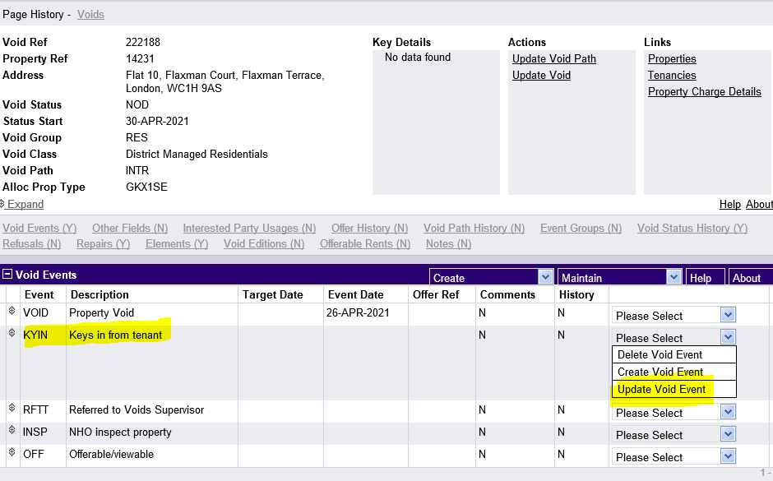
Updating a void event (Keys in)
Please Select then Update Void event

Slide 25
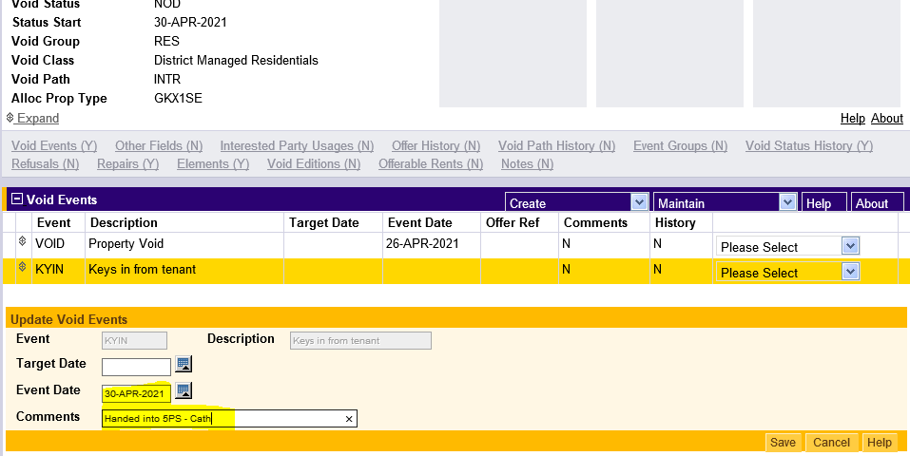
Fill out Event Date and add a comment (I always add my name too). Click Save

Slide 26
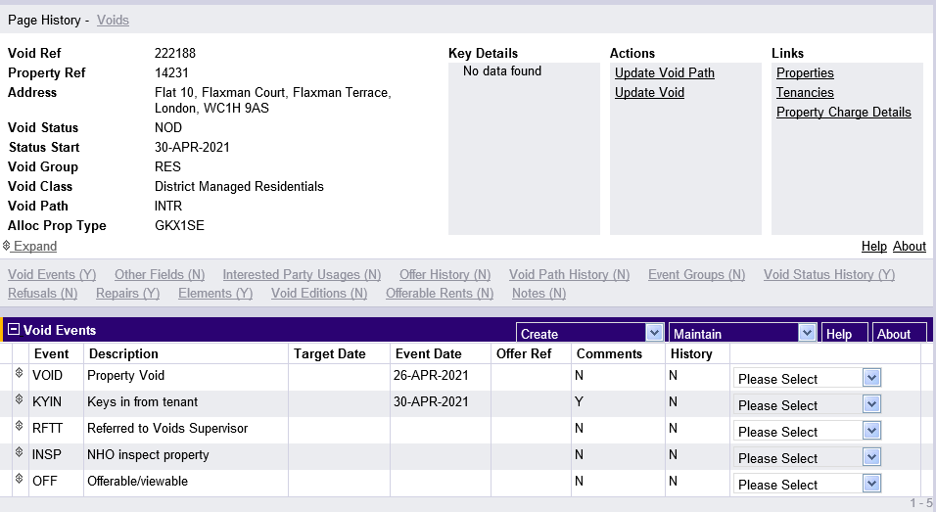
Looks like this. You can add in any other Events by clicking on Please Select and Create Void Event

Slide 27
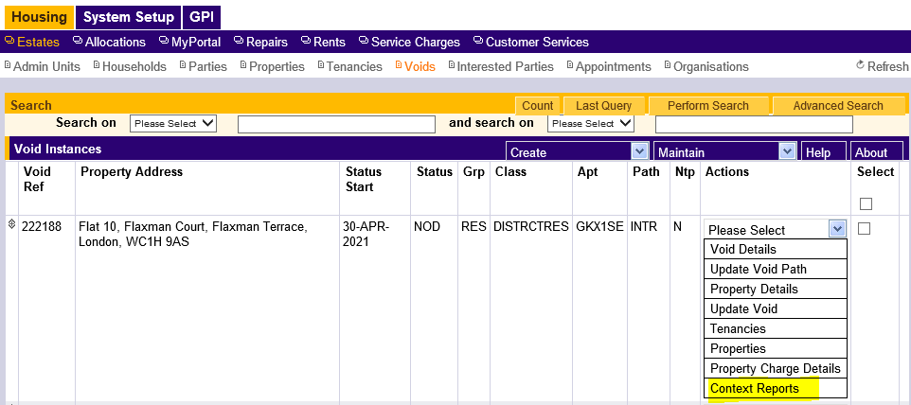
Referring to Repairs (void team and major repairs)
Go back to main void page, click Please Select then Context Reports

Slide 28
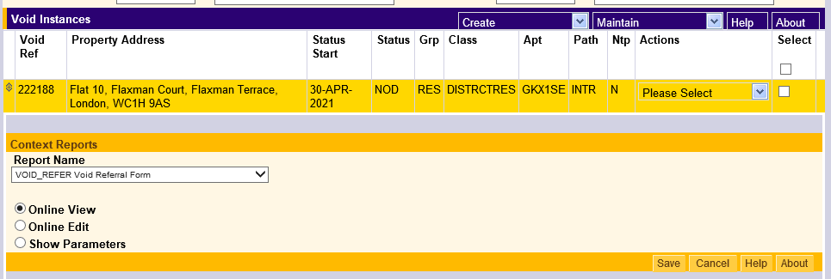
Click on VOID-REFER then Online View then Save. This will open a referral form as a Word doc. Complete and send to void.referral@camden.gov.uk not to individual members of staff. Make a note on the form if it is to go to Majors.
Take care to choose the correct form because running these reports automatically update void events. If you run the wrong one it will update the wrong event.
If you accidentally run the wrong form go into void details and delete the incorrect date from the void event.

Slide 29
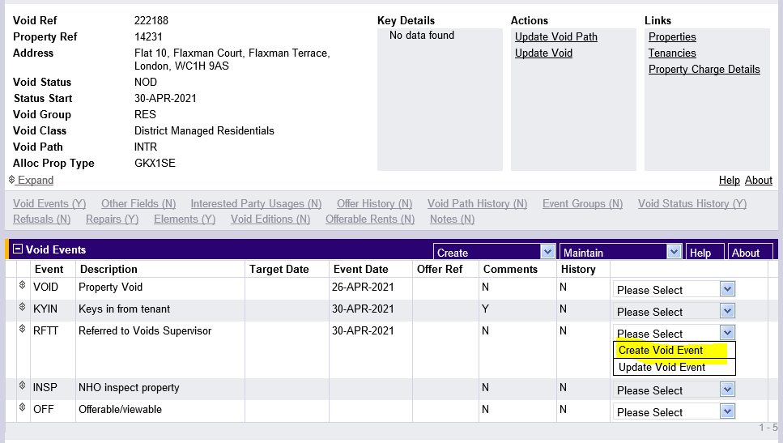
Floating void events (how to add in different events e.g. SENS, NOTE, DOAC – direct offer agreed)
Go to last completed event and click on Create Void Event

Slide 30
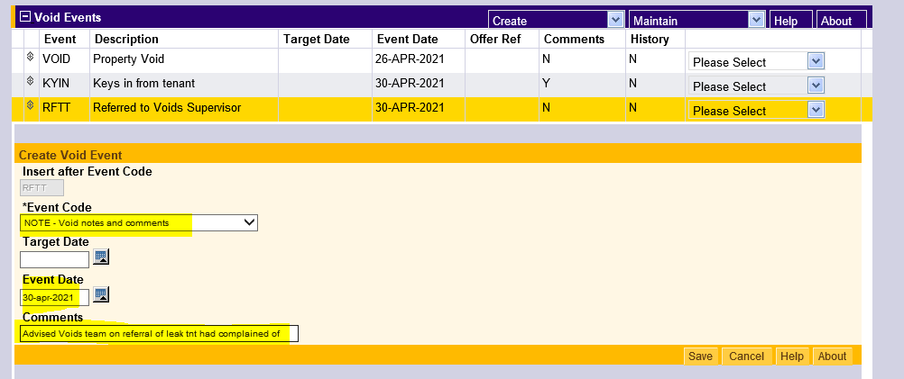
Chose relevant event code (there are a lot). Fill out today’s date as event date and comment. E.g. If it was a sensitive let, you would explain why. Click save

Slide 31
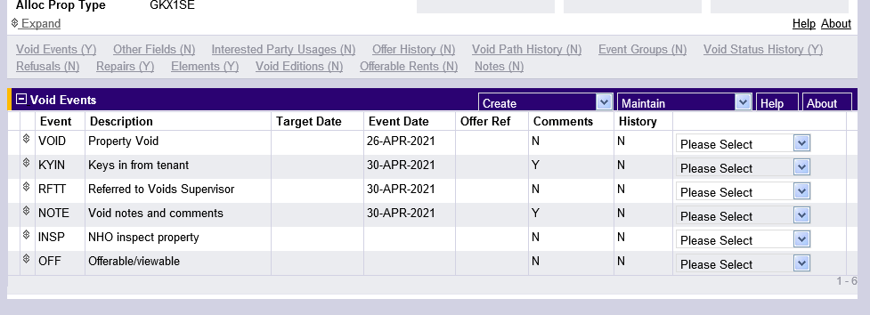
Looks like this

Slide 32
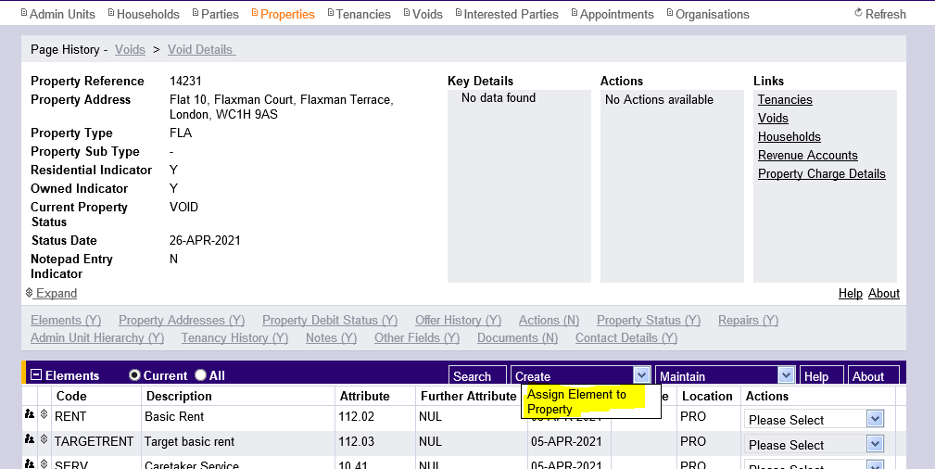
Property elements
Completed in Properties. Elements will open automatically. Click Create then Assign Element to Property

Slide 33
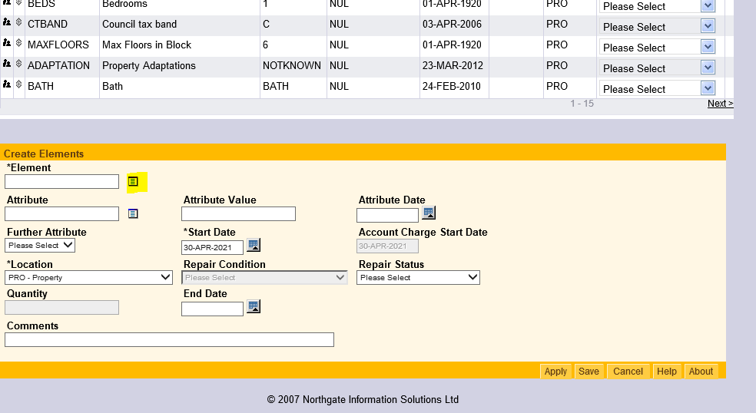
If you know the name of the element just type it into the *Element field. Alternatively click on the small box to the right

Slide 34
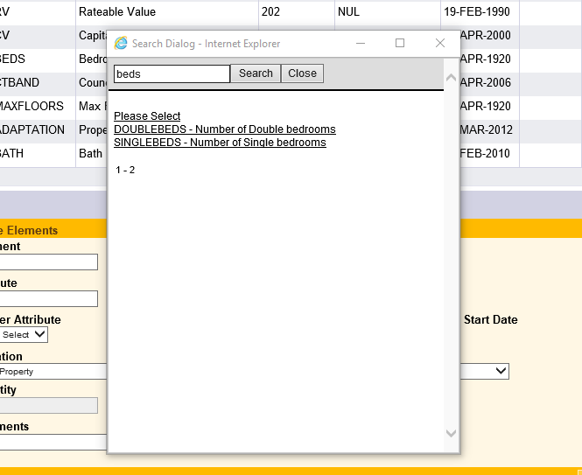
Type into the search field what you are looking for and click Search and chose the event you want to complete.

Slide 35
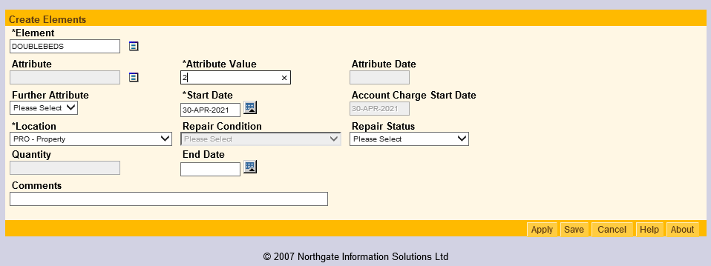
Complete either the Attribute or Attribute Value fields. The relevant one for your particular element won’t be greyed out.
If an element has been completed incorrectly this can only be changed by IT at present

Slide 36
How a CBL is arranged Handover or advice that handover is due
Change status to CBL/HS2 at handover
Enter viewing date using VIEW event on the void by updating the VIEW target date with the date of your viewing (remember to add the CBL to your calendar, or make arrangements for someone else to manage if you are going to be on leave). This is provisionally advised to be 14 days notice.
For New builds (only) add in an OFF void event
Advert closes: HNG will text shortlisted applicants with the viewing date that you have added above and advise to collect keys from 5PS. NHO details included in the text.
3 applicants are shortlisted to view at 10am, 12 noon and 2pm on the day that you advised.
Check if you need to renew your access to HNG and check if there is a risk assessment available for any applicant.

Slide 37
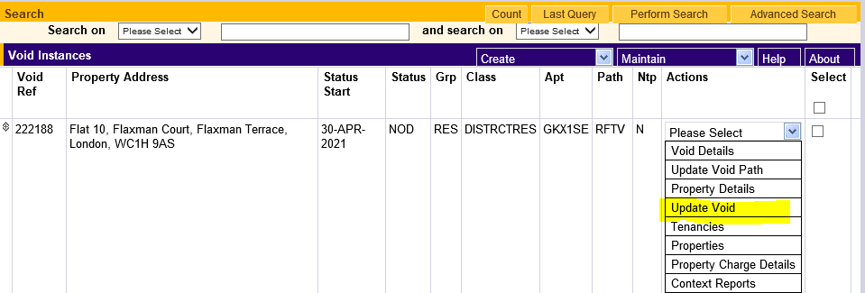
Arranging a CBL
In voids select your void and chose Update Void

Slide 38
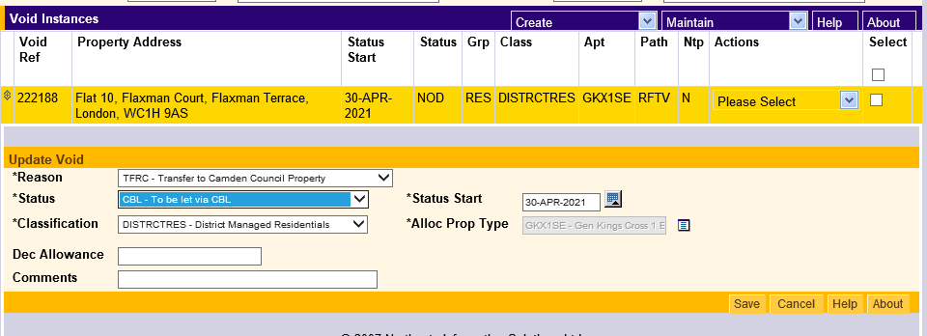
In the dropdown next to *Status chose CBL. Be careful not to accidentally choose CBLA – it’s easily done!
Click Save

Slide 39
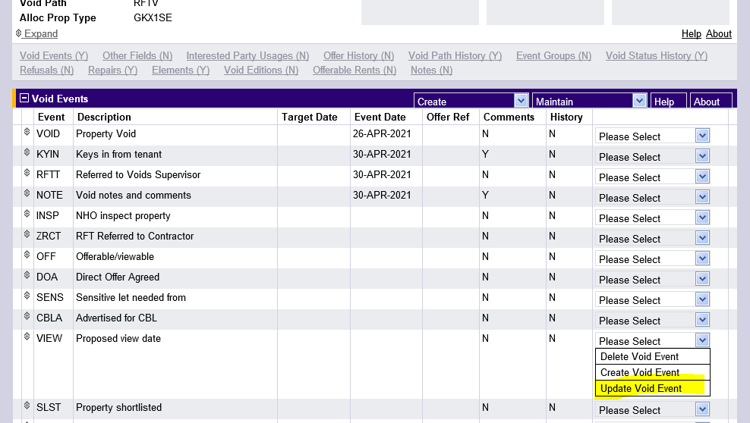
Go to void details. Find the VIEW void event (or create a new one) and click Update Void Event

Slide 40
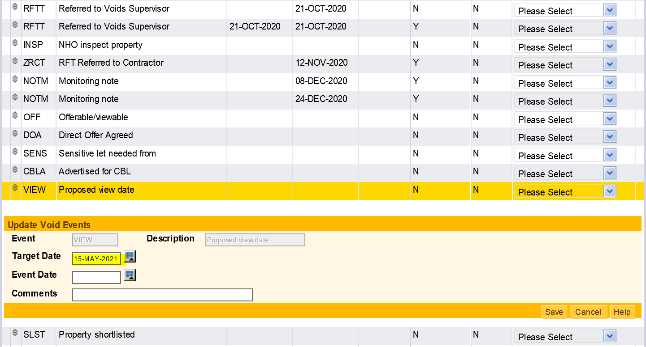
Fill out the target date as the date you want to do a viewing. Click Save. Allocations will pick up this date and will add it to Home Connections to let bidders know in advance

Slide 41
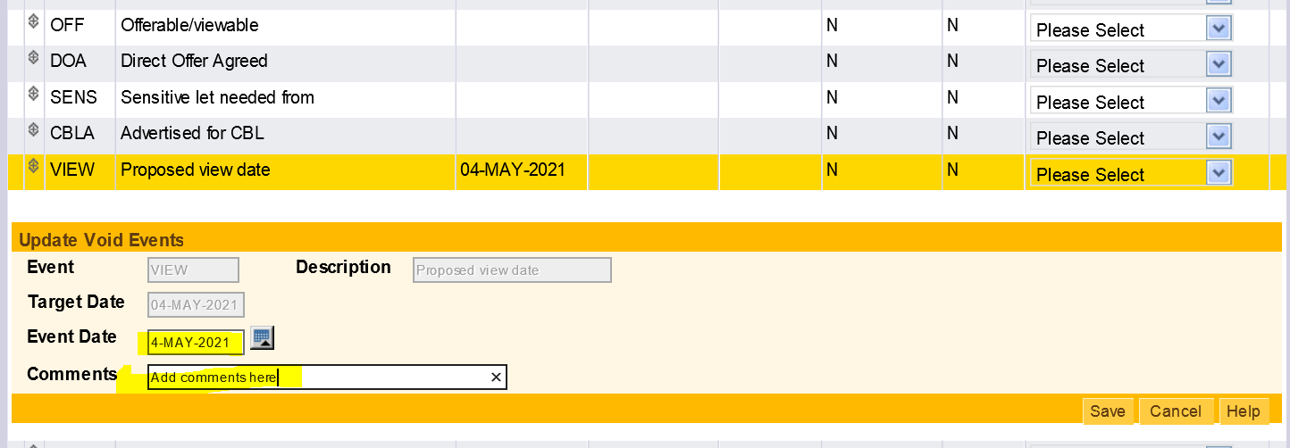
After viewing, updated Event date with viewing date. Where a new viewing date is needed create a new void event called VIEW (see slide 25) and add in a new target date

Slide 42
Allocations
Repairs enters handback date on Northgate/ Rapid
NHO updates CBL or DOC (matching meeting)
HNG advertises property
CBLA
Property Advert - Home Connections – 3days
Viewings
Shortlist
Direct offer refused NHO makes CBL
No verification – return to shortlist and repeat
HNG update to
FVER
NHO manages viewings
Direct offer viewing accepted
Tenant start date
LET
NHO gets tenancy agreement signed
Viewing outcomes: Property accepted
Verification passes . HNG update to ACC or DOAC
Verification. HNG update to
VERF

Slide 43
Sign up
Remote sign up
Keys
Result offer
Create tenancy
Store tenancy sign up documents on TRIM once account set up

Slide 44
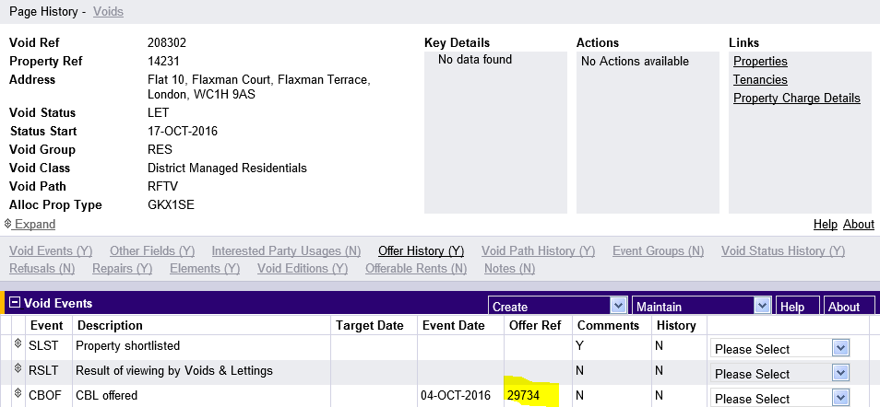
Resulting an offer
Find the Offer reference in your void’s void events.

Slide 45
Go to Allocations > Offers – Search on Offer Ref and enter offer reference.

Slide 46
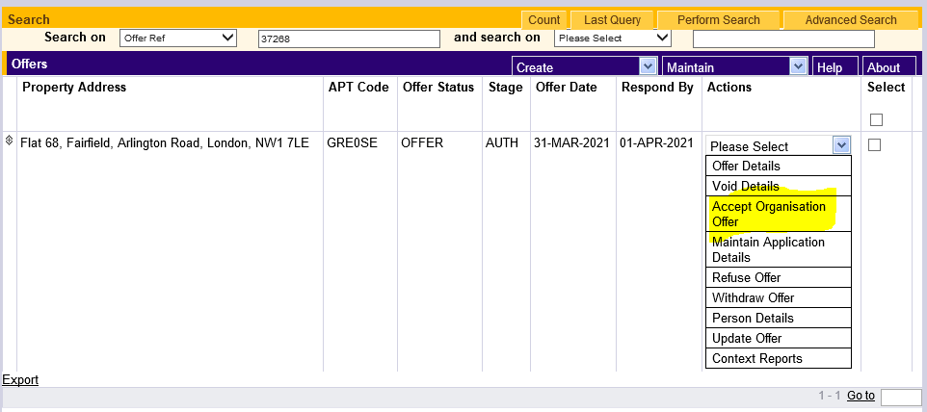
Click enter. Then next to your offer chose Please Select then Accept Organisation Offer. Click on save and this will amend the Offer Status to OFFACC

Slide 47
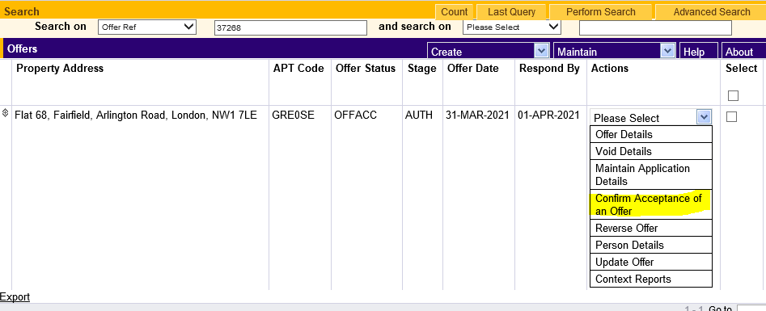
Setting a new tenancy date
Don’t end the tenancy of a transferring tenant moving to your patch. The tenancy will be ended by the NHO managing their old address when they hand in keys.
Find the offer, click on Please Select then Confirm Acceptance of an offer

Slide 48
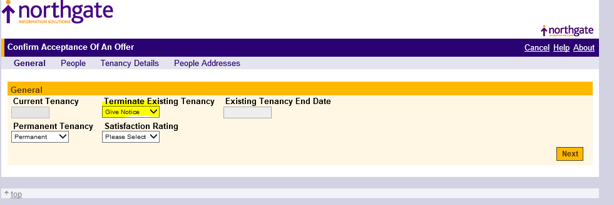
Chose Give Notice to Terminate Existing Tenancy and leave the Tenancy End Date blank.
Click next to fill out or amend household details then next again

Slide 49
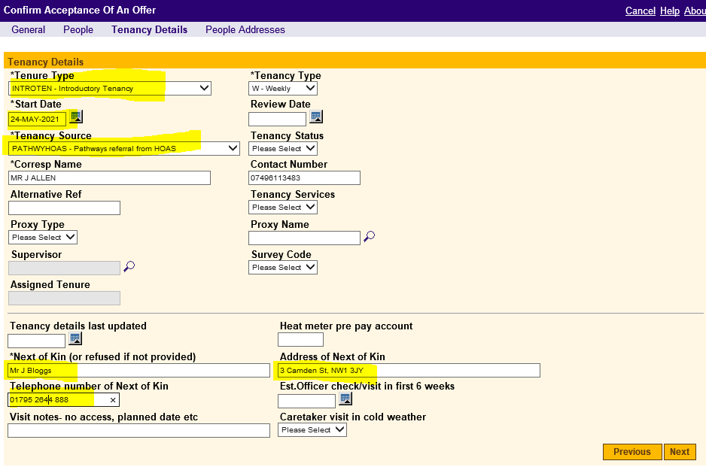
Check or complete Tenure Type, Start date, Tenancy Source, NOK details. Click Next then Copy For All on the following page then Save.

Slide 50
Keys returned and NOV signed
End tenancy on NG and add keys in date.
Change void status to NOD
Complete void referral context form and send to mailbox
Check void path has changed from INTR
Update elements (stairs, lift, bedrooms, heat type etc)
Keep in contact with void supervisor
If NO add new VIEW date 3 days away
Property handed back – change to CBL
Add void event VIEW with date 14 days away
Email results to allocations
Viewing
If YES progress to verification –allocations change status to
VERF
Viewing
If DOC arrange viewing with current NHO
Arrange sign up
Once verified (status = ACC, DOAC) check for offer number

Slide 51
Appendix
Virtual viewings – pilot of 40 properties following successful letting of 3 Garnett House.
Info shared on service launch workshops
Northgate voids guide
Voids management on the Hub

