Slide 1
Multi-disciplinary approach to domestic abuse
Promoting Joint working through a DVA and Housing lens

Slide 2
What is a Multi-Disciplinary Team (MDT) approach?
Tim Cosh – Service Manager Complex Families

Slide 3
Domestic abuse policy:
Our Policy Statement was published in January 2020 following endorsement by Cabinet.
It defines the Council’s ambition to be a place where domestic abuse is unacceptable and where equality and respect is a reality for everyone in their relationships. It seeks to protect and empower people to have positive life experiences.

Slide 4
The policy has five themes:
Prevent
Enforce appropriate action against domestic abusers, including using information and intelligence gathered by partner agencies.
Identify
Disrupt
Enforce
Prevent domestic abuse by increasing awareness across all parts of the community and empowering people to make positive life choices.
Support
Identify everyone affected by domestic abuse at the earliest opportunity, signposting and referring people to the right services.
Support those affected by domestic abuse to be safe and resilient.
Disrupt the behaviour of offenders and others affected by domestic abuse to make Camden a safe environment for everyone.

Slide 5
Shared Ambition:
We will take a multi-disciplinary approach, ensuring our services are accessible, approachable and easy to navigate, working as ‘one council’.” (support)

Slide 6
Mdt Support Strand Aim:
The aim of the cross- council review is to find new ways of ‘collectively managing the risk of domestic abuse’ by developing a new systems approach, with appropriate partners, to dealing with domestic abuse.
Support those affected by domestic abuse to be safe and resilient, including enabling others to provide support where possible.
Housing was identified as an area to prioritise and for Camden to consider its role as a landlord.
How do we support Survivors? And how do we hold perpetrators to account ?

Slide 7
What is a Multi Disciplinary Team ?
A Multi-disciplinary Team, is a group comprised of one or more professional disciplines who together make decisions regarding recommended interventions for survivors. It gives survivors prompter access to specialist input and provides more joined-up and tailored packages of support.
MDTs can have static membership but not be located together. Our membership of the DVA MDTs is an example of bringing skill sets together on a regular basis to review cases, ensure that information is shared clearly to assist with decision making and build stronger connections between different departments that work under different governance and leadership.

Slide 8
Mdt Support approach
Pull on existing practice within Camden
Build a sustainable model for future
Influence wider system and culture changes

Slide 9
What is a Multi Disciplinary Team Meeting?
A Multidisciplinary Team Meeting is a meeting of the group of professionals from one or more professional disciplines who together make decisions regarding recommended interventions for survivors. It was agreed that meetings would take place every Thursday between Nov – Dec 2020 for 2 hours. There have been 6 meetings in total.
Agreed that the focus of the meeting will be to reflect on 4 Survivors currently in the system that had been in temporary accommodation long term.
Agreed that this will be rolled out for a further 12 weeks from Feb 2021 to support new demand with a full review undertaken May 2021.

Slide 10
Survivor centred approach
Most important common guiding principle for all MDT regardless of organisational setting is a having a shared commitment to the delivery of persons centred coordinated care from the perspective of the individual
“I can plan my care with people who work together to understand me and my carers allow me control, and bring together services to achieve the outcomes important to me”

Slide 11
ambitions for the initial phase of the project
To positively impact on the quality of life and outcomes of the 4 survivors and their children.
To develop a clear flow chart from point of entry which aims to support and identify a clear and efficient pathway for all survivors within Camden.
Generate a deeper understanding of barriers that exist between services.

Slide 12
ambitions for the initial phase of the project
To assess the benefits of a MDT approach ?
To keep in mind the value, impact and challenges of perpetrator work.
To develop a training package for colleagues across Housing and Camden Safety Net based on the existing Resilient Families Programme model.

Slide 13
Membership:
Survivor
Neighbourhood Housing Officers
Homeless Prevention
Camden Safety Net
Housing Placements
Organisational Design
Accommodation Placement
Policy and Projects Officer
Transformation Team (Early Help Family Support)

Slide 14
Model of group development: Bruce Tuckman (1960)
Forming
Introductions
Ground rules
Storming
Communication improves
Individuals over group
Norming
Feel part of a team
See value in other viewpoints
Shared communication
Performing
Build Trust
Flexibility
Shared outcomes

Slide 15
Why an mdt approach WILL HELP WITH DVA WORK?
Promotes utilising knowledge, skills and best practice from multiple disciplines across service provider boundaries.
Helps reach solutions based on improved collective understanding of complex survivor needs.
Promotes a better understanding of the survivor and whole family need outside of emergency planning and response.
Shares responsibility for decision making at key and critical points.
Helps identify the person who has the key trusted relationship with the survivor.
Helps facilitate the sharing of key information across partners.

Slide 16
Why an mdt approach will help with dva work?
Reduces duplication and helps build trust and respect between professionals.
Fosters a positive, supportive team culture that creates an environment where staff can deliver high quality holistic care to survivors.
Survivors experience a coordinated seamless service this is centred on their voice and decision making, personalised to individual circumstances. Promoting independence and quality of life
Allows vision is to provide personalised care responding to the changing needs of survivors.

Slide 17
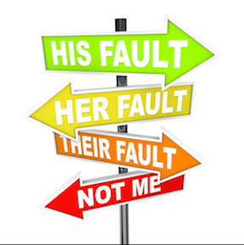
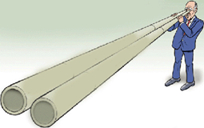
How minds work under stress
Notes:
#
Here are some of the ways of representing some of the states of mind that arise under stress – includes the modes from the previous slide in picture form! What can you spot?
Being certain (where actually it’s not possible to always know what others are thinking/feeling or what the best thing to do is etc).
Blaming – again, not really trying to make sense of behaviour, but getting quite simplistic about why things have happened or not…
Waffling– talking a lot and not really saying much! Maybe professionals are guilty of getting into this in meetings…..
Getting too quickly into action – rushing out to solve problems or fix things, without stopping to think and understand first
Becoming tunnel visioned or narrowed in our thinking, so that we stop seeing or thinking about the bigger picture
Burying our head in the sand (pretend mode) – i.e. disconnecting from the reality of the situation by denying/minimising/avoiding the real issues or how we might actually be thinking/feeling about things
Our sense is that it is inevitable that teams and workers will notice these states of mind happening in themselves or others on occasions (when emotions become intense) – it is likely to be functional that our brains kick us into these modes sometimes e.g. to have to be certain that there is a safeguarding risk and take action; to be able to switch off from a distressing visit in order to be able to move onto the next one etc. However, we would not see it as helpful for teams/practitioners to be permanently inhabitating these states of mind or for them not to be able to recognise and respond accordingly if they did notice that one of these states of mind had arisen. More on this when we discuss Working with your Team – one of the key quadrants on the AMBIT wheel throughout the week.

Slide 18
Challenges to mdt work
System and bureaucratic boundaries to access joined up specialised support
Cultural boundaries between teams
Funding and budgets
Not being able to look beyond ones area of expertise – become too focussed on our own area of specialism and reluctant to coordinate care outside our areas of expertise.
Focus on professional intervention rather than focussing on health and wellbeing, building competencies and self-care

Slide 19
Resilient family framework
RFF is Camden’s model, created by adapting and combining two approaches; the Family Partnership Model and AMBIT. Shared model of practice across Early Help and the Voluntary sector services in Camden

Slide 20
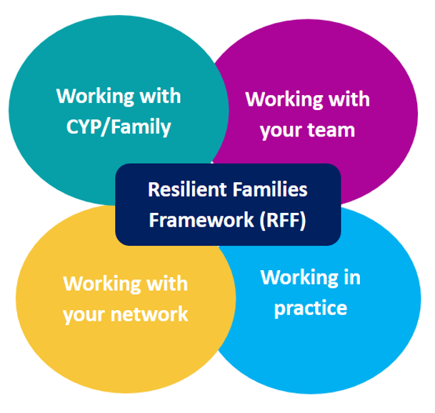
Notes:
Today is going to focus on the Team and Network elements of RFF.
As a recap from last time - RFF is Camden’s model, created by adapting and combining two approaches; the Family Partnership Model and AMBIT. Shared model of practice across Early Help and the Voluntary sector services in Camden.
The workshops focus on sharing the core ideas with you and giving you some time to practice using some of these elements. There are some practice integration workshops, that will enable you to reflect together on how you are implementing these ideas in your work post-training. There will be spaces in your teams to think about your team’s ongoing implementation and adaptation of the RFF ideas.
We will focus on sharing some of the theory with you today that underpins FPM (Constructs) and AMBIT (mentalizing). These are key ideas that help the rest of FPM/AMBIT make sense. We will be thinking about how these ideas apply in different areas of work – namely our work with families, how we work as a team and how we work as a network around the family, across the course of the workshops.
Some of these ideas may not be “new” to you – but what we are interested in here is supporting teams to be consciously applying these ideas in their practice. The work we do brings with it inherent challenges that can make it difficult for us to do “best practice” consistently. Think of this less about “learning something new” (although there may be aspects that are new, but a chance to think about expanding your team’s ability to ensure that these elements are visibly and deliberately incorporated into their practice.

Slide 21
The Resilient Families way of working is based on five principles
Relational - we place a high value on healthy, consistent, positive and helpful relationships, with families, within families and with each other. It means recognising that relationships are 'the most powerful agent of change’
Systemic - we don't try to locate a problem in an individual in a family. We try to look at the whole family as a system. We think about what has happened in that system in the past and what is affecting that system in the present to try and figure out "why now“
Reflective - taking the time to think deeply about what we are seeing and feeling to make sense of it - we are always curious and we always 'listen like crazy'.
Reflexive - being able to examine our own feelings, reactions and motives (our reasons for acting) and how these influence what we do or think in a situation, with families and with each other.
Restorative - thinking about our work as helping to repair harm, resolve conflict and restore relationships. We think all families have gifts and strengths and that their networks and communities can help solve problems.

Slide 22
What did we achieve and learn from the first set of mdt cases?
Michael Walsh – Organisational Design Team

Slide 23
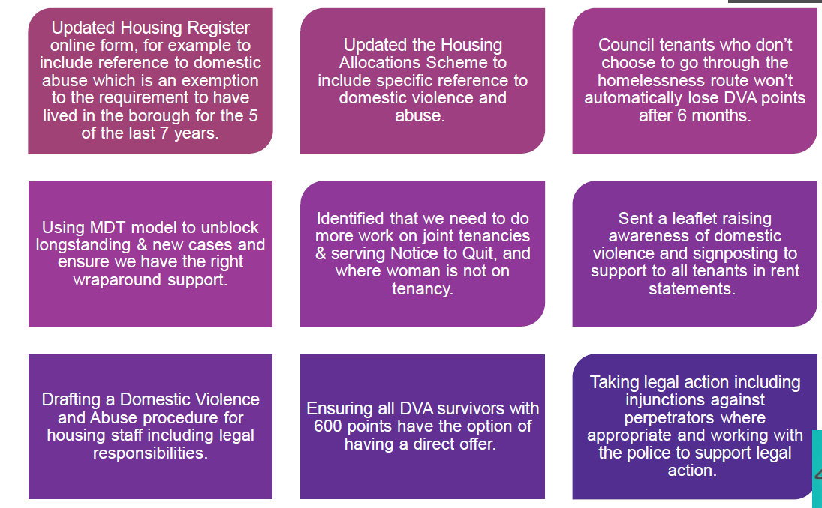
A quick bit about what we’ve committed to (and done already)

Slide 24
We looked at four cases where families had been in temporary accommodation for more than six months. One family had moved before we discussed them and one was in the process of viewing after receiving a direct offer.
Case 1
Tenant and 3 daughters living in 1 bed property (joint tenancy).
Wife was brought to UK from Sudan.
Experienced years of physical abuse and financial control.
Husband threatened his children and to take their three daughters back to Sudan for FGM.
Over 12 months in TA at a cost of £15K.
Survivor made direct offer, husband to become sole tenant.
Issues – was unable to get right legal advice to end the tenancy
Case 2
Tenant and adult daughter living in 1-bed property (joint tenancy)
Survivor works locally and daughter has MH issues
Long history of coercive control that led to physical attack (strangulation) when she tried to leave – socially isolated
Husband not aware of domestic abuse behaviour.
Over 9 months in TA at a cost of £12K
Direct offer made, NTQ issue to be tackled, further discussion about husband
Issues – Survivor very anxious about issuing NTQ, delays in rehousing due to this.
All four cases were discussed for learning purposes …

Slide 25
What did we learn?
How we work
There are some myths and preconceptions about what can and can’t be done e.g. holding two tenancies, advice around NTQs
We could do more to help NHO's develop their knowledge domestic abuse and what can be done
We should do more to avoid single officers holding the burden of the case
Perpetrators
We don't have any guidance or agreed working practice around how to tackle abusive behaviour.
We prioritise helping the survivor as a separate issue to dealing with the perpetrator.
Survivors may also be reluctant for us to take action
Sometimes it maybe the best option to allow the perpetrator to stay in the property.

Slide 26
Policy and Procedure
There are usually contextual reasons why people aren't cooperating with the system e.g. changing phone numbers to avoid being harassed, wellbeing stresses, fearing for their safety.
People experiencing trauma aren't always able to follow our processes e.g. bidding, getting legal advice etc and need more bespoke help.
Hand offs and communication between various teams cause misunderstandings and delay.

Slide 27
What we want you to do
Contact Camden Safety Net with any new cases of domestic abuse – they can help!
Contact Scarlett, Tim or Mike to arrange for your case to be discussed at the MDT.
Contact Rose Mullahy or Tara Cookson if you need some informal advice around domestic abuse cases.
Log any new cases as domestic abuse where appropriate.
Check in on old cases still open – ask for help if you need it.
Monitor any cases where someone is in TA closely and pull help if necessary
Let us (managers, MDT) know about challenges you face with this work.
Undertake the e-learning module on domestic abuse.
Help feedback about new procedure – what do you want from it?

Slide 28
Any Questions, comments or thoughts?
Starter for ten … what would a new procedure provide clarity on?

