Slide 1



This slide has the early help logo (triangle and words combined), and the words and triangle as separate images

Slide 2
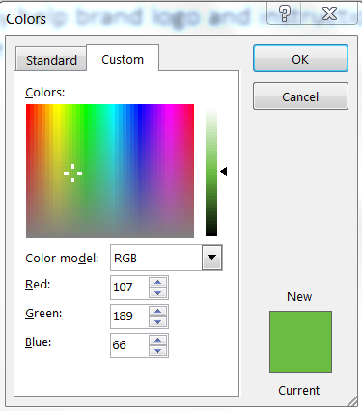

Early Help Uses a specific colour palette. You can recreate it yourself, using these custom colours.
(the screen shot is to show you how to create the custom colours – click font, then font colour, then more colours and you should get to this page. Got custom and change the boxes marked red, green and blue)
Early Help Colour Test
Early Help Green
  Red: 107
  Green 189
  Blue 66
Early Help Pink
  Red 244
  Green 125
  Blue 124
Early Help Orange
  Red 248
  Green 166
  Blue 45
Early Help Blue
  Red 75
  Green 171
  Blue 199

Slide 3

This slide has combined triangles and individual triangle (you can use these as bullet points for example

Slide 4


