Slide 1
`Tree of Life’
Notes:
My experience – Refugee team

Slide 2
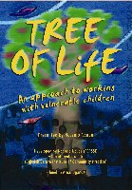
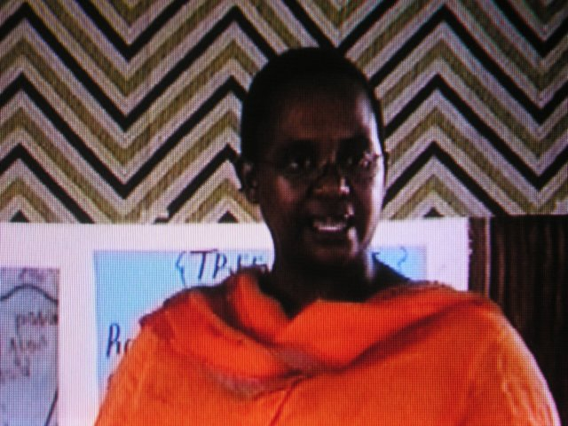
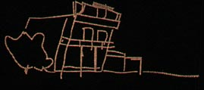
The Roots of the ‘Tree of Life’
Developed by Ncazelo Ncube (ncazelo@repssi.org)
& the Dulwich Centre (www.dulwichcenter.com)
Ncazelo works for REPSSI, a regional capacity organisation working in East & Southern Africa to enhance the provision of psychosocial care & support to children affected by HIV/AIDS, poverty and conflict

Slide 3

Narrative Therapy
Developed by Michael White & colleagues at the Dulwich Centre in Adelaide
Influenced by M. Foucault & Social Constructionism
  Language constructs experience
  Attention to power
Post-modern approach
Paulo Freire: ‘Telling our stories in ways that make us stronger’
Notes:
3

Slide 4
Narrative Therapy…
People are experts of their own lives.
Views problems as separate from people and assumes people as having many skills, abilities, values, commitments, beliefs and competencies that will assist them to change their relationship with the problems influencing their lives.
Stories in a ‘narrative therapy’ context are made up of events, linked by a theme. These stories both describe and shape people’s perspectives on their lives, histories and futures.
Practitioners engaging with narrative ideas and practices work alongside people in resisting the effects and influences of problem stories and deficit descriptions. In therapeutic conversations this involves listening and looking for clues to knowledge and skills that run counter to the problem-saturated story. With curiosity and exploration these preferred stories and accounts of people’s lives can become thickened and richly described.
The focus is not on ‘experts’ solving problems. It is on people co-discovering through conversations, the hopeful, preferred, and previously unrecognized and hidden possibilities contained within themselves and unseen story-lines. To this end, those interested in narrative practices collaborate with people in ‘re-authoring’ the stories of their lives.

Slide 5
Dilemmas & Challenges | Things to consider…
Revisit loss and listen to painful stories can be re-traumatising – problem saturated | How can we change the narrative/story about their lives? First story – devoid of hope Second story development, emotional safety (Skills, hopes and dreams)
Unable to sustain preferred ways of living | ToL allows distance between themselves and the problems – they experience control and are able to do something
Conflict with their families – alienating young people from their families and communities | How clients be effectively supported without separating them from their families, values and cultural norms?
How can the support move from ‘having a nice time’ to meaningfully assist clients to take steps in shaping their lives and future? | Thinking about goals – ways forward utilising their strengths

Slide 6
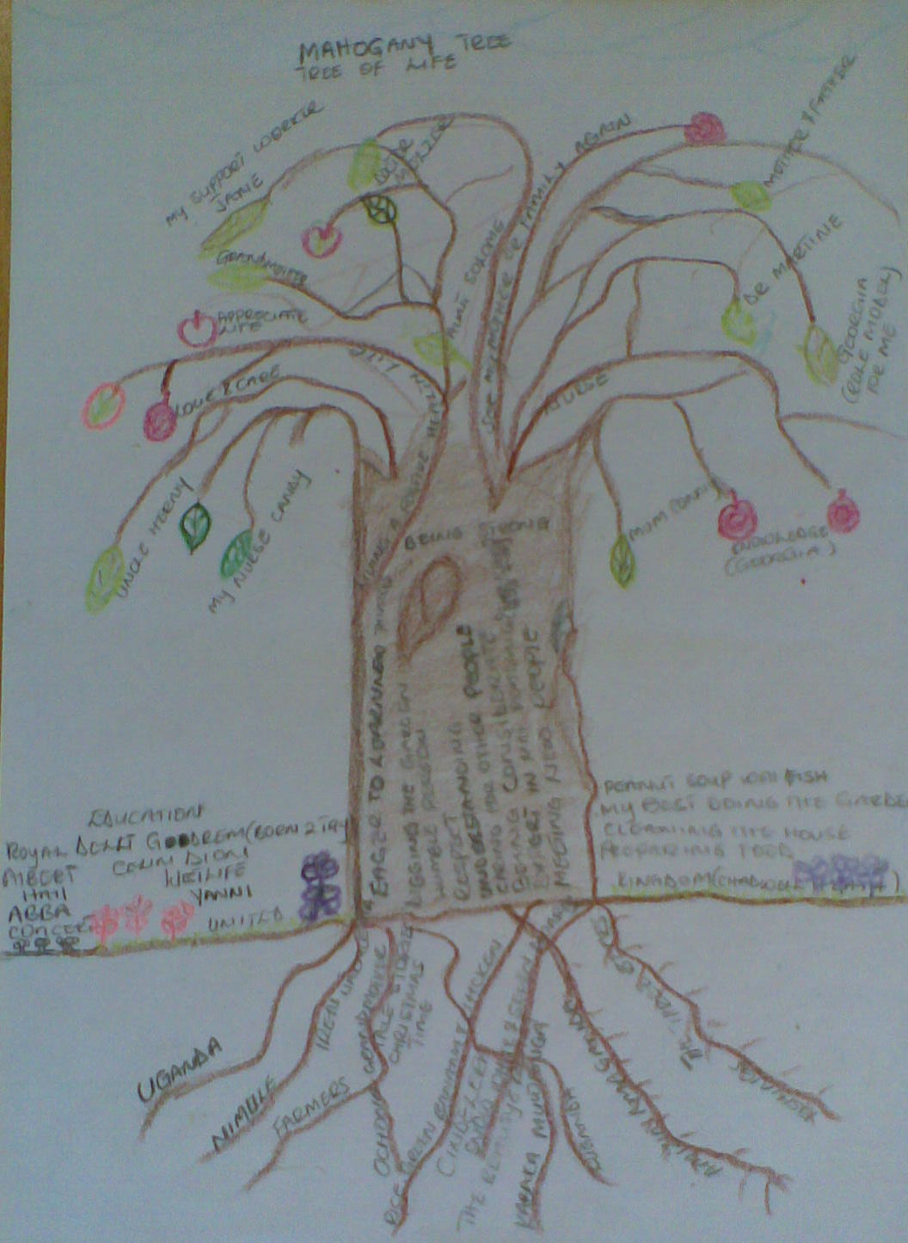

The Tree as a Metaphor
The Roots = your roots, heritage, family, those who have taught you most in life
The Ground = where you are at present, e.g. where you live, daily activities
The Trunk = your skills & abilities
The Branches = your hopes, dreams & wishes
The Leaves = important people in your life
The Fruits = gifts you have been given
Notes:
6
6

