Slide 1
Moving in and out: Voids workshop
Cath Armstrong and Dave Warren
24th and 25th September 2019
Notes:
Medium
Introductions
Who has dealt with voids?
Run through of high level process. Some slides were prepared by Holy McGivern - project lead for the Llord review now off work. Any jokes hers. Any Qs we can find out answers later
Worked on the hub. All on hub. May refer to this a couple of times. We can look if time at end
Comfort break half way through if people wish

Slide 2
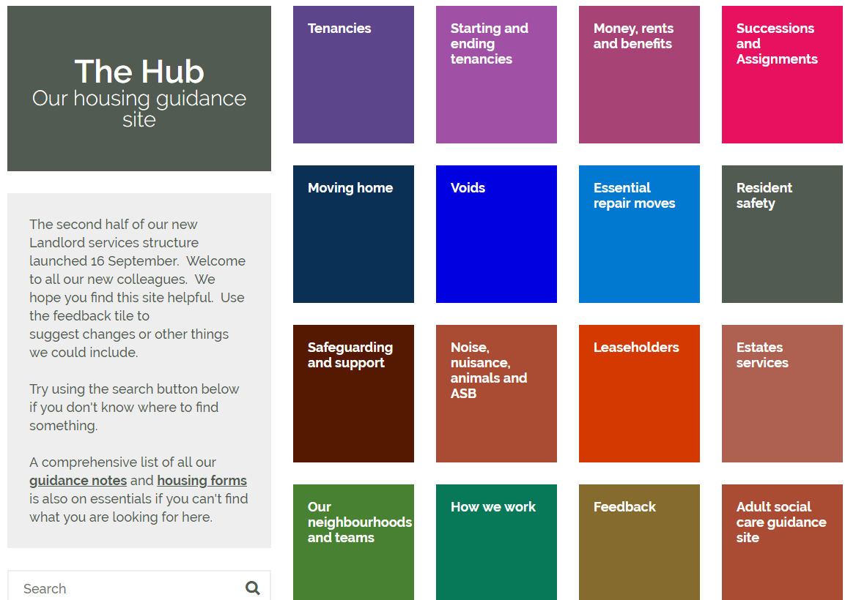
The Hub
Notes:
Tile for voids
Search
Managers want this to be your first point of contact… before asking someone else.
Give example of email to Angela re CBL

Slide 4
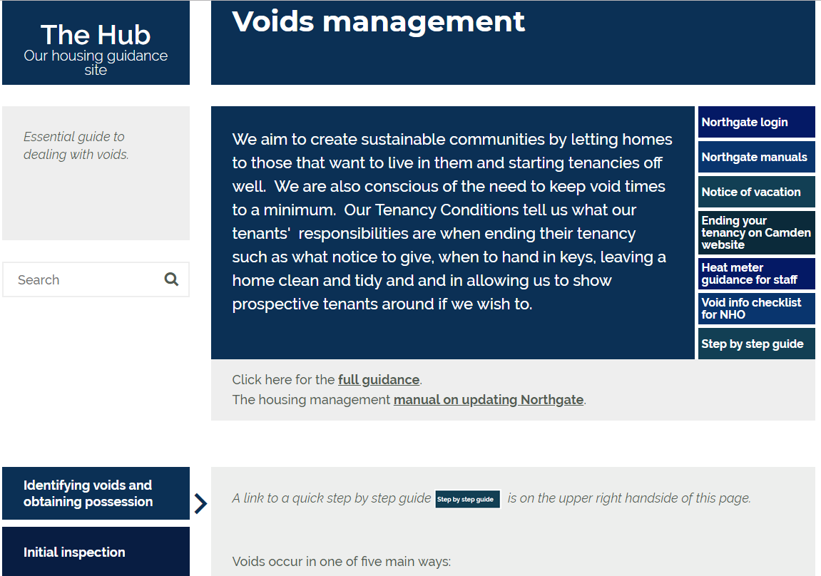
Notes:
In particular
Full guidance and manual on updating Northgate
Notice of vacation
Heat meter guidance
Void info checklist
Step by step guide

Slide 6
Why is letting voids important?
Housing crisis/lack of affordable social housing
Rent loss
Vandalism
Squatting
Reputation of the Council
Lots of other reasons
Notes:
1 - e.g. homeless, people overcrowded or under occupying, people bed blocking, temp accom
Rent loss
3 - Empty homes can encourage vandalism and theft for example, boiler theft, fireplace theft.
4 - Squatting - less common now but still occurs, possibly just a one night stay.
5 - Reputation of council - e.g recent FOI
6 - Lots of other reasons - e.g. neighbours can get worried if a neighbouring flat is empty. Pests (pigeons).

Slide 7
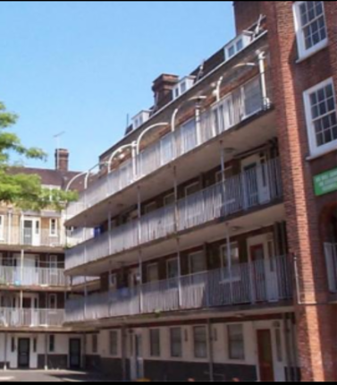
The right people, in the right homes – set up to succeed in their tenancies
Notes:
Review outcome - we want to set people up in their tenancies and off to a good start giving them the support they need to do this.
The void process is an ideal opportunity to have an early dialogue with new tenants.
However, can be tricky though as it covers 3 different services. Ourselves, repairs and housing needs.
An outcome of the review and how we work we think pulls these services together more closely.
We want to do the work that's needed when it's empty as this should be cheaper over time. In the old system 76% of voids needed repairs after letting.
This will lead to fewer rent arrears from the start of the tenancy, fewer requests to move and less failure demand. Takes more time at the start of the tenancy to do this.
Money, health and risk often missed in the old way of sign-up

Slide 8
Flow of work
Person gives notice they are leaving home
Visit and understand property; conversation about logistics; specify works to be done
Keys to void trades
Work done
Keys back
Tenancy starts
Keys in
Find suitable new tenant with housing need, set up with what they need to succeed
HNG officer advertises (if CBL), shortlist and verify as required
‘End to end’ ownership by Neighbourhood Housing Officer, pulling in support as needed
District Voids Supervisor liaises with contractor and trades, modifying specifications as required by new tenant.
Works completed by trades
Notes:
High level flow chart. We will go into this in more detail.
Once you've had a look and (possibly) arranged storage (more of that later) it is passed to the voids surveyor who specifies works.
During this period, and in conjunction with the voids surveyor, the property may either be advertised under CBL or made a direct offer. The advertising and making of offers is done by the housing needs service.
Surveyor may modify spec depending upon new tenant
End to end ownership - NHO

Slide 9
Keys in/ notice received
Tenancy conditions say should give 4 weeks notice (with exceptions).
If we get notice that someone is leaving (or has died) – add expected end date to Northgate (not transfers).
Be flexible with notice and discuss clearance;
Keys come in – tenant is given a notice of vacation (NOV)
End tenancy on Northgate, and collect keys (5PS);
Set up as a case on Landlord Case Management.
Confirm void on Northgate
Notes:
2 - In a lot of circumstances we know when someone is to leave – transfers or people tell us. In 2018/19 about 40% of people moving, for example, were transfers
4 weeks notice but not transfers or moving to resid care – all on Hub
3 - e.g. someone might be moving into the private rented sector and be put into a position of being charged 2 rents at once (HB/UC)
Clearance – encourage people to clear (website has some info on this).
Dialogue with outgoing tenant
4 - Notice of vacation – collects forwarding address, possibly meter readings and gives permission to dispose. Signed and dated and we date stamp – given to tenant as evidence.
4 - Normally people sign a notice of vacation when they hand in keys and doing so gives us permission to clear anything they leave behind. Be careful if they don’t – legal obs. Can’t just dispose of stuff , e.g. eviction/abandonment. May need to store for a period of time while we try and find them to serve notice. All on the Hub.

Slide 10
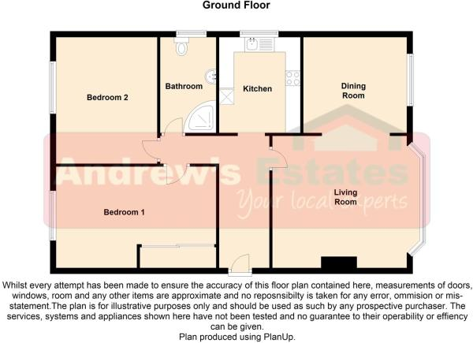
Visit/ Understand Property
Purpose: to see the home, understand the property, who would be suitable, neighbours if appropriate.
Notes:
Suitability of incoming tenant - is this for example a block with predominantly older residents
Is it one that you may have a tenant identified who needs to move – ESR – that it would be suitable for
Should it be sensitively let? where there has been ASB, or a partic reason we might want to exclude certain people for bidding. Process is on the Hub.
Could it be reconfigured?
Has it already been adapted?
What had been left behind. Do we have permission to clear everything? If, not, take photos of what has been left behind and refer to the Hub for what to do next
If people leave furniture in good condition or carpets we may want to recycle it to the incoming tenant. Let the surveyor know
As well as the above you need to collect the following details for Northgate….

Slide 11
Void elements and other info
No of double bedrooms
No of single bedrooms
Floor level
Is there a lift?
Garden type
Does it have it’s own entrance?
Internal steps within flat/house
External steps
Heat type
Also – if you can easily find and read the gas and elec.
Void info check list for NHO on Hub
Notes:
to help you remember there is a link to a blank word doc on Hub
Add elements to Northgate

Slide 12
Complete void form for voids supervisor
Notes:
Can now be run from Northgate.
I can show people how if useful.

Slide 13
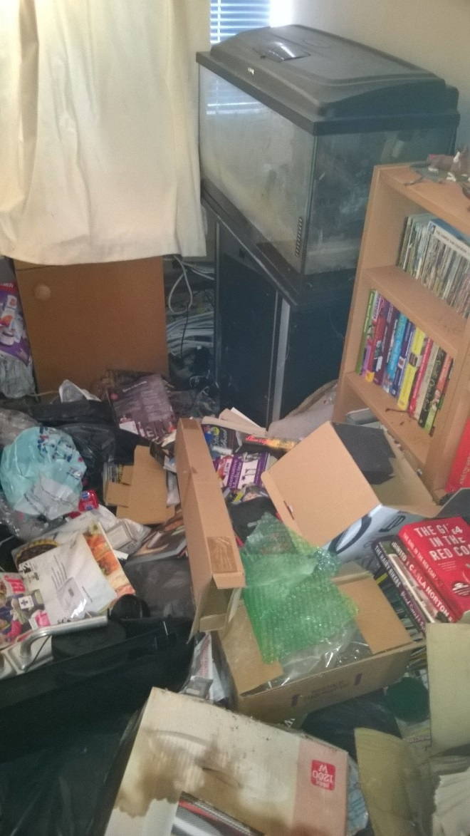
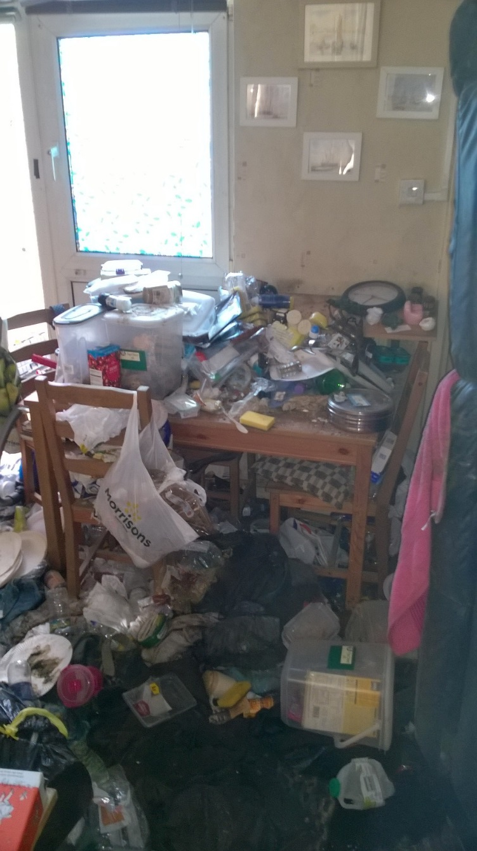
Conditions
Notes:
There are varying degrees of conditions that properties come back in – most require clearance, but we predict this will decrease over time for tenants moving between properties.
Take photos.

Slide 14
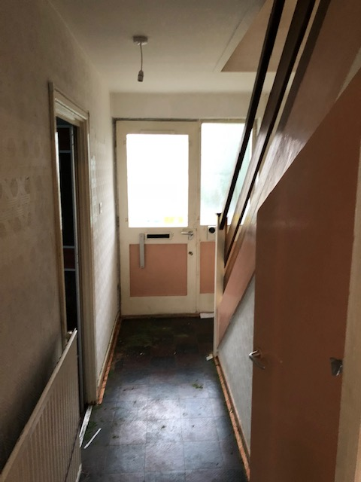
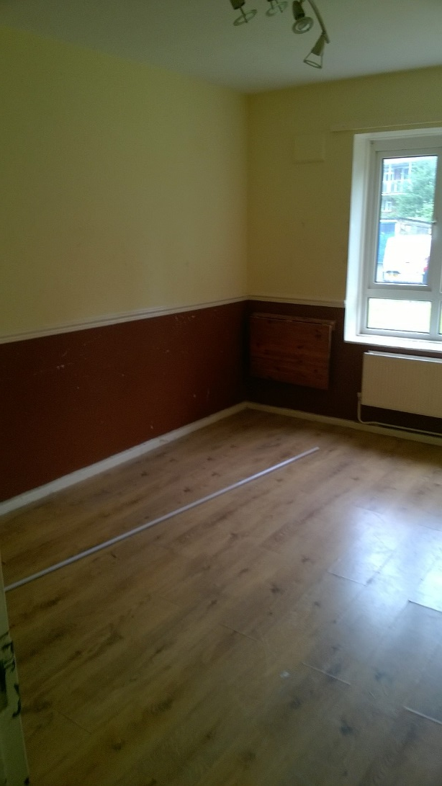
Conditions

Slide 15
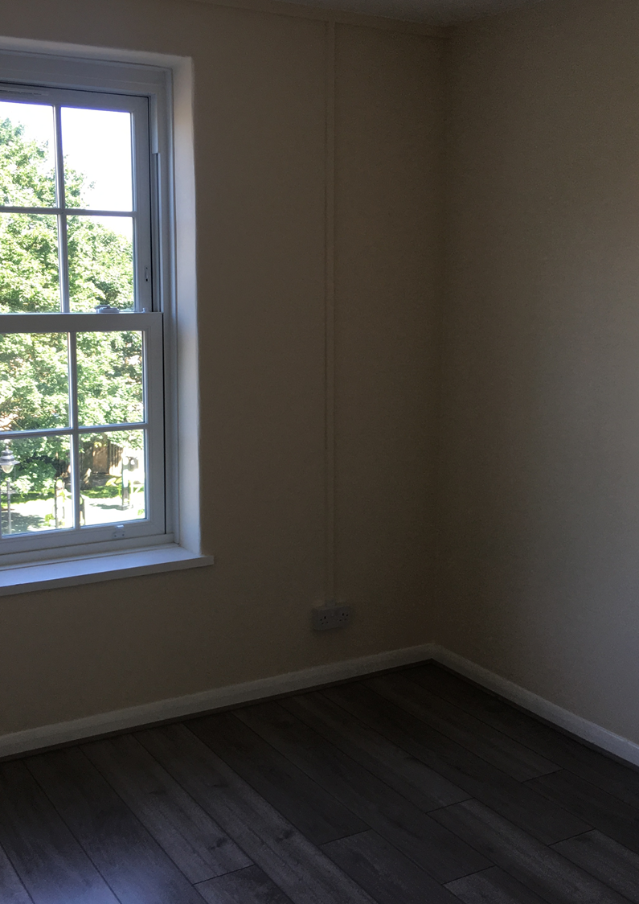
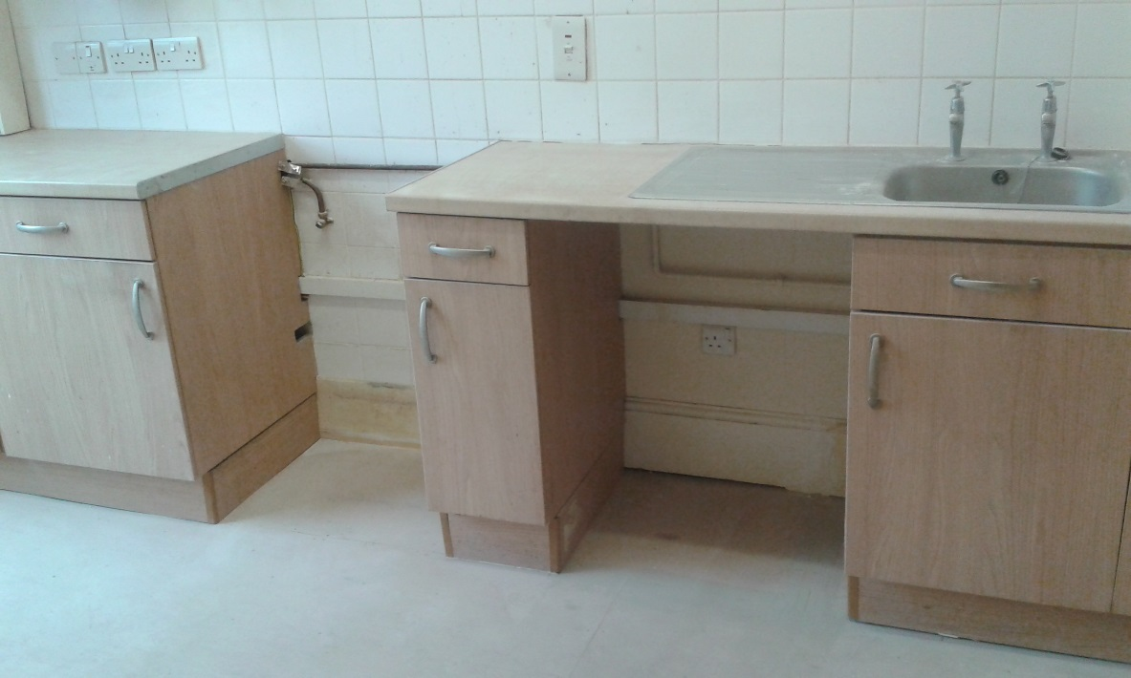
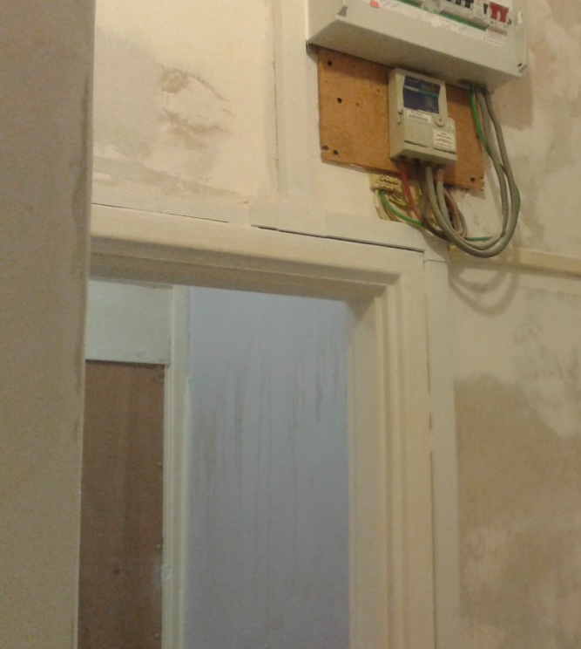
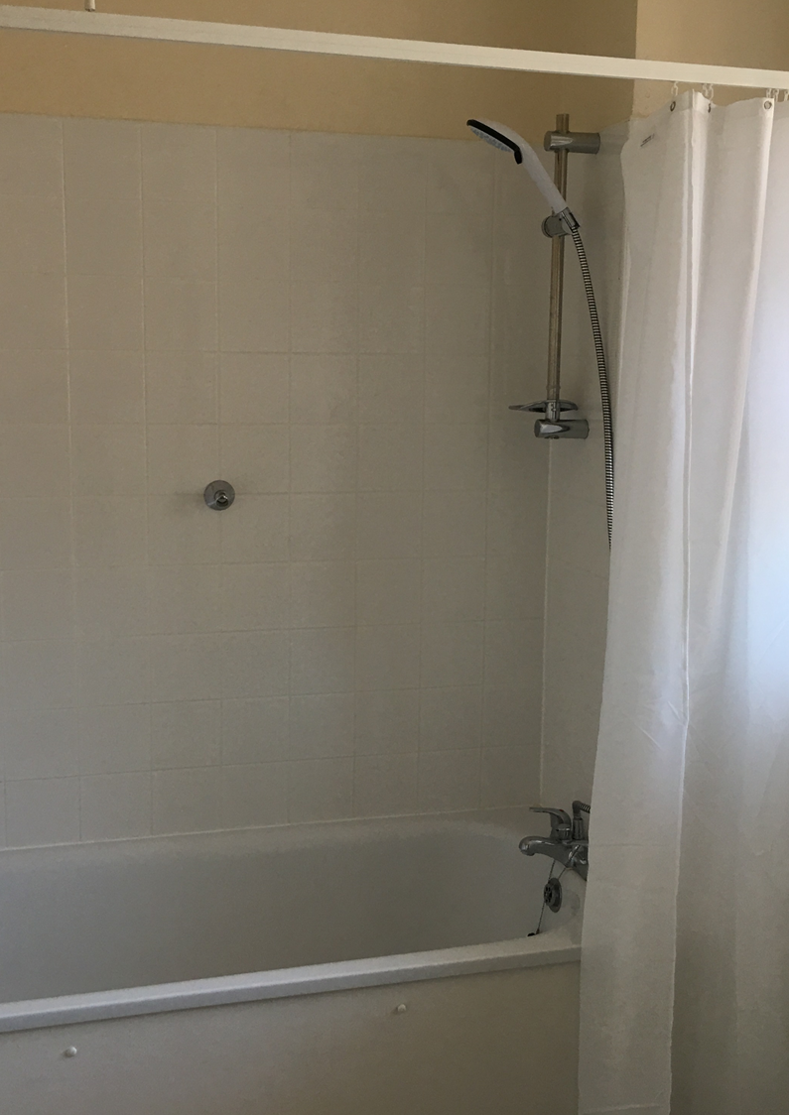
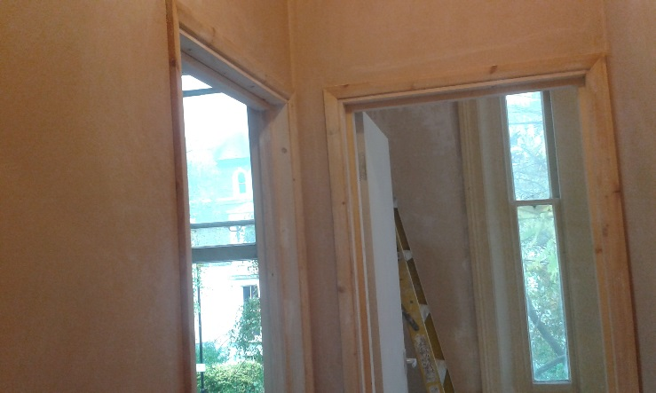
Works ongoing - Completed
Notes:
Letting - Voids Supervisor and NHO to link in throughout works.
Does tenant want to view before decs done and choose paints etc.
2 week turnaround for advertising. “When’s best to advertise? Check if it’s a sensitive let that it will be advertised as such

Slide 16
Making offerable
Notes:
Done in conjunction with voids supervisor during works if possible –
Is this a direct offer or to be advertised? CBL or OKOF
Generally advertised unless a direct offer identified by housing needs.
Or you identify one via Angela (you all know - all on the Hub)
when is right time to advertise? 2 week lead in.
Done by NHO

Slide 17
Advertising
Notes:
Through Home connections
Allocations pick up NG update and advertise with closing date, ad runs Thurs to Mon. then shorlitst – about 2 weeks from making property offerable
Allocations scheme applies – highest bidders get shortlisted

Slide 18
Shortlisting/ Viewing
Notes:
Co-located HNG pull shortlist
Arrange viewing with void supervisors
Viewing – generally in groups. NHO decides how many at any one viewing.
opportunity to meet incoming tenant at the earliest opportunity
Conversation about property nuances – eg. Low water pressure at Kenbrook.
Verification – some will fall out – 95% need verifying at point of offer – co-located.
New tenant checklist

Slide 19
New Tenant – new home
Notes:
Works completed
By now Initial money conversation about rent, expected bills and income/ benefits, acceptable behaviour/ flooring. Use New tenant checklist to help – starting tenancies bit of the Hub.
When can they move?
Tncy extensions – no longer need NM approval but still need to go to Rents
Sign tenancy agreement
Sort out HB if appropriate
Setting up rent account early before tenancy starts
Updating NG

Slide 20
Who does what?
Neighbourhood Housing Officer – Moving in/ out | Understand property as home Point of contact whilst works ongoing Updating Northgate with key stages, including adding in an expected end date, ending the tenancy, when to advertise, when prop accepted, tenancy date Viewings Setting up new tenant cleanly in new home Monitoring moving in cases on Landlord Case Management
District Voids Supervisor/ voids admin | Managing works in properties on redesign patch with contractors/ trades Linking in with Neighbourhood Housing Officer about live works progress and timescales. Decorating allowances if applicable Updating Rapid (Repairs) with live notes
HNG Officers | Linking in with Neighbourhood Housing Officer when property ready for direct offer or advertising Advertising Pulling shortlist (Tuesday morning) Contacting bidders Verification Updating application on Northgate – e.g. Offer
Neighbourhood Housing Managers | Monitoring overall voids in each area – Qlikview and both Rapid systems Spotting patterns and trends in performance, unblocking system barriers – e.g. key issues.

Slide 21
Any Questions?
And Homework……
The Hub
Notes:
Visit a void on your patch in conjunction with voids surveyor
Look at the Hub
Read the voids procedure

