Slide 1
Facilitating Reflective Practice Sessions
Team Manager Workshop
Emma Haigh
Gemma Mitchell
Holly McGivern

Slide 2
If you talk to someone about a dilemma, and you find it a helpful conversation, what has the other person done, or shown you, within that conversation?
Notes:
10mins (5mins in pairs, 5mins feedback) This gives them an opportunity to experience the small – to – large group issue discussion process.
Write up ideas on flip chart
e.g.
They’ve listened
They’ve asked questions to aid their understanding
They’ve not just told you what to do
They’ve paid attention to how you’ve felt
They’ve offered some tentative ideas or opinions
They’ve been non-judgemental
Etc…
So: What does reflective practice mean?

Slide 3
Team Case Reflection Roles:
Facilitator - likely to be the neighbourhood manager to begin with, but could be any team member in future. Sometimes it might help to request a facilitator from outside the team (e.g. a systems thinking officer / Gemma for a MH related case)
Note taker (flip chart or laptop connected to big screen)
Presenter
The Team - Everyone else is there to listen actively, help the presenter to explore different perspectives and offer ideas and insights

Slide 4
The reflection session:
Presenter shares the story of the resident, and says what they would like the team to focus on. 15 mins.
Facilitator ask questions of clarification 5 mins.
‘Fishbowl’ conversation between other team members 20mins. (Presenter listens to this and does not say anything). See guidelines on making reflections.
Presenter reflects on what they have heard in the discussion, what ideas stood out to them and how these ideas will be taken forward for action. 10mins
Notes:
A one-hour process. 45 today
Facilitator needs to time-keep.

Slide 5
Facilitator Role:
Ask the presenter to talk about the case, using the supporting sheet, if helpful.
Ask: ‘If we’ve had a useful discussion, what have we talked about? What is clearer to you? What are you able to do?’
Summarise what the presenter would like clarity on, to check shared understanding
Notes:
Present: 15
Clarify: 5
What have you already tried?
What ideas have you already had?
for any examples that might help understand the situation
Widen the system
Who else is involved, concerned, significant?
Who else has a view?
What might they say about this…?
How would you like the reflecting team to focus now? (remind of the dilemma)
Reflect: 20
Presenter reflects: 5
What has stood out to you from today's discussion?
What particular ideas were most interesting to you?
How will these ideas play a part in your work?
Observers reflect / other reflections from the group in terms of the process rather than the content.

Slide 6
The Reflecting Team Role:
Listen:
To the presenters’ language
With curiosity, avoid knowing too quickly
For achievements, successes & abilities, rather than problems
For resources in the system / network
For different positions and perspectives
Don’t start planning solutions
Note what you are learning from the presenter

Slide 7
Clarifying Questions
Ask: What have you already tried?
Ask: What ideas have you already had?
Ask: for any examples that might help understand the situation
Widen the system
Ask: Who else is involved, concerned, significant?
Ask: Who else has a view?
Ask: What might they say about this…?
Ask: How would you like the reflecting team to focus now? (remind of the dilemma)
Notes:
These are suggestions or ideas about the sorts of questions that could be useful to ask to get deeper into the dilemma and case.
It can help uncover areas that it could be helpful to find out more information about even if the presenter does not know all the information about a case.

Slide 8
The Reflecting Conversation:
Point out achievements, abilities and competencies
Use presenter’s language
Speak about everyone with positive regard, as they are trying to cope (avoid blame or criticism)
Offer multiple perspectives
Include all members of the system
About relationships (what’s the pattern of communication between people?)
Not too unusual – keep to what was said and heard (avoid interpretations)
Recognise the effect of a communication by one person might bring about a variety of responses from others. And these responses will in turn, effect others (notice the circularity of communication).
Express in terms of what people do, think & believe, and feel, and not what people are (avoid labels & diagnoses)
Acknowledge how the presenter might feel, reflect back to them that it seems that they might be feeling ___ e.g. worried, stressed, frustrated etc
Do similar or different experiences come to mind as the presenter has been speaking?
Connect with own experience and what learnt from the presenter
Notes:
The remaining team members can a conversation together, with the presenter just listening.

Slide 9




Thinking Space - System of work
Notes:
Discussion space?
Holly – 2 jobs – doing the work and learning from the work
Start with one case/ barrier/ trend
How typical is this?
What is the impact of this
TSP?
Problem solving framework – session on barriers coming up
How reflective practice has shaped our work design so far

Slide 10
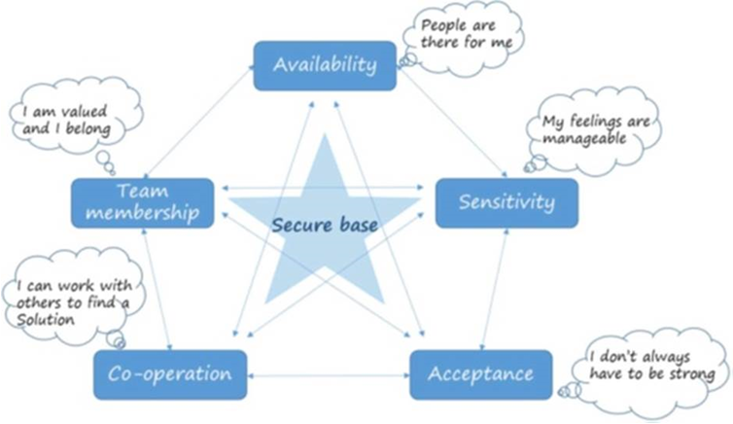
Why be …?
What is the effect of being …?
How do we show we are …?
Available
Sensitive
Accepting
Co-operative
Part of a Team
Notes:
Emma – 5-10mins
Referring back to the idea of establishing the Team as a Secure Base discussion at Workshop #2…
Availability - Regular and repetitive opportunities for team to meet and reflect, Formal and informal, In person and via other avenues.
Sensitivity - Staff need to feel heard and understood, which means feelings can be managed more effectively. Supervisors and managers to be ‘tuned in’ and sensitive to what team members might be feeling and thinking. Validation of feelings "I can hear that you are feeling xxx”. Checking in with people – “how did that make you feel?” “What were you thinking when that happened?”
Acceptance – positive feedback, feeling not-judged, Regular opportunities to review the work they are doing
Co-operation - When colleagues and supervisors provide opportunities to work together, this helps facilitate independent but supported practice. Practice improves through sharing ideas with experienced colleagues. Staff value collaborative styles of supervision - promotes feeling heard - rather than receiving instructions or reprimands. Asking questions rather than giving answers.
Team Membership - feeling that the team care for staff(everyone), Regular and frequent contact with each other to help deal with feelings of isolation, Reflective group supervision provides an opportunity for creating team membership and learning from one another.

Slide 11
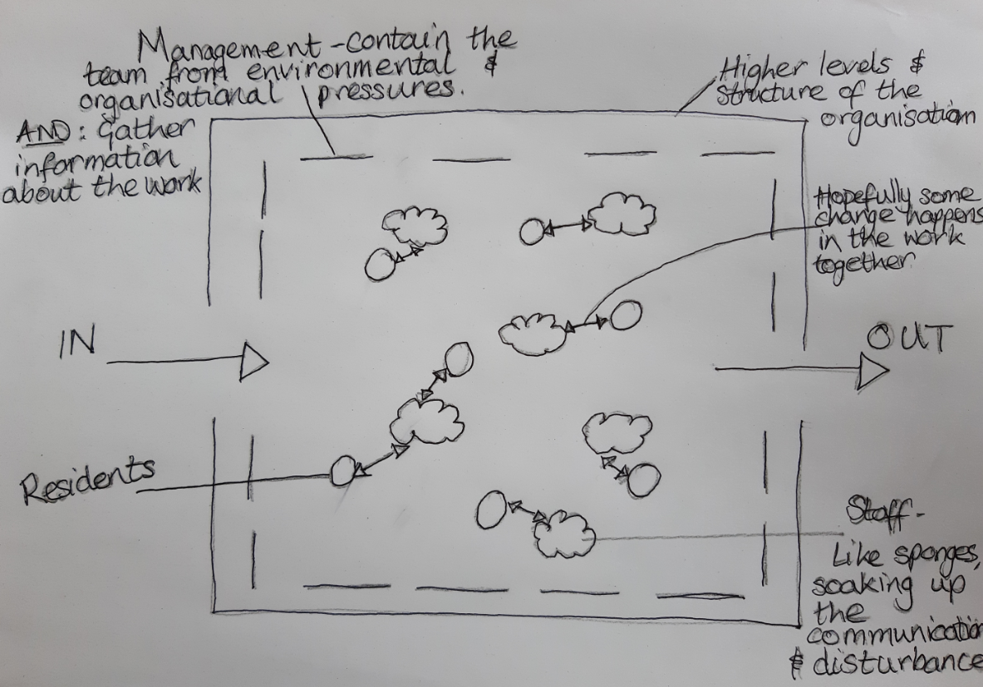
Notes:
Gemma – 5-10 mins
Here we have a drawing of the system.
We have work flow coming in – residents (circles) connect to their NHO (sponges) - and we hope that this is where the work happens. We want to build a relationship with our residents, so that we are able to have some effect on them / their lives and circumstances, and then the work comes to a close (out).
Because of the nature of relationships and being human, this effect does not just happen in one direction (two way arrows) – our residents will effect us, as we hope to effect them.
Our NHOs will experience sometimes strong feelings and uncomfortable thoughts in response to the residents they work with and the circumstances of their lives they are in touch with.
We have to pay attention to the human realities of service provision – the work might effect staff’s capacity to think about what they are supposed to be doing and remain emotionally available to engage in the work…
Like Sponges, Front-line staff are ‘permeable’ to the experiences of the residents’ lives. We need to provide opportunities for thinking – this looks like a conversation.
We need time to think and reflect on what residents explicitly communicate, and how we can be left feeling, and the thoughts we can be left thinking, once we've spent time with them.
When we attempt to think together (through CONVERSATIONS) in a team, (when we try to understand what is going on for a staff member in their relationship with a resident), it becomes possible to translate this information and understanding into decisions designed to help people using the service, as well as develop our staff.
Reflective case discussions can help us consider how to thoughtfully act in response to a resident / situation.
The experiences of the team can be seen to be a representation of the experiences of the residents. This is useful information.
As a manager, it is therefore helpful to gather information from the team as a whole about the experience of the work.
Ideally the manager is also present to pick up the feedback from the impact on the staff, which can help managers make useful decisions. “I wonder what this means?”… and they can gather information to help them update the system of work.
The outer boundaries are the higher levels and structure of the organisation. The role of Neighbourhood Team Managers (dash - - line) is to act as a filter - to pass up the information from the team to update the organisations' system of work, as well as to contain the front line staff from some of the environmental and organisational pressures.
Bion’s ‘container’ – The team can act as a container (not the job of the team manager alone) for the confusing, challenging communication and lives of the people we work with.
Within this container, relationships occur - our work is done through communication, talking, modelling behaviour, listening to our residents.
We need time to make some sense of what they communicate to us.
This is why it's important to consider the impact of the work on individuals and the team.

Slide 12

“I don’t know, I really don’t know”
Notes:
“The greatest gift a manager can give to their staff team when they are clamouring for an answer is to say ‘I don’t know. I really don’t know’ and then to remain silent and stay with the anxiety that follows. Out of this anxiety comes possibility and, above all, thinking”
A highly important ability to hold the tension of being at the edge of knowledge and understanding
An especially important and difficult position for a manager to take up, when the pressure to ‘do something’ is almost unbearable at times.
The team will look to their manager to rescue them from anxiety

Slide 13

Underlying Principles and approach
Notes:
‘Not knowing’ what to do is a helpful position to find yourself in
Curiosity - to explore an issue, hold own ideas 'lightly' and flexibly
Checking in at the beginning of the conversation to ask what practitioners would find useful from a conversation
We’re attempting to ‘make meaning’ - “what does this mean?”
Offer tentative and speculative ideas (avoid giving advice, instruction or an expert position)
Asking questions rather than giving answers or suggestions
We are sharing experiences with each other and talking about what it is like to do the work that the team does.
Hold an attitude of learning
Asking questions rather than giving answers – Examples:
what ideas have you already had,
what have you already tried,
what might other people in the network think/suggest?”
I wonder what the effect would be of doing XXX, or of trying YYY?
I wonder how things would change if XXX happened, or if YYY did this …?
One idea that has come into my mind is ZZZ
It makes me think of a similar situation I had, and I did ZZZ, which had this effect …
When someone is sharing their experience of the work, do not make suggestions.
We are sharing experiences with each other and reflecting on what it is like to do the work that the team does.

Slide 14
How to encourage reflective thinking together

Slide 15
Thinking Together
      A 4-step process, to support workers to regain their capacity to mentalize
      A process that teams “sign up” to using to help each other with the work
        Marking the task
        Stating the case
        Mentalizing the moment
        Return to Purpose
Notes:
15
Describe Thinking Together and ways in which this might link to some of the reflections raised by watching Thinking Apart

Slide 16


Thinking Together
Marking the Task
Helper says “Let’s mark the task. What do you need out of this conversation?”
Enables the helper to be better able to help
Marking the task might take time – the worker might not know immediately
The helper might have to be strict – the worker may want to get on with telling the story!
Notes:
Sometimes well-intentioned helpers have their own ideas about what would help their colleague. Unless there is explicit discussion about what help is being sought at the beginning of the conversation, these interactions can easily go off track: the helper thinks that their colleague needs ideas about what to do, when they already had an idea but wanted to check it out; the colleague actually wanted an idea, not just to be validated etc.
Due to the nature of the state of mind that is associated with experiencing a dilemma (ie. Accompanied by emotional arousal), the person with the dilemma may not know what they want to get out of the conversation. This is unlikely to be worked out through telling the story, where the worker may become even more overwhelmed and confused.
Holding a clear boundary about the need to negotiate the task before story-telling can be a challenge for both parties and the helper stating their intention to want to be helpful “I want to understand what you want the help with, so that I can make sure I’m as helpful to you as I can be” is really important.
Considerations when selecting a helper
Be aware that those with an existing relationship to the situation being discussed may find it difficult to truly take up an “edge of the pond” position in relation to the dilemma, which may mean that their own capacity to mentalize is compromised. Selecting someone who does not know much or who has a low involvement may be more helpful.

Slide 17

2. Stating the case
Worker tells the helper just enough information to enable them to assist with the task
The helper’s job is to elicit the bare bones
It can be helpful for the helper to offer frequent summaries to check for understanding
The helper might have to be strict – the worker may struggle to stick to the “bare bones”!
Notes:
The helper’s job is to elicit the bare bones, not necessarily to ask lots of exploratory questions
It can be helpful for the helper to offer frequent summaries to check “Here’s what I’m understanding so far – is that right? What else do you think I need to know in order to be able to help?”
The emphasis is getting to the point of both parties agreeing that the helper has got “enough” (rather than all the) information to be able to help with the current task
The helper might have to be strict – the worker may struggle to stick to the “bare bones”!

Slide 18
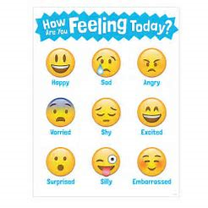
3. Mentalizing the Moment
Helper asks worker “How are you feeling? What it’s like for you to be in this situation?”
They can also make guesses “If I were you, I could imagine feeling….. Or thinking….?”
THEN, worker and helper consider how relevant others might be feeling/thinking?
Notes:
Mentalize the worker first – the client isn’t there!
Supporting the worker to restore their own capacity to mentalize (through being understood) will help them to more accurately mentalize others
Helper checks out whether worker feels ready to move on to Step 4 – Return to Purpose, where next steps can be discussed

Slide 19

4. Return to purpose
Helper asks worker to return to the original purpose of the conversation. They might ask
Tell me a bit about what you’re thinking now in relation to our task?
Where has this conversation taken you?
What are the next steps?
Do you need any additional ideas?
Notes:
Worker might share some new insights into the situation or ideas about what they could do
Shifts in perspective and thinking are as helpful as concrete actions
Helper can ask worker if they would like any additional ideas or whether they feel satisfied with what they have identified
Again, helper needs to remain attuned to whether the worker has got what they need – lots of additional ideas/perspectives from the helper (however well-intentioned) may not be required!

Slide 20
Practicing Thinking Together
Get into 3s.
Person A, Person B and Person C.
Person A shares a dilemma with B.
B takes A through the steps of Thinking Together (on next slide)
C can help out
Notes:
Trainer instructions:
Person A - Pick a genuine dilemma – a live one that is causing you some emotional reaction. Not one that you already know the answer to!
Person B – be firm in following the steps. Do not start until you are clear on the Marked Task. Your job is not to problem solve or make suggestions (even if they are disguised as questions e.g. “have you thought about doing x?”). You can ask for help from C if you are getting stuck.
Person C – interrupt and help out! Stop Person B if you don’t know which step they are on or if you notice any problem-solving creeping in!

Slide 21
Thinking Together: a framework for case discussion
Steps | Description
Mark the task | What does the worker need from the conversation? Kick-starting the worker’s “mentalizing” (i.e. capacity to be aware of their own state of mind) Increases likelihood of worker experiencing the conversation as helpful
State the case NO PROBLEM-SOLVING! | Just the “bare bones” The information relevant to the task
Mentalize the Moment NO PROBLEM-SOLVING! | Ask A – how are you thinking/feeling about this? B can make some guesses about how might the worker be feeling / what might they be thinking about this? (If I was in your position, I might feel/think…) Then, mz relevant others (i.e. child, parent, prof)
Return to Purpose | What does the worker think now in terms of ideas relevant to the marked task? Any ideas? THEN, person B can offer additional ideas
Notes:
Practice in threes.
This is a framework from AMBIT which encourages a 4 step process for case discussion; although a prescribed process, it contains useful principles that can generally be applied to case discussion.
i.e. its useful for the discussion to have a clear purpose, so that everyone knows what the goal of the conversation is
It’s useful to share information in a purposeful and relevant way – and recognise when “enough” information has been shared
Focus on the state of mind of the person bringing the dilemma – its their dilemma you are attempting to assist with. Don’t get distracted by offering your own musings/perspectives/ideas/stories of how you’ve had something similar without checking in about whether this is helpful.
If workers’ are feelings stressed/overwhelmed with emotion, they are unlikely to be able to think clearly; with some validation/exploration of this, they usually regain their own capacity to think about solutions.
Don’t offer solutions without first understanding the problem – save this until the latter part of the conversation! Ask the person what they’ve already thought of before offering suggestions. Remain interested/pay attention to whether what you are offering is being received as helpful!

Slide 22
Structure and Boundaries
Guidelines / contract of shared responsibilities and commitment to each other
Practical arrangements
Type of reflection session – case, issue, TSP, acting on barriers
Preparation
Team members put forward in advance / or on a rota basis, a case or issue that they'd like to discuss at reflection. Managers can also keep this in mind through information of cases from 1-1 meetings etc.
Notes:
Guidelines:
Develop these with your team.
Already begun on Induction days 1 & 2 – refer back and build on these. Have them up on the wall / flip chart for a reminder to everyone.
These will help manage team dynamics
Awareness of group development processes – in&out, up&down, near&far
Ideas for guidelines:
e.g. – mobile phones off / silent
any apologies for needing to leave before the end
not interrupting when someone is talking
being aware of how much you have spoken / given space for others to speak
recognising that we all have different interpretations of circumstances, so even if we’ve been through the same experience, it might mean different things to each of us, and therefore we might feel differently about the same thing. We need to accept that there will be differences of opinion, and that this is okay, and we can be the richer for hearing each other’s perspectives.
How to indicate if you would like to add something
Practical Arrangements:
Set day & time for everyone to keep in their calendars
Book a room – ideally the same space is helpful
Type of session:
Routine?
What about team meetings where you might need to impart information / discuss ‘business’?
Preparation:
Work out in advance who is going to present a case / bring an issue.
Have a rota for who will have different roles within the team

Slide 23
Reflections!
One thing that stood out to you from today?
What particular idea was most interesting to you?
How will these ideas play a part in your work?
Notes:
15mins
How to evidence the usefulness of the time spent thinking?
Have we learnt something?
Have we progressed a case – are you leaving with some ideas to try out? Has your thinking altered in relation to the case?
Is there somewhere we can save our shared learning / notes from discussions for us to refer back to again?

